Slide 1
The Arena of Liquid Biopsy
From CEA to Complexomics, and How to Get There
Mark A. Watson, MD, PhD
Assoc. Professor, Pathology and Immunology
Div. Of Laboratory and Genomic Medicine
Washington University School of Medicine
** No conflicts of interest to disclose

Slide 2
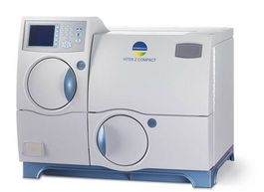
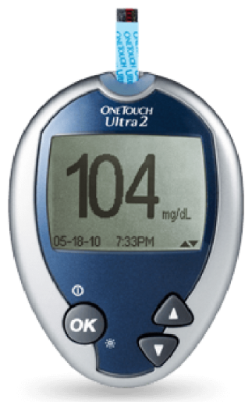
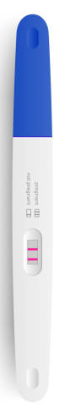
Liquid Biopsy in the Continuum of Cancer Care
Early detection decreases cancer mortality
Targeted (expensive) therapies require repeated companion diagnostic assays- often from inaccessible solid tumor sites
Effective primary treatment renders many malignancies a disease requiring on-going surveillance- for clinically occult progression
Screening and Early Detection
Precision Diagnosis
Therapeutic Response
Monitoring Remission
Relapse Precision Diagnosis

Slide 3
Evolving Complexity in Liquid Biopsy Assays
Single Biomarker Assays
Homotypic Biomarker Panels
Multicomponent Testing Strategies
CEA
CA14.3
PSA
4Kscore
ctDNA panels
ctDNA + Protein (CancerSEEK)
ctDNA + CTC
CTC + Exosomes
Expansive understanding of cancer biology
New technologies for detecting rare analytes
Novel bioinformatic (AI) approaches to synergize disparate data types
Challenges to create integrative testing platforms

Slide 4
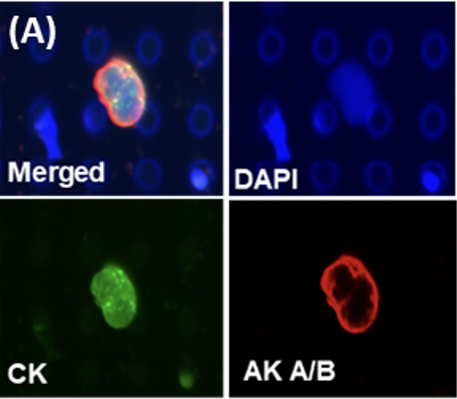
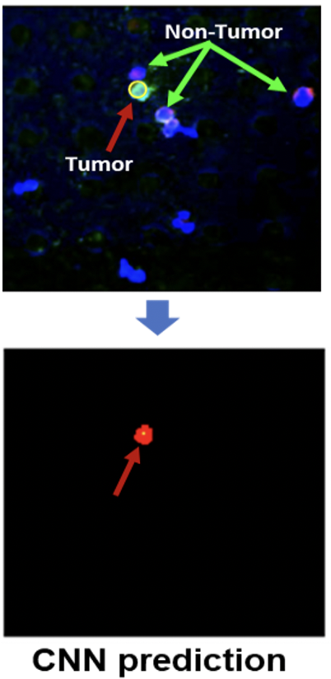
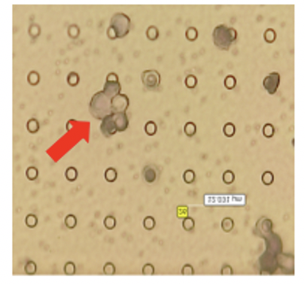
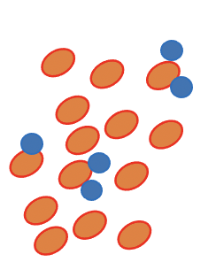
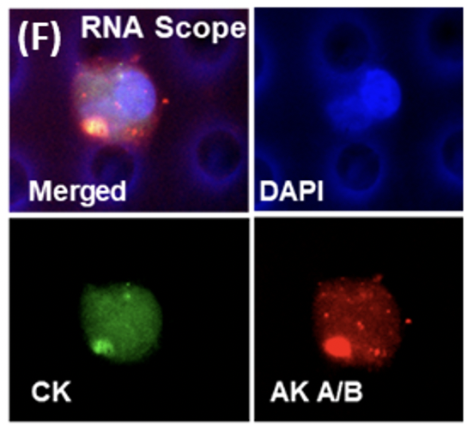
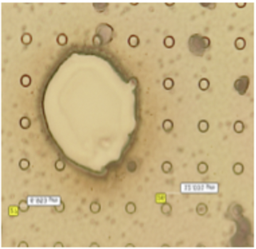
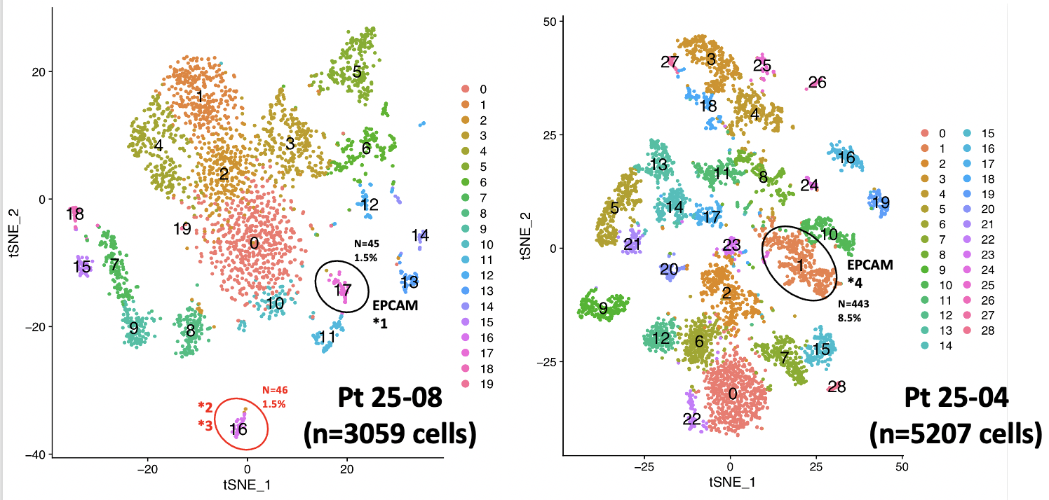
CTCs: Populations of complex packets of diagnostic information that mediate malignant progression
R. Core / S. Rawal / C. Yang
Cytomorphology
+
Targeted Biomarkers
+
Molecular Profiles
Capture / Enrichment
IHC / ISH Multi-marker assessment
AI-guided image analyses
Dissection or Release
Single cell expression population profiling
(Pre-Rx, DTC-enriched)

Slide 5
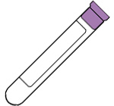
EVs: Discrete, complex packets of diagnostic information that mediate tumor behavior
CD63
CD81
ErbB2
EGFRvIII
EpCAM
CD86
Surface Antigens
EVs
21
200a,b,c
141
101
1246
4306
4644
miRNAs
KRAS
BRAF
EGFR
p16
DNA Mutation
Methylation
EV fractionation
Antigen based capture / detection
Lysis
miRNA probes
Methylation loci probes
Whole Blood / Plasma
Detection = f (Sa, Sb₁₋₃, Sc₁₋₃, Sd)
mutation probes
Fractionation, Detection, Quantification in a Homogeneous Assay

Slide 6
Components of Neoplastic Progression as Liquid Biopsy Targets
“SEEDS”
“FERTLIZER”
“SOIL”
CTCs / cCAFs
EVs
Metastatic Niche
Occult Reservoirs
cfNA
Proteins
Soluble Biomarkers
A multi-component analysis may improve diagnostic utility

Slide 7
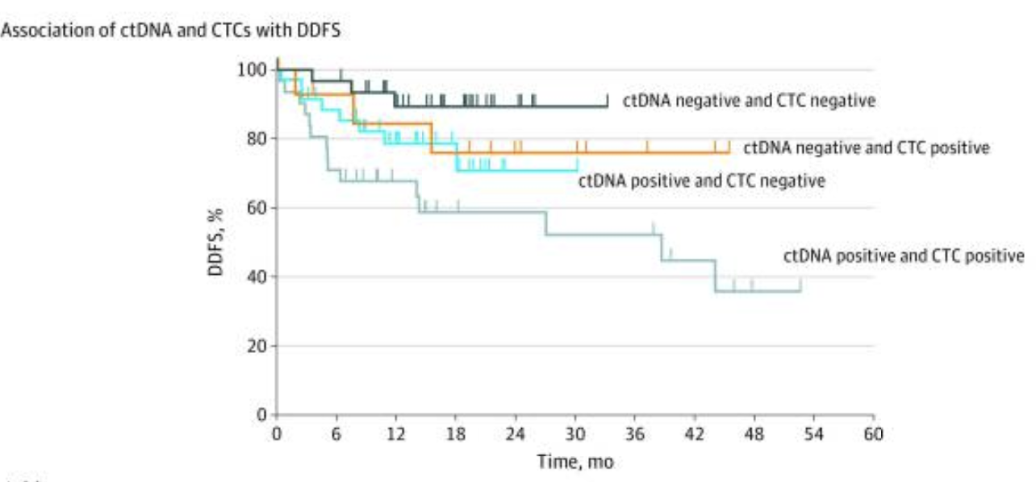
Multi-component Analyses
Comparison and Synergy Between CTC and cfDNA analyses
TNBC in neoadjuvant setting
142 ctDNA ; 123 CTC analyses
FoundationOne ctDNA assay
EpCAM based CTC capture / enumeration
Radovich, et al. JAMA Oncology, 2020. PMCID: PMC7349081
Fewer Comparative Exosome <> CTC studies
Unique opportunities for cross-platform comparisons using reference sets

Slide 8
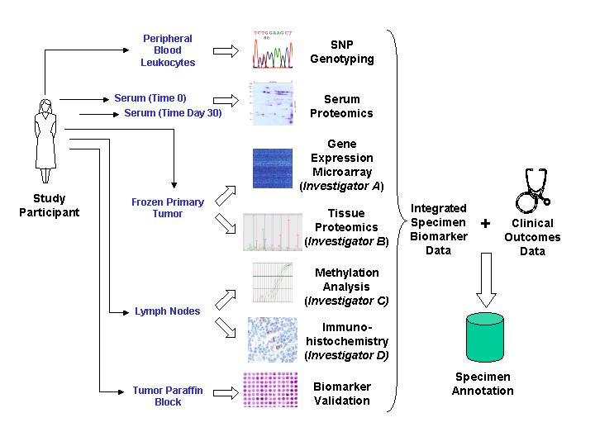

The Evolution of Biospecimen- Based Biomarker Research
FFPE Tumor Block
Pathology Review
Simpler trial design
Tissue and blood
Limited biomarkers
Limited technologies
1971
Peripheral Blood Cells
Buffy Coat
DNA; Genotyping
Complex trial designs
Multiple assay timepoints
Multiple analytes
Multiple biomarkers
Sophisticated technology platforms
Requirement for viable specimens
Demand for control of pre-analytical variability
Biospecimen tracking and data integration over multiple laboratories and assay platforms
PBMC
Immunoprofiling
Plasma
CTC
MRD Assessment
Serum
PK / PD
Proteomics
Metabolomics
cfNA
MRD Assessment
2021
FFPE Tissue
Exosomes
Biomarkers
IHC
Spatial Profiling
Fresh Tissue
Digital Imaging / AI
Genomics
Single Cell / Expression
Methylation
Stool
PDX Models
Urine
cfNA
Metagenomics
Timepoint:
Pre-RX - CNDX - Surgery - Post-RX - Relapse
Specialized collection tubes
Shipping kits
Advanced biobanking procedures
Expanded Storage
Informatics

Slide 9
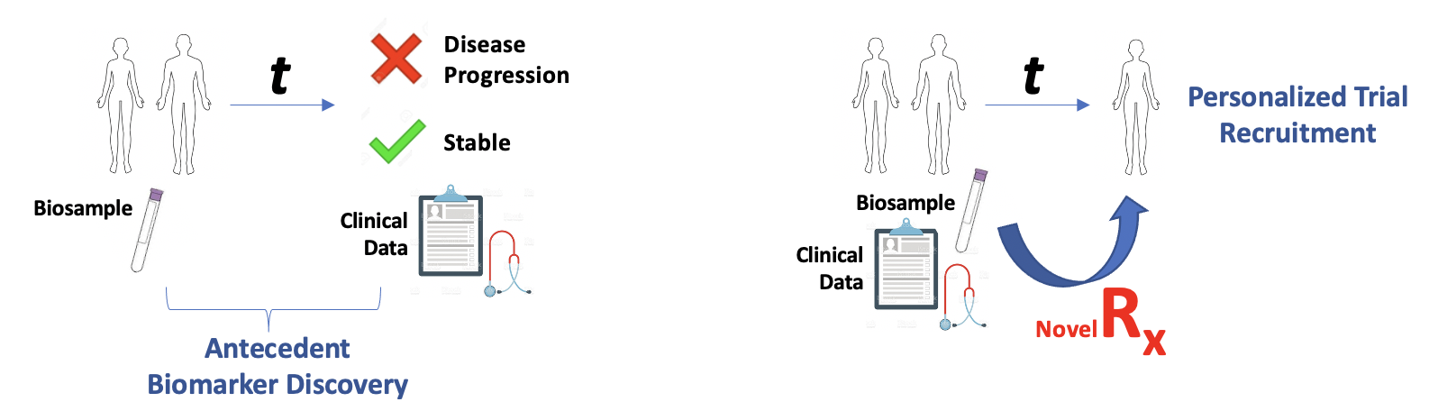
Resource Requirements to Advance the Field
Prospective collection may require years of ‘clinical maturation’
Robust- Abundant- Accessible- Annotated biospecimen resources needed for assay validation
Appropriate control populations
Racial / ethnic / gender diversity
Serial Collections
Wide variety of sample types
Standardized clinical data and follow up
Documenting pre-analytical variability
Cost, Time, Effort, Space

Slide 10
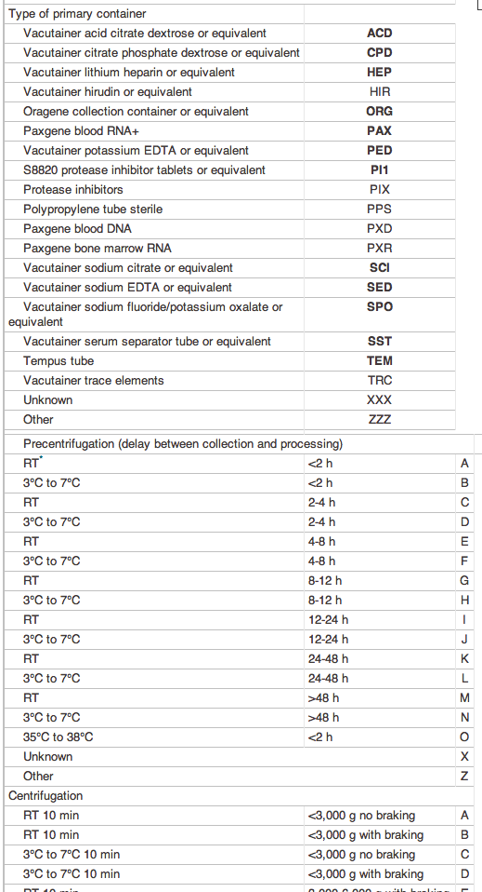
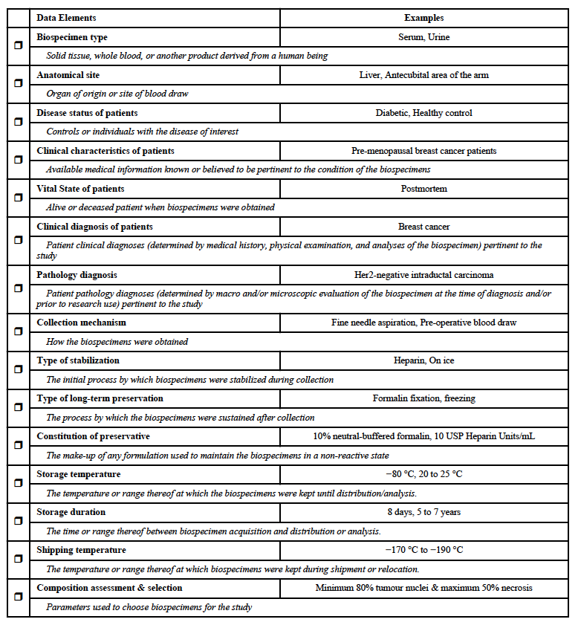
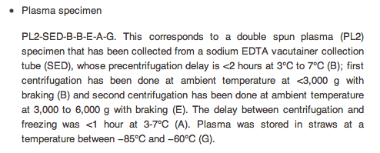
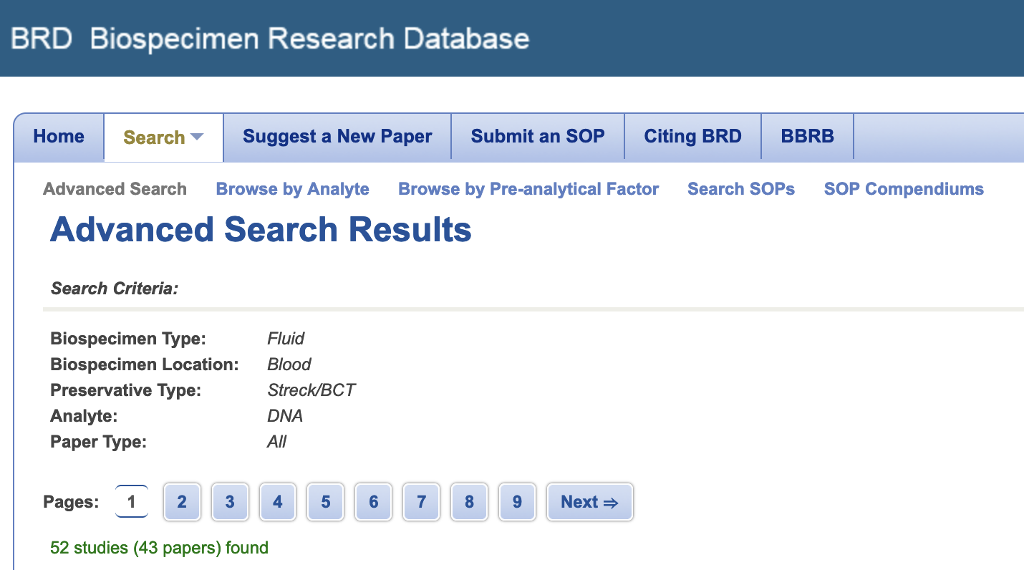
Documenting Pre-analytical Variability
SPREC- (Standard PREanalytical Coding of Biospecimens)
BRISQ- (Biospecimen Reporting for Improved Study Quality)
J Proteome Res., 2011; 10(8): 3429–3438.
Cancer Epidemiol Biomarkers Prev 2010, 19; 1004

Slide 11
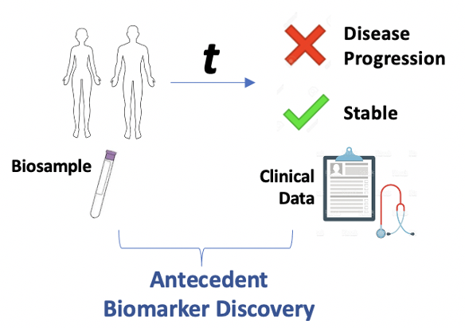
WUSTL Women’s Health Repository
PI: G. Colditz
Recruited 12,288 women from 2008-2012
Baseline collection of plasma and PBL
121,166 sample aliquots
EHR clinical data follow-up
Routine screening mammograms
Incident benign biopsy and malignant tumor tissues
Median Age 54.8 years
26.7% African American
Average 9.7 years follow-up
272 (2.2%) incident malignancies at 10 years; 116 in situ lesions

Slide 12
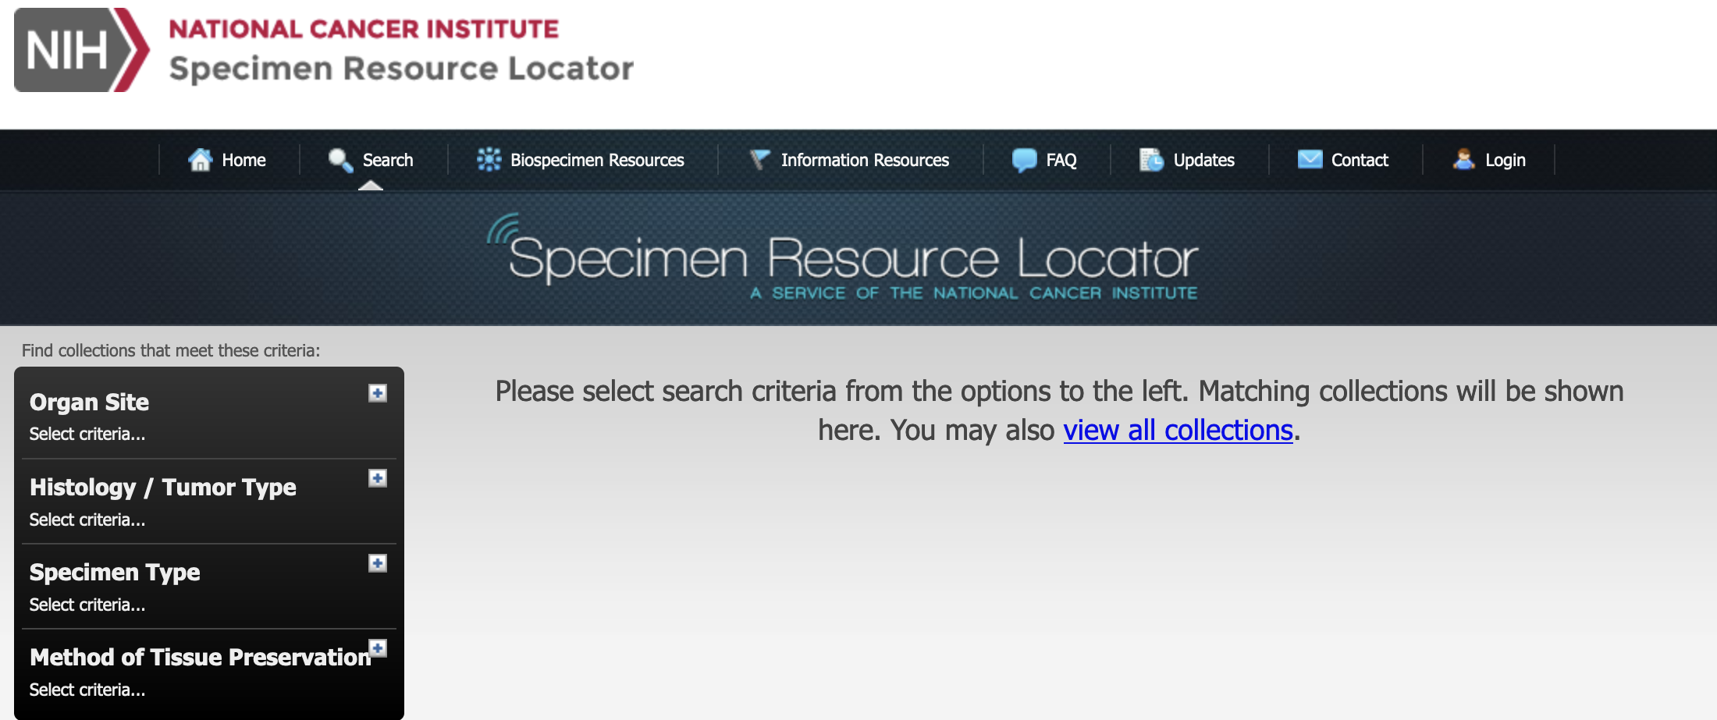
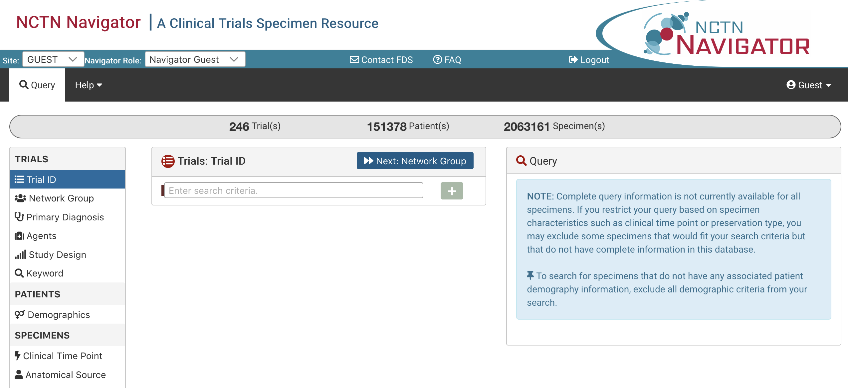
NCI Resources
EDRN Biospecimen Reference Sets
  Multiple Cancer Types
  100-900 patient cohorts
  Serum, Plasma, (Tissue)
Specimen Resource Locator
NCTN Biospecimen Resource

Slide 13

ALLIANCE A212102
ALLIANCE A212102
Blinded Reference Set for Multicancer Early Detection Blood Tests
M. Wood; M. Liu
Primary Objective- To provide a blinded reference set of cancer vs. non-cancer blood samples that will be used to validate assays for inclusion in a prospective clinical trial focused on utility of blood-based multi-cancer early detection.
Utilizes existing NCTN infrastructure to manage recruitment, and sample and data collection across numerous network sites
1,000 patients with a confirmed histological diagnosis of any 1 of 19 tumor types
1,000 healthy controls with no history of malignancy
6 x 10 ml of blood in Streck BCT tubes
Collection at baseline and (optional) 12 months
A model for future resource creation

Slide 14
SUMMARY
Liquid biopsy is a critical tool for the long-term management of many cancer patients, akin to those used in other chronic health conditions.
New technologies are creating increasingly sophisticated biomarker assay platforms; opportunities and challenges for controlled comparisons and integrations across multi-modal assays exist.
Equally important to the biomarkers and the technologies that support their implementation, is robust access to biospecimens and data for statistically defensible validation studies.
Academic, investigative consortiums are critical to realize opportunities for assay integration and creation of need validation resources.

