Slide 1

Liquid Biopsies:
The New Frontier for Personalized Medicine Initiatives
Razelle Kurzrock, MD
Chief Medical Officer,
Worldwide Innovative Network (WIN)
Consortium for precision medicine
Twitter @Dr_R_Kurzrock

Slide 2
Disclosures
2019 to present
Research funding from Boehringer Ingelheim, Debiopharm, Foundation Medicine, Genentech, Grifols, Guardant, Incyte, Konica Minolta, Medimmune, Merck Serono, Omniseq, Pfizer, Sequenom, Takeda, and TopAlliance;
Consultant and/or speaker fees and/or advisory board for Actuate Therapeutics, AstraZeneca, Bicara Therapeutics, Inc., Biological Dynamics, EOM Pharmaceuticals, Merck, NeoGenomics, Neomed, Pfizer, Prosperdtx, Regeneron, Roche, TD2/Volastra, Turning Point Therapeutics, X-Biotech
Equity interest in CureMatch Inc. and IDbyDNA
Serves on the Board of CureMatch and CureMetrix, and is a co-founder of CureMatch.

Slide 3
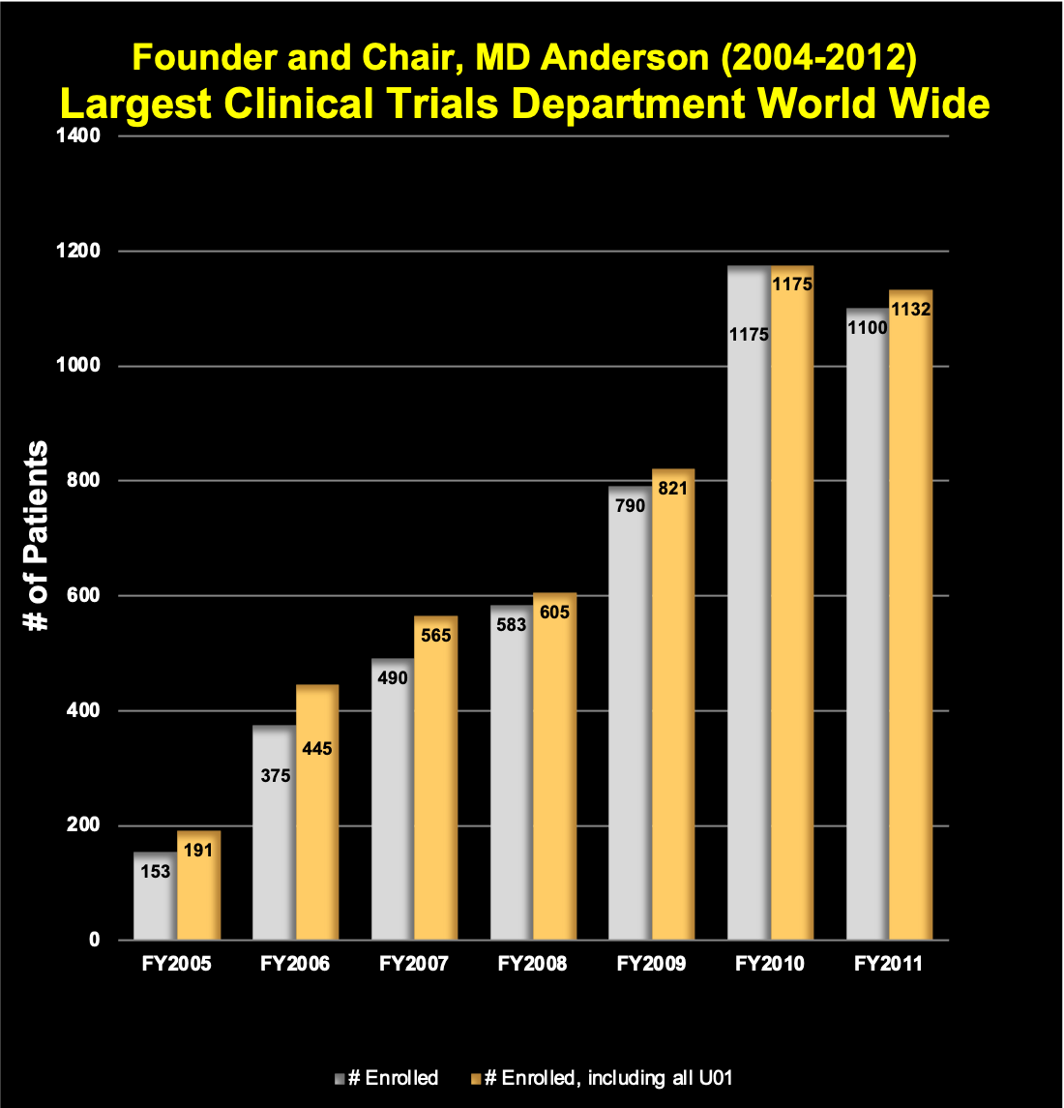
Precision Medicine in the Clinic: Experience
Center for Personalized Cancer Therapy
at UCSD Moores Cancer Center
Director: Razelle Kurzrock, MD
Developmental Therapeutics
Phase I Trials/ Genomics/Immunotherapy
Discovery to Bedside Enabling Program
Adolescent and
Young Adult Clinic
San Diego
Biotech,
Pharma,
UCSD Super Computer Center
Molecular Tumor Board
Rare Tumor Clinic
Molecular Pathway Clinic
Hereditary Cancer
Predispositon
Genetic Counselling
Financial
Aid
Laboratory Processing
UCSD, Salk, Scripps, Sanford-Burnham
Over 850 peer-reviewed publications
Oversight >500 early phase trials, including 8 drugs that have gone to FDA approval
Clinical-grade genomic profiling >21,000 patients
Leadership positions: SWOG, WIN, NCCN,

Slide 4
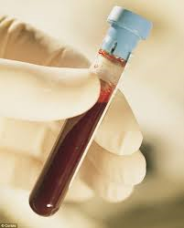

Doing genomics on DNA from a small tube of blood or from urine
No tissue biopsy
Liquid Biopsy Program
~6000 patient samples
Schwaederle…..Kurzrock. Use of Liquid Biopsies in Clinical Oncology:
Pilot Experience in 168 Patients. CCR, 2016

Slide 5
Circulating Tumor DNA (ctDNA) and Circulating Tumor Cells (CTCs)
Applications
Predict car T cell response
Differentiate unique immune checkpoint blockade response patterns
Predict immune checkpoint blockade response (blood mutational burden)
Assess shed DNA from multiple metastatic sites; heterogeneity
Assess potentially actionable alterations
Serial levels for response and early detection of resistance
Prognostic tool
Assess difficult-to-biopsy patients
Early detection of cancer
Jacob J Adashek , Filip Janku , Razelle Kurzrock
Signed in Blood: Circulating Tumor DNA in
Cancer Diagnosis, Treatment and Screening.
Cancers 2021

Slide 6

Low Coverage, Genome-Wide Sequencing of Cell-free DNA Enables the Monitoring of Response to Immunotherapy in Cancer Patients
NIPT (Non-Invasive Prenatal Testing)
Liquid Biopsies & Minimally-Invasive Diagnostics
Jensen TJ…..Kurzrock R.
Genome-Wide Sequencing of Cell-Free DNA Identifies Copy-Number Alterations That Can Be Used for Monitoring Response to Immunotherapy in Cancer Patients
Mol Cancer Therapeutics. 2019

Slide 7


Incidental Detection of Maternal Neoplasms
Sequenom Laboratories
450,000 samples
Data from Sequenom Laboratories
18 malignant
> 55% of malignant cases previously unknown
Altered genomes
Genomic alterations prevent accurate NIPT reading
40 cases
“Non-reportable” samples, patients and physicians decide follow-up
Dharajiya, et al. Clinical Chemistry, 2017. In press.

Slide 8
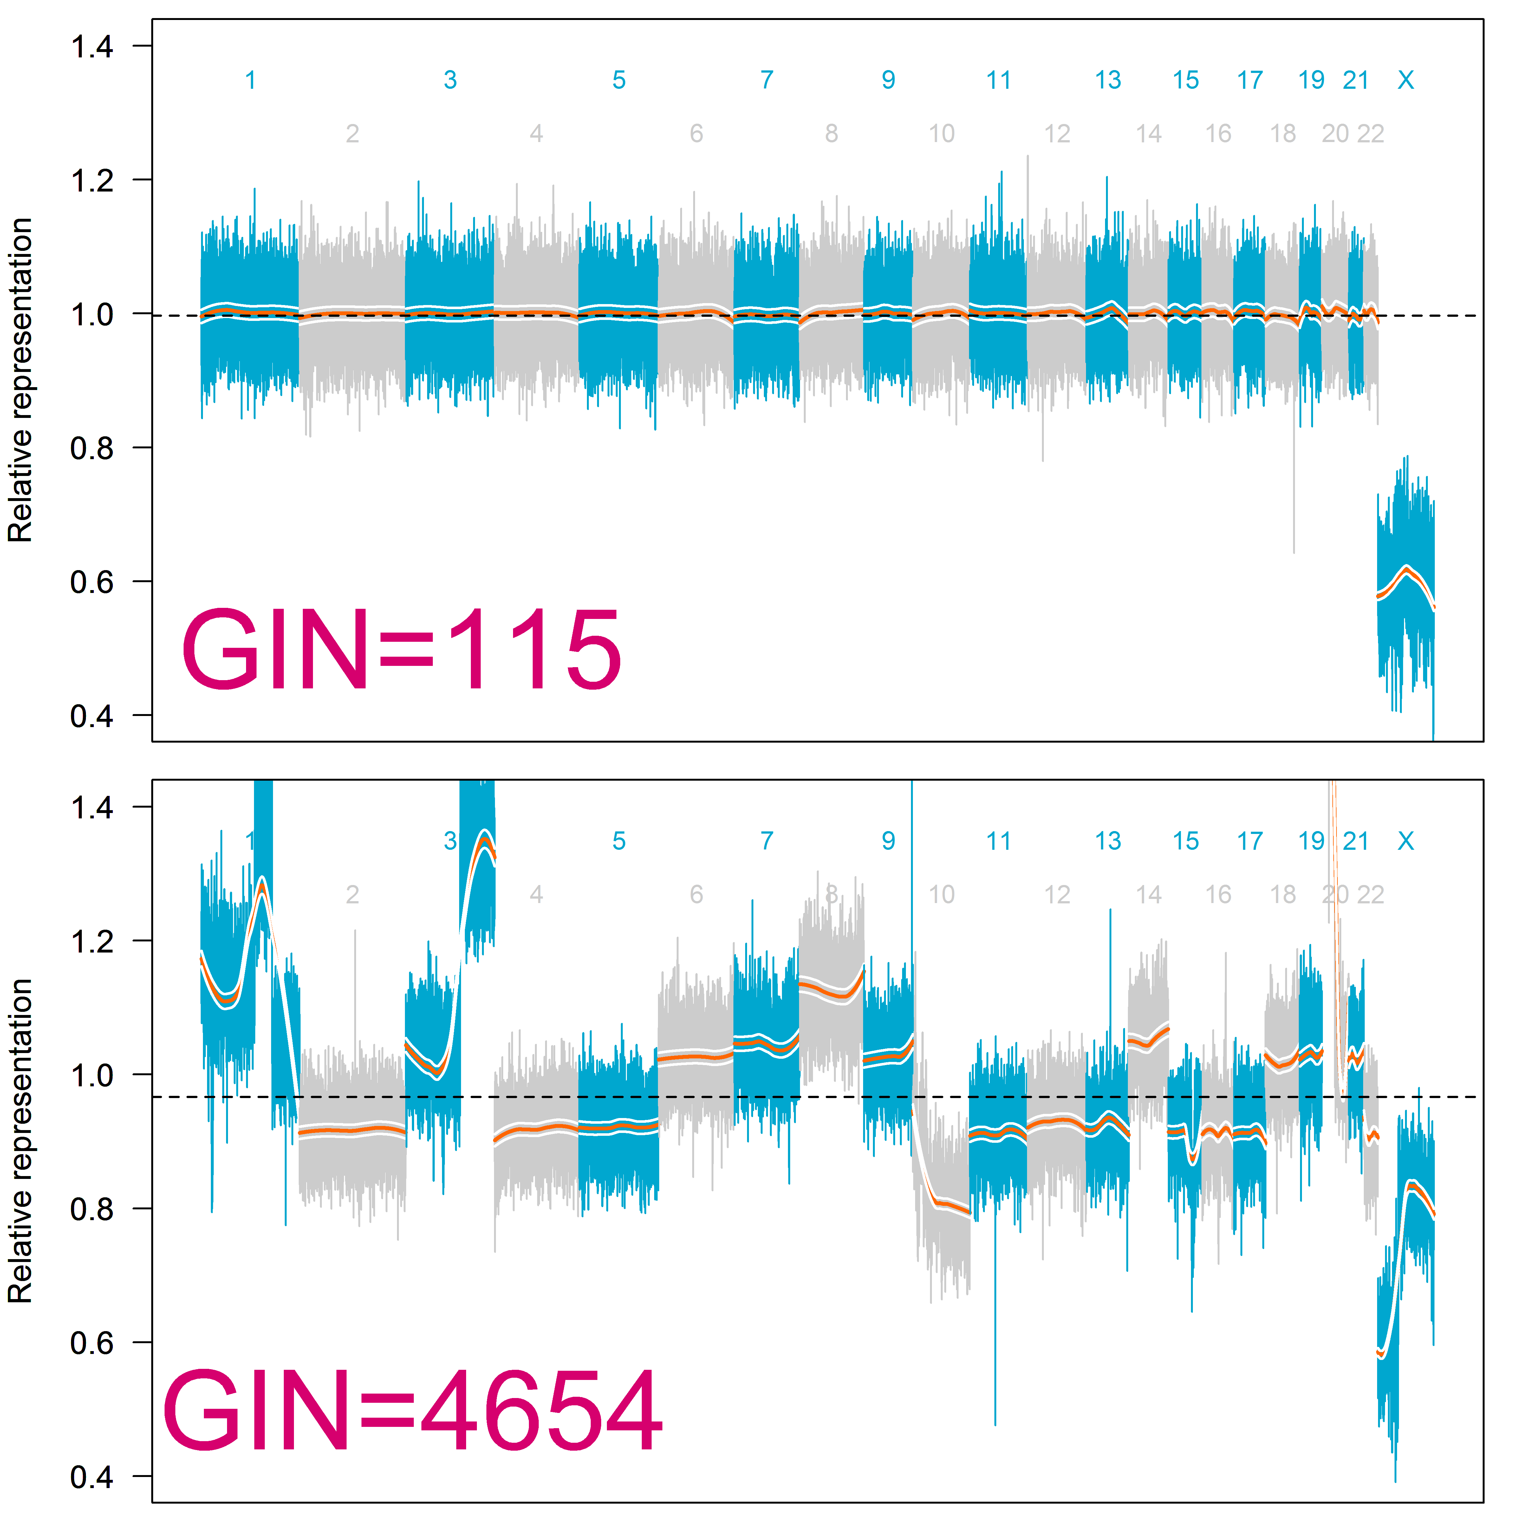
Genome Instability Number (GIN)
Quantification of total copy number alterations
In addition to counting CNAs, we wanted a metric to quantify the level of genomic instability
  Genomic Instability Number (GIN)
  Represents the cumulative deviations of all CNAs across the genome
  Influenced by both the magnitude of the CNA and the level of ctDNA in the plasma
Higher GIN = more significant copy number alterations

Slide 9
Response to CAR-T therapy can be monitored using genome-wide sequencing of cell-free DNA in patients with DLBCL
Aaron M. Goodman¹, Kimberly A. Holden², Ah-Reum Jeong³, Lisa Kim², Kerry D. Fitzgerald², Eyad Almasri², Graham McLennan², Marcia Eisenberg⁴, Amin H. Jahromi⁵, Carl Hoh⁵, Michael Hurley¹, Carolyn Mulroney¹, Dimitrios Tzachanis¹, Edward D. Ball¹, Taylor J. Jensen^{2,6}, Razelle Kurzrock⁷
Transplantation and Cellular Therapy
Oct 13 2021

Slide 10

Method
Sequential patients who received CAR-T therapy for relapsed/refractory B-cell lymphoma were enrolled.
Responses were determined by PET/CT using Lugano criteria
Conditioning chemotherapy (days -5 to -3)
CAR-T infusion
PET/CT (between 4-6 weeks)
-5 0 1 3 5 7 14 21 28 50
Blood draws
cfDNA was isolated from plasma aliquots and subjected to low-coverage, genome-wide sequencing.
Data were analyzed using normalization procedures developed for NIPT and algorithms developed specifically for patients with cancer. Using these algorithms, genome instability number (GIN) value was determined.
The GIN threshold (GIN = 170) has been utilized previously to identify patients with an aberrant CNA profile consistent with the presence of a tumor¹.

Slide 11
Results – Baseline Characteristics
12 patients were enrolled.
8 patients were male. Median age was 52 years (range: 38-77).
5 patients had DLBCL, 4 patients had high grade B-cell lymphoma NOS.
Median number of prior therapies was 2.
11 patients received Axicabtagene ciloleucel and 1 patient received Tisagenlecleucel.
Elevated GIN was detected in 10 of 12 patients at baseline and in all 12 patients during follow-up.

Slide 12
Results – GIN Value Trend By Best Response
A. GIN trend for patients who had CR by PET/CT
B. GIN trend for patients who did not have CR by PET/CT
Best response:
Best response:
Notes:
In all four patients with an ongoing complete response, the GIN value at the time point closest to the date of data censoring was below the threshold, suggesting the GIN was consistent with clinical response.
Of the five patients that ultimately progressed after an initial PR or CR, four had evidence of progression based on the GIN. In one patient that had a mixed response but ultimately progressed, the progression could be observed using the GIN 66 days before clinical relapse was noted.
Finally, two patients had no evidence of a clinical response; however, one of these patients had no detectable ctDNA after treatment and represented a second discordant result in this cohort.

Slide 13
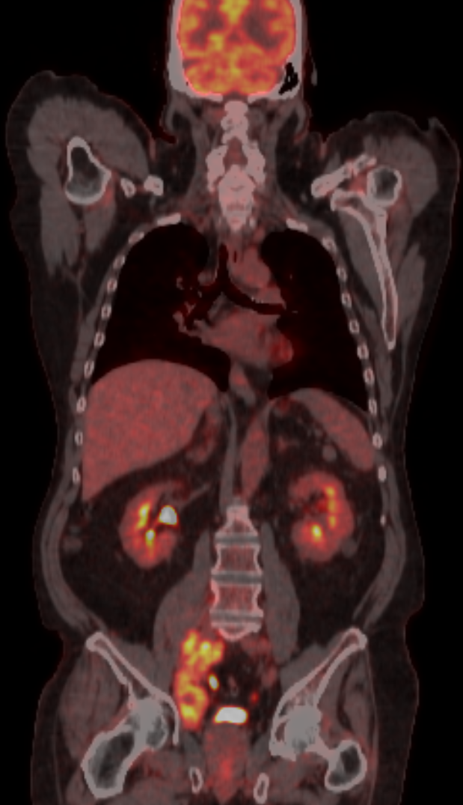
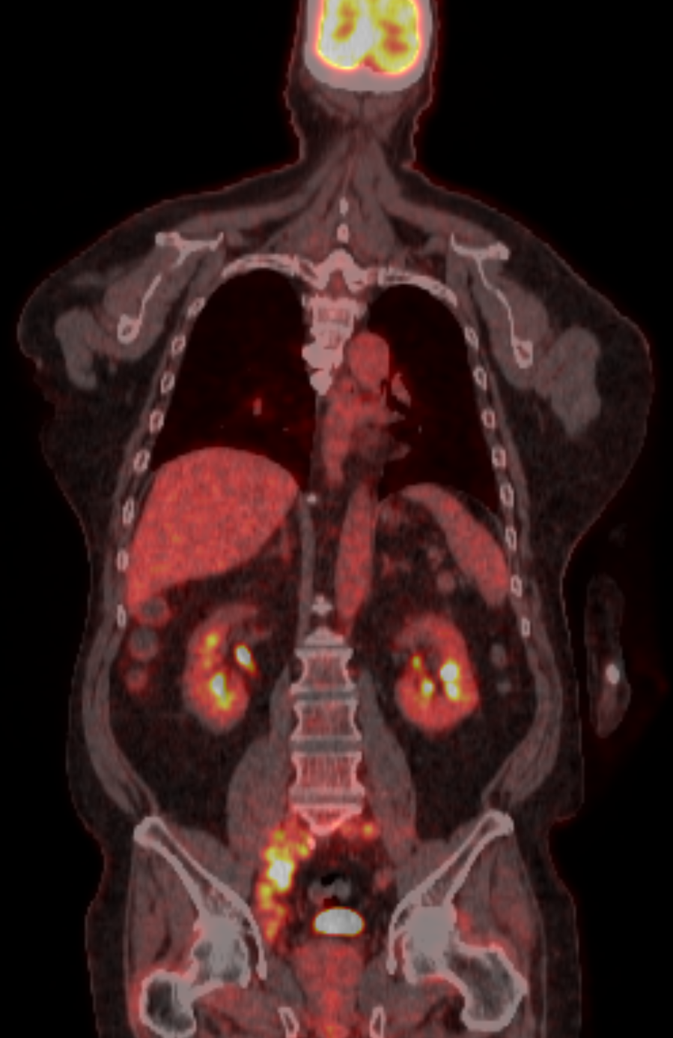
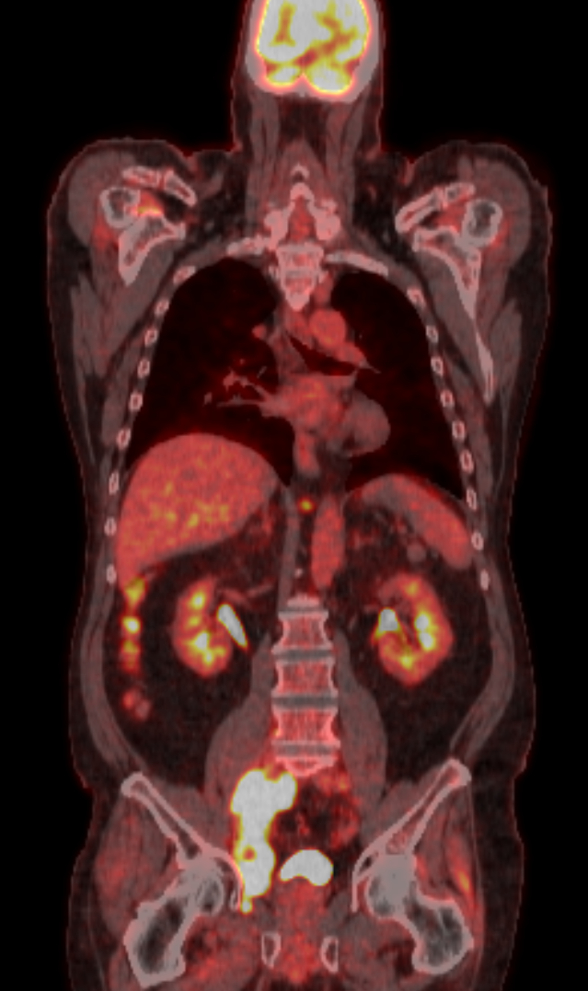
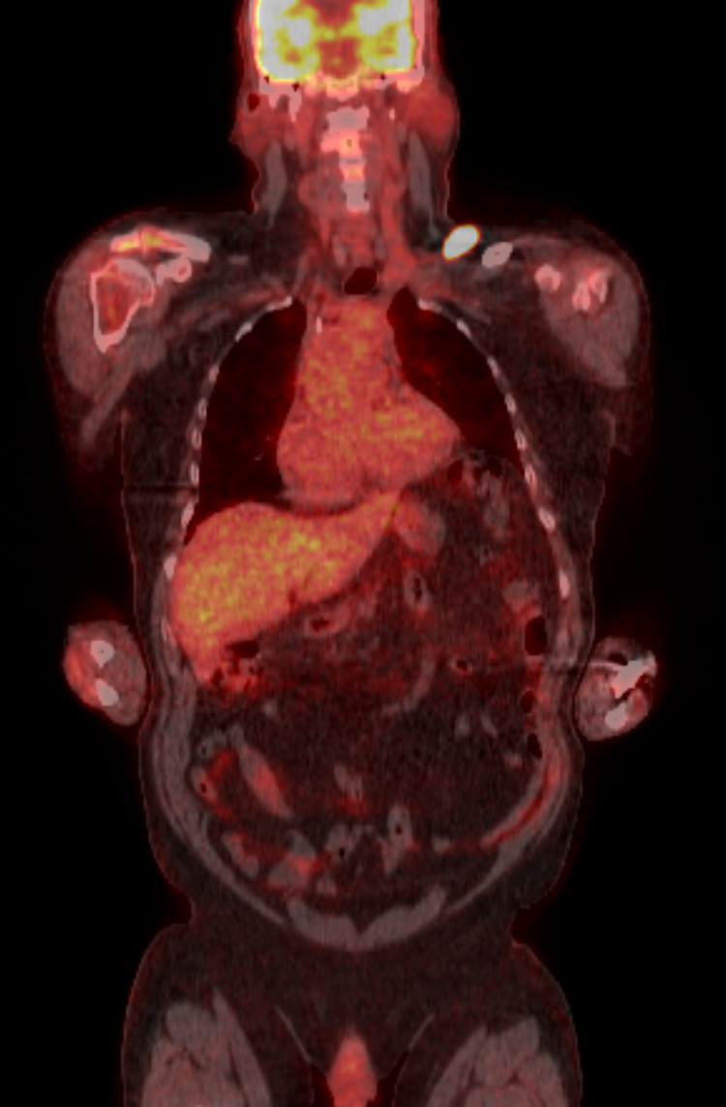
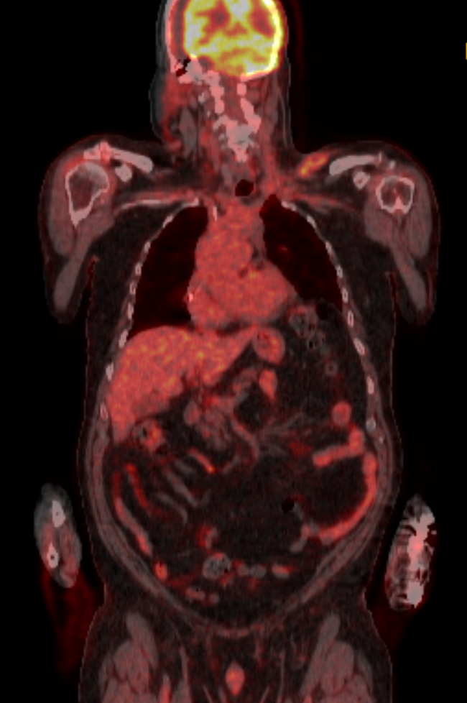
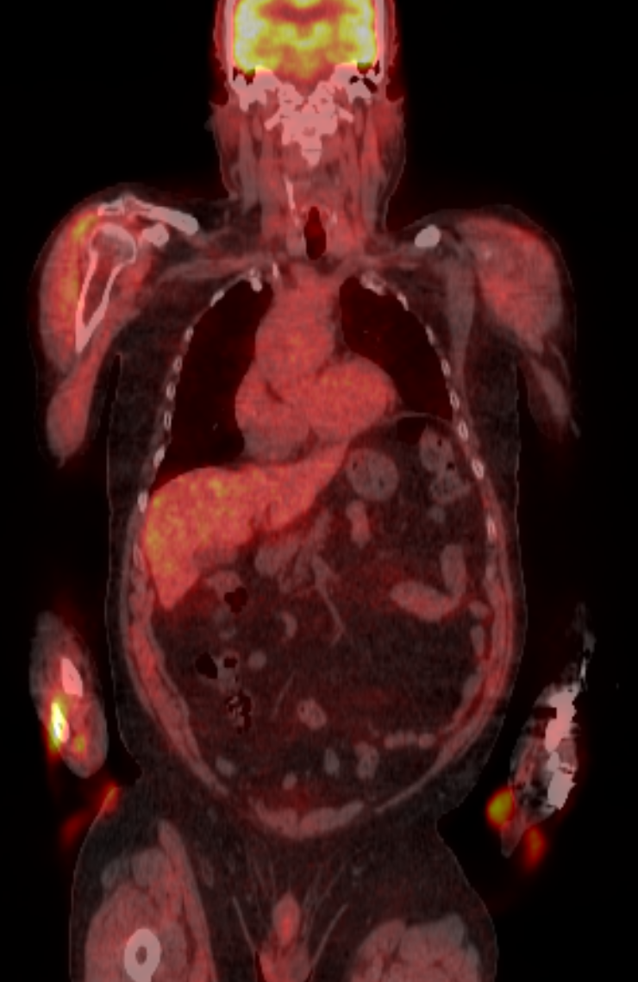
Results – Response by PET/CT and Corresponding GIN Value
Patient 4: Stable disease → progression
Patient 6: Complete response
Baseline
D42
D98
Baseline
D24
D88

Slide 14
Conclusion
These data describe a proof-of-concept for the use of serial liquid biopsy technologies to monitor therapeutic response in aggressive B- cell lymphoma receiving CAR-T therapy.
Quantification of cfDNA using GIN has the ability to predict responsive and progressive disease in patients with aggressive B-cell lymphomas treated with CAR-T therapy.

Slide 15
Liquid biopsy to differentiate unique immunotherapy response patterns

Slide 16
Immunotherapy response patterns may be distinct from those of gene targeted treatments.
Response patterns
Super-response
Response
Pseudo-progression
Progression
Hyperprogression
Using genomics to find the best immunotherapy match and to predict response/resistance pattern

Slide 17
Potential Responses to Immunotherapy Treatment
Progressive disease
Disease burden
Clinical response
Time

Slide 18
Potential Responses to Immunotherapy Treatment
Hyperprogressive disease
Progressive disease
Disease burden
Clinical response
Time

Slide 19
Potential Responses to Immunotherapy Treatment
Hyperprogressive disease
Progressive disease
Disease burden
?
Clinical response
Time

Slide 20
Potential Responses to Immunotherapy Treatment
Hyperprogressive disease
Progressive disease
Disease burden
Pseudoprogression
Clinical response
Time

Slide 21
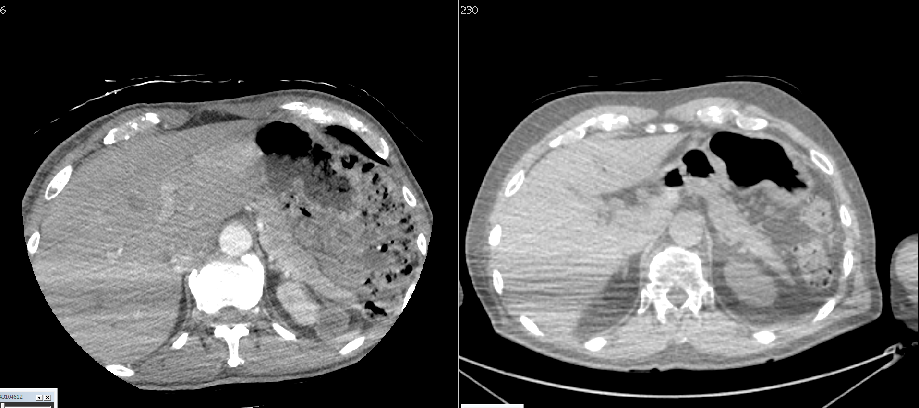
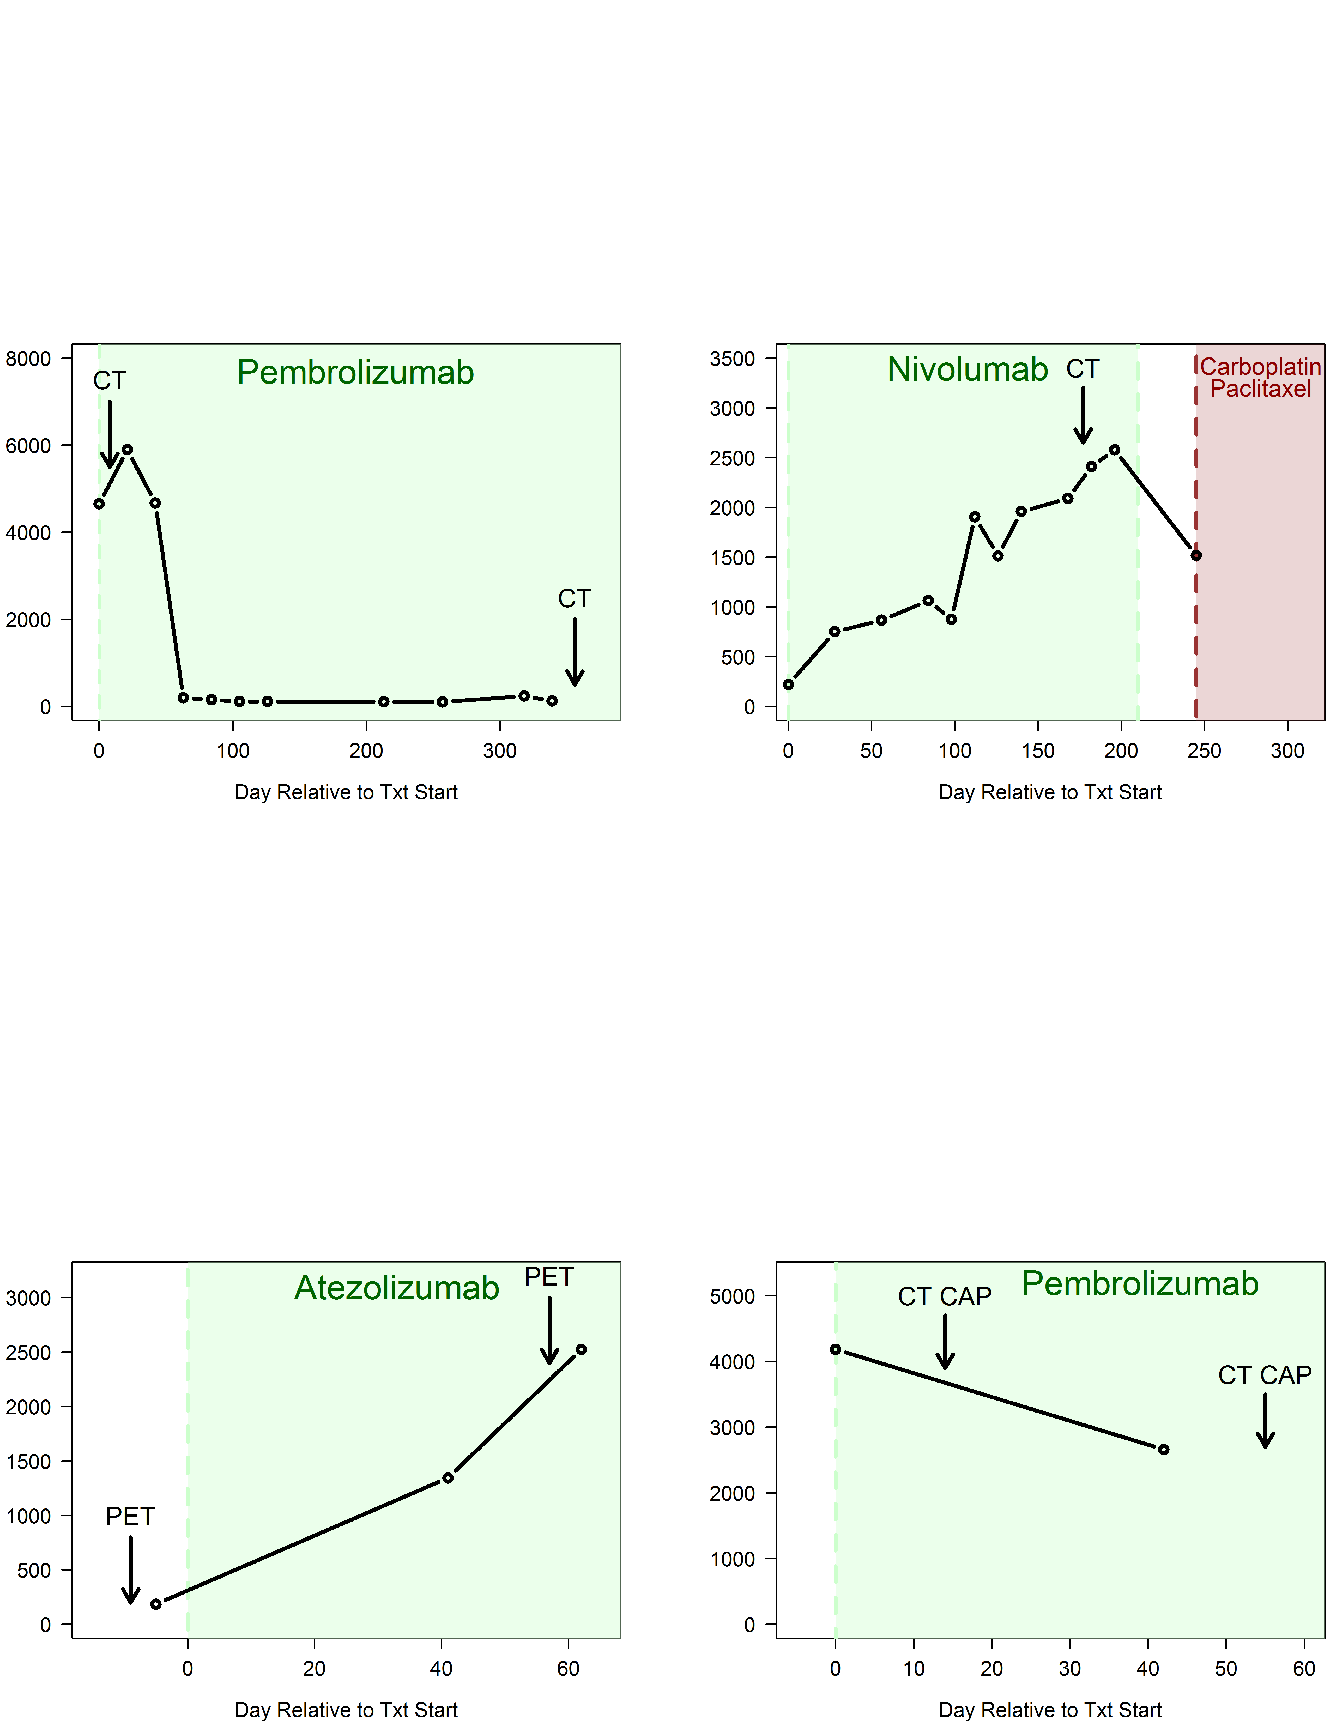
Patient example
Complete remission
Cancer type: Cutaneous squamous cell carcinoma
Treatment: Pembrolizumab
GIN prediction: response
Clinical response: complete remission ongoing 11+ months
  GIN remains below threshold at most recent time point

Slide 22
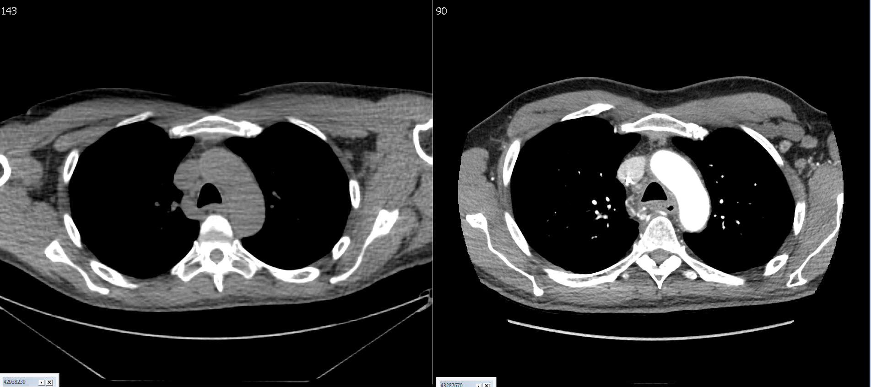
Patient example
Progressive disease
Cancer type: Head and neck squamous cell carcinoma
Treatment: Pembrolizumab
GIN prediction: progressive disease
Clinical response: progressive disease
  Note: GIN value decreased after treatment change

Slide 23
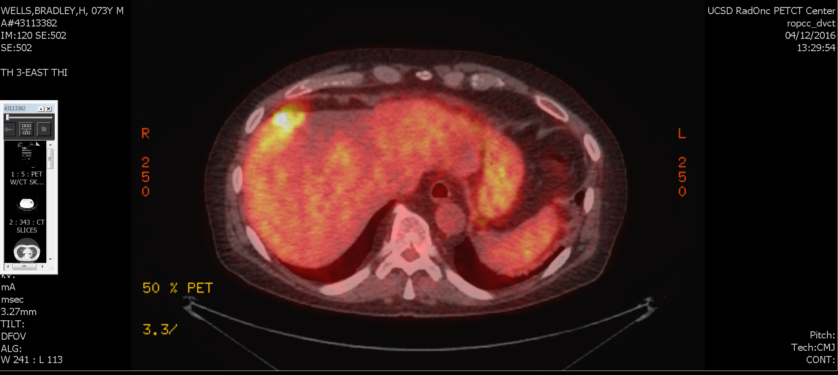
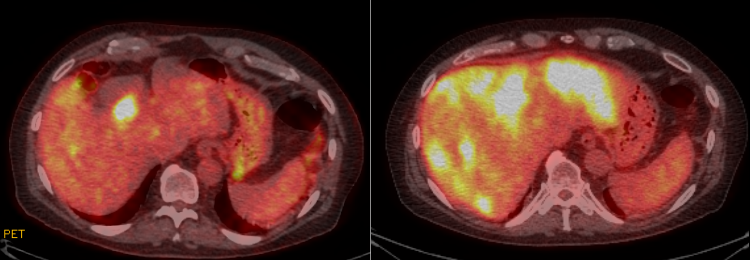
Patient example
Hyperprogressive disease
Cancer type: Bladder urothelial carcinoma and high TMB
Treatment: Atezolizumab + radiation
GIN prediction: rapid progression
Clinical response hyperprogressive disease
Kato…. Kurzrock. Hyperprogressors after
Immunotherapy: Analysis of Genomic Alterations
Associated with Accelerated Growth Rate CCR, 2017

Slide 24
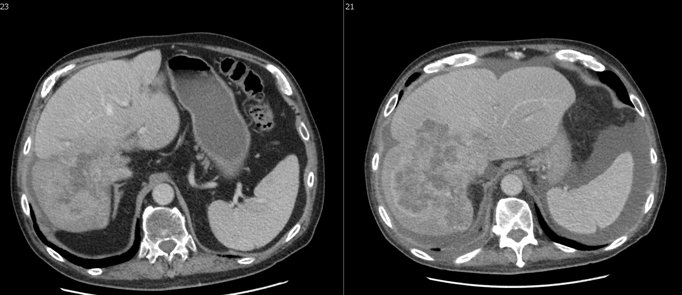
Patient example
Partial remission following pseudoprogression
Cancer type: GE junction adenocarcinoma
Treatment: Pembrolizumab + Radiation
GIN prediction: clinical response
Clinical response: Patient ultimately exhibited a partial remission after pseudo-progression

Slide 25
Overall summary of results
Detected CNAs in 24/44 (55%) of baseline samples
  18 samples had elevated GIN and longitudinal samples to enable response monitoring
Predicted response based on GIN at day +42 or nearest time point thereafter
Prediction from GIN was concordant with clinical outcome in 17/18 evaluable cases
Patient | Clinical | GIN
1 | Response | Response
30 | Progression | Progression
40 | Response | Response
40B | Progression | Progression
51 | Response | Response
55 | Response | Response
65 | Progression | Progression
67 | Progression | Progression
69 | Progression | Progression
70 | Progression | Progression
79 | Progression | Progression
82 | Progression | Progression
83 | Progression | Progression
100 | Progression | Progression
110 | Progression | Response
111 | Progression | Progression
114 | Response | Response
125 | Response | Response

Slide 26
Super-Responders
and Optimized Immunotherapy
The role of hypermutated ctDNA

Slide 27

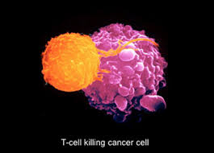



The Pillars of Precision/Personalized Medicine
Genomics
Immunotherapy
T-cell killing cancer cell

Slide 28
Bridging
Genomics and Immunotherapy
Mutanome-Directed Immunotherapy
  The more mutated the tumor,
  the better the response to immunotherapy
  4% response rate for low mutational burden
  26% response rate for intermediate
  45% response rate for high
  67% response rate for very high mutational burden
  Goodman……Kurzrock. Tumor Mutational Burden as an
  Independent Predictor of Response to Immunotherapy
  in Diverse Cancers. MCT, 2017

Slide 29
High-grade neuroendocrine cervical cancer
49-year-old woman from Saudi Arabia
Past treatments at OSH in Saudi Arabia:
Myomectomy around 4/2015
Cisplatin/etoposide chemo x 3 cycles with progression\
Radiation treatment x 2 sessions with progression last session 11/15/2015
First visit
Exam: Very large abdominal tumor
Impending bowel obstruction,
Partial ureteral obstruction
Urology consult→ stent not indicated, suggest hospice

Slide 30
Question
What would you most likely do next for this patient?
Send to hospice
Comprehensive genomic profiling
C. Enroll on a clinical trial
D. Taxane-based chemotherapy

Slide 31
High-grade neuroendocrine cervical cancer
Genomic Profiling
ctDNA Blood
PTEN R130Q FBXW7 R465H PIK3CA E545D PIK3CA R88Q NRAS Q61R CTNNB1 S33A VUS ARID1A P600P ARID1A P427L BRCA2 L3184V NOTCH1 G309D NOTCH1 N2389N STK11 W332* APC Q767Q CDH1 A408A FGFR2 A260A ERBB2 I435F SMO T541T BRCA1 G1077R MET P325S
Hypermutated
ctDNA

Slide 32
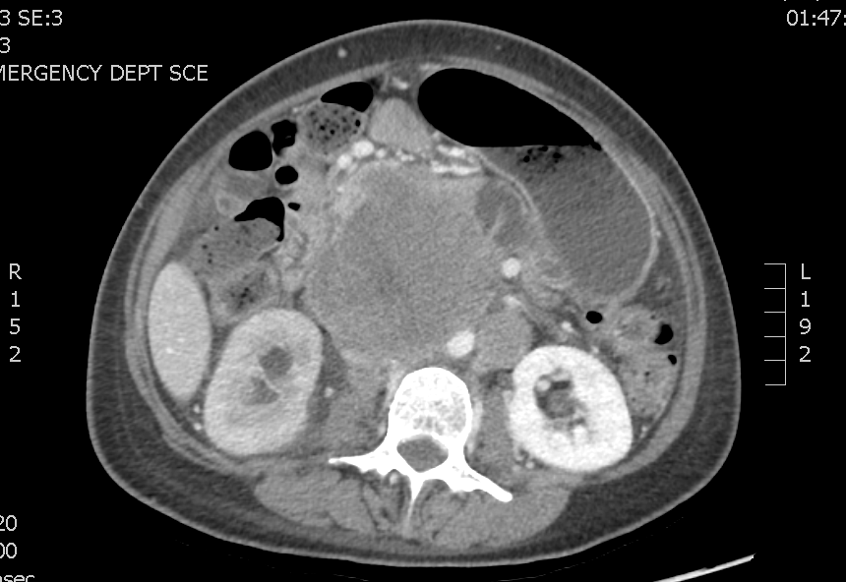
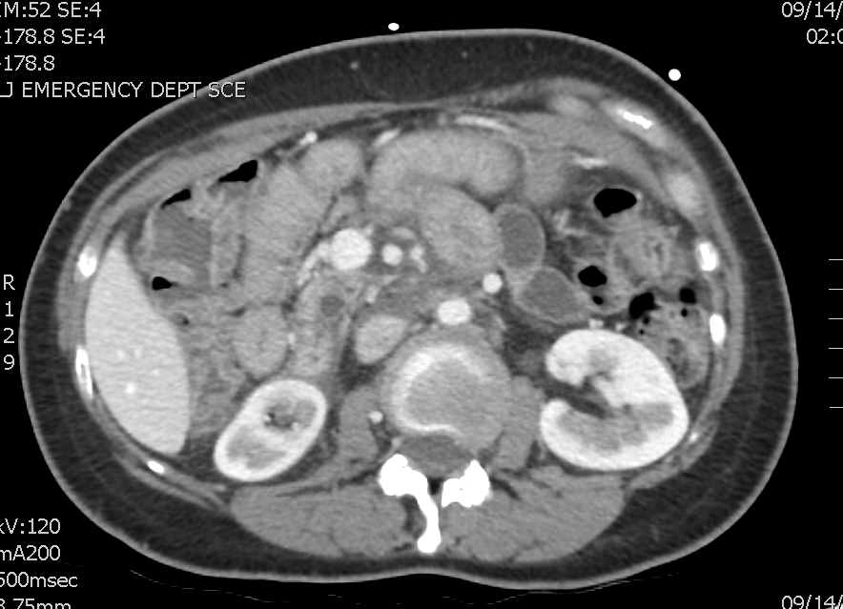
High-grade neuroendocrine tumor of the cervix
Ultra Rare
Immunotherapy: Nivolumab plus SBRT (radiation) plus somatostatin
Pre-Treatment
8 months after treatment
Sharabi…..Kurzrock. Oncologist, 2017
Response ongoing at 3.5+ years ongoing

Slide 33
High-grade neuroendocrine cervical cancer
Genomic Profiling
ctDNA blood | Tissue NGS | Other markers
PTEN R130Q FBXW7 R465H PIK3CA E545D PIK3CA R88Q NRAS Q61R CTNNB1 S33A VUS ARID1A P600P ARID1A P427L BRCA2 L3184V NOTCH1 G309D NOTCH1 N2389N STK11 W332* APC Q767Q CDH1 A408A FGFR2 A260A ERBB2 I435F SMO T541T BRCA1 G1077R MET P325S | FBXW7 R465H MSH2 E48* MSH2 Q324* PIK3CA E545D PTEN K267fs*9 PTEN R130Q STK11 W332* MEN1 R521fs*43 NOTCH1 R1586H ABL2 P497fs*7 ATRX D1940fs*15 BLM N515fs*16 FGF6 V127M JAK1 K860fs*16 JAK1 P430fs*2 MLL2 P2302fs*20 MLL3 K2797fs*26 PREX2 S565fs*3 QKI A338T SETD2 F636fs*6 SMARCA4 Q214* SMARCA4 T296fs*7 TET2 R1440fs*38 TET2 R550* | High: tumor mutational burden 53 (>19 mutations per megabase = high) MSI-H PDL-1 low positive

Slide 34
Mutation Burden (ctDNA) Predicts SD≥6 months/CR/PR
(P=0.025)
(P=0.014)
40% —
30% —
20% —
10% —
0% —
45%
41%
SD≥6 mos/PR/CR
24%
16%
15%
All Patients
Alterations
<6
Alterations
≥6
VUS ≤ 3
VUS > 3
Khagi…Kurzrock. Hypermutated Circulating Tumor DNA: Correlation with Response to Checkpoint Inhibitor-Based Immunotherapy
Clinical Cancer Research, 2017

Slide 35
Important point
Important point
Cutting–edge technologies needed for complicated cancers
Blood-based technology with added features
tumor mutational burden (TMB)
microsatellite status
300+ gene panels

Slide 36
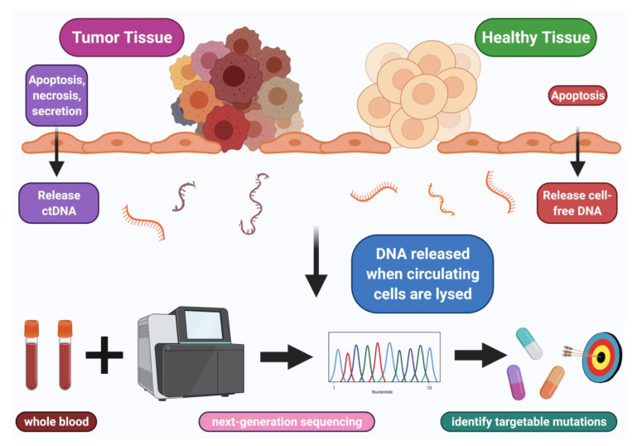
Using ctDNA to choose the best therapy

Slide 37
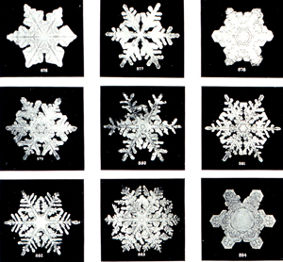
What if every patient with metastatic disease is different?
Molecular Heterogeneity

Slide 38
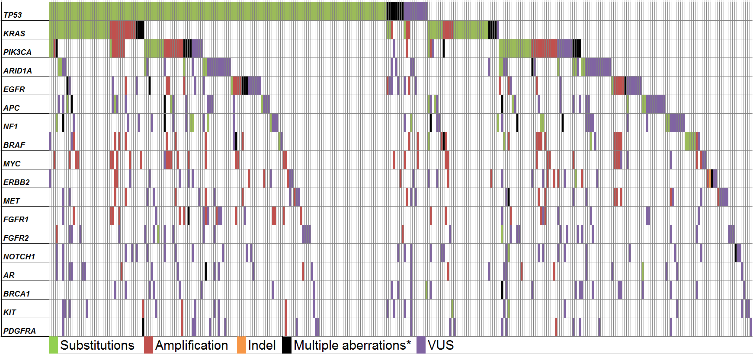
ctDNA analysis: carcinoma of unknown primary (N=442)
Most (~90%) patients had unique genomic profiles.
Kato …... Kurzrock, Cancer Research 2017

Slide 39
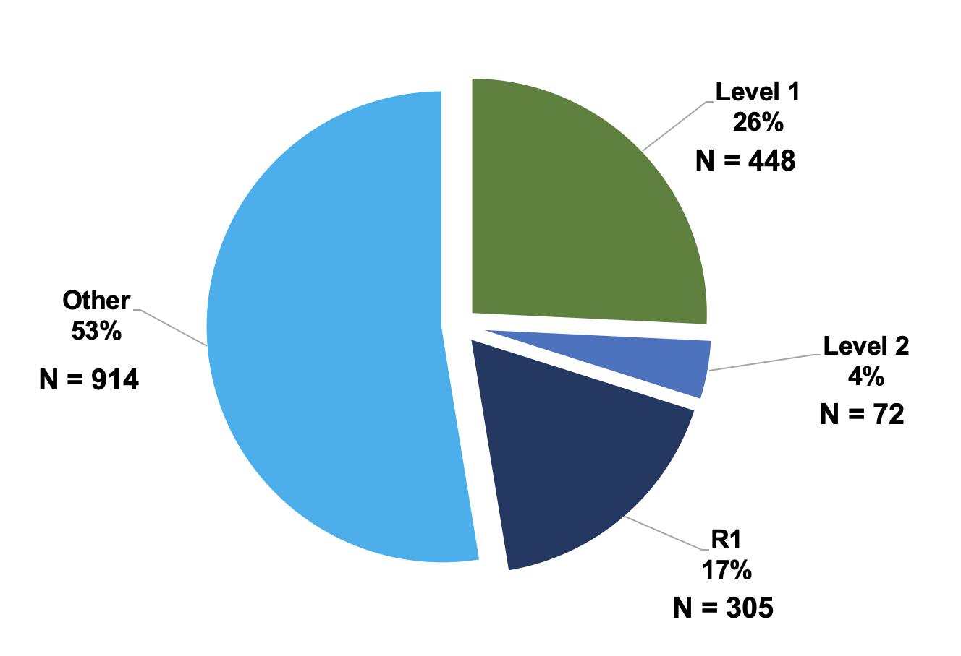

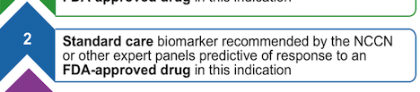
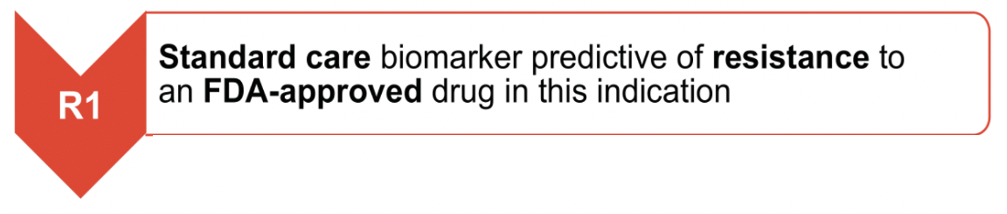
~47% with OncoKb level 1, 2 or R1 alteration in ctDNA
Carcinoma of unknown primary (CUP): Molecular features
N=1,739 patients with CUP evaluated by cfDNA (Guardant)
e.g. BRAF V600E (melanoma), ERBB2 amplification (breast)
e.g. CDK4 amplification (liposarcoma)
e.g. KRAS and NRAS mutations (colorectal cancer)
Kato… Kurzrock , JCO PO 2021

Slide 40
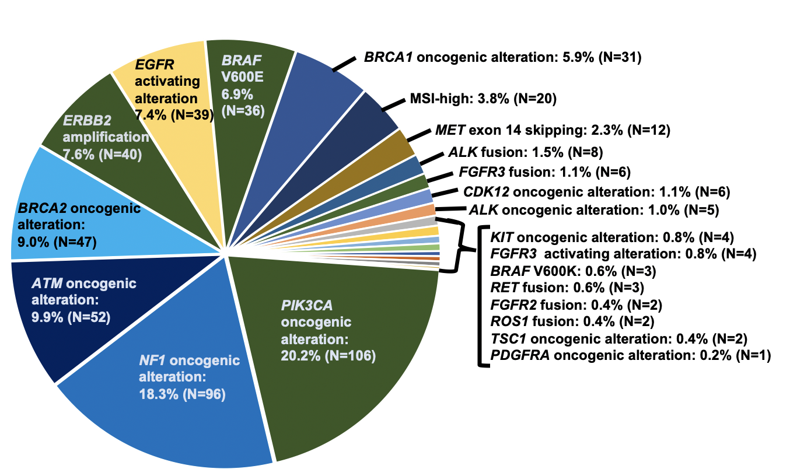
Carcinoma of unknown primary (CUP): Molecular feature
Landscape of Level 1 alterations based on OncoKB classification
Kato… Kurzrock , JCO PO 2021

Slide 41
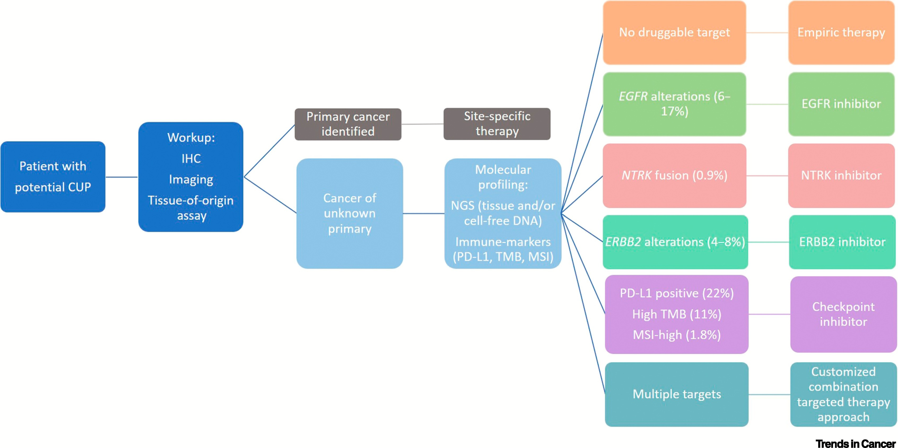
Carcinoma of unknown primary (CUP): Treatment strategy
Kato… Kurzrock, Trends in Cancer 2021

Slide 42
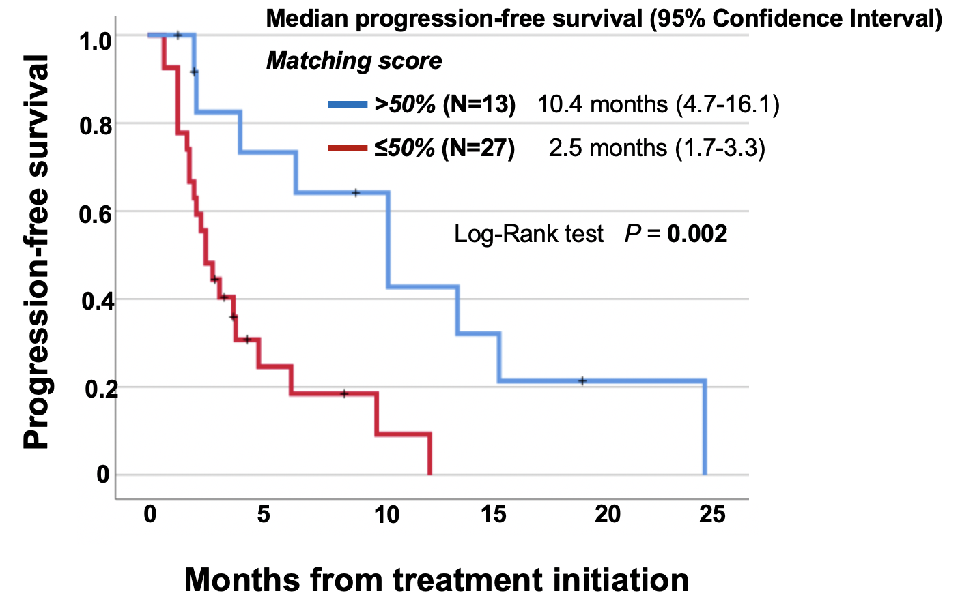
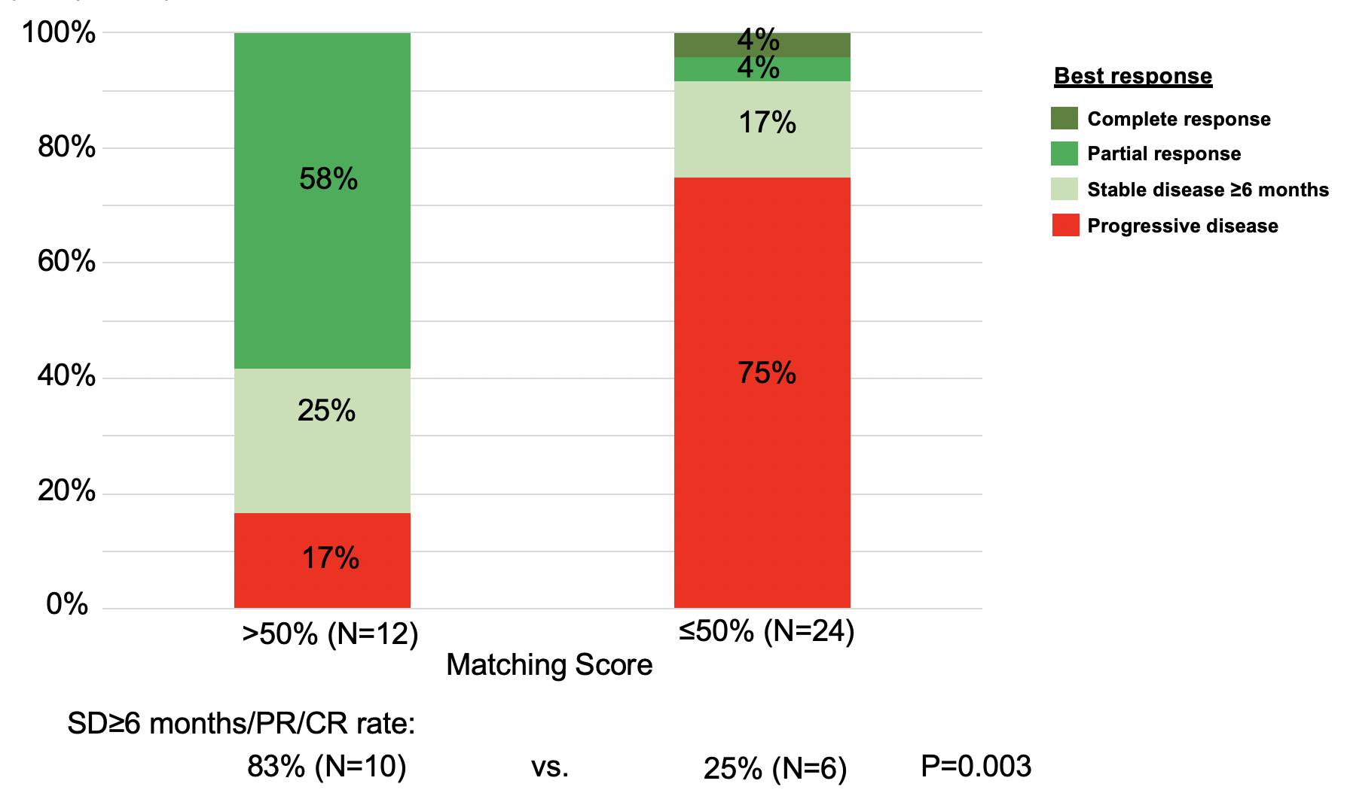
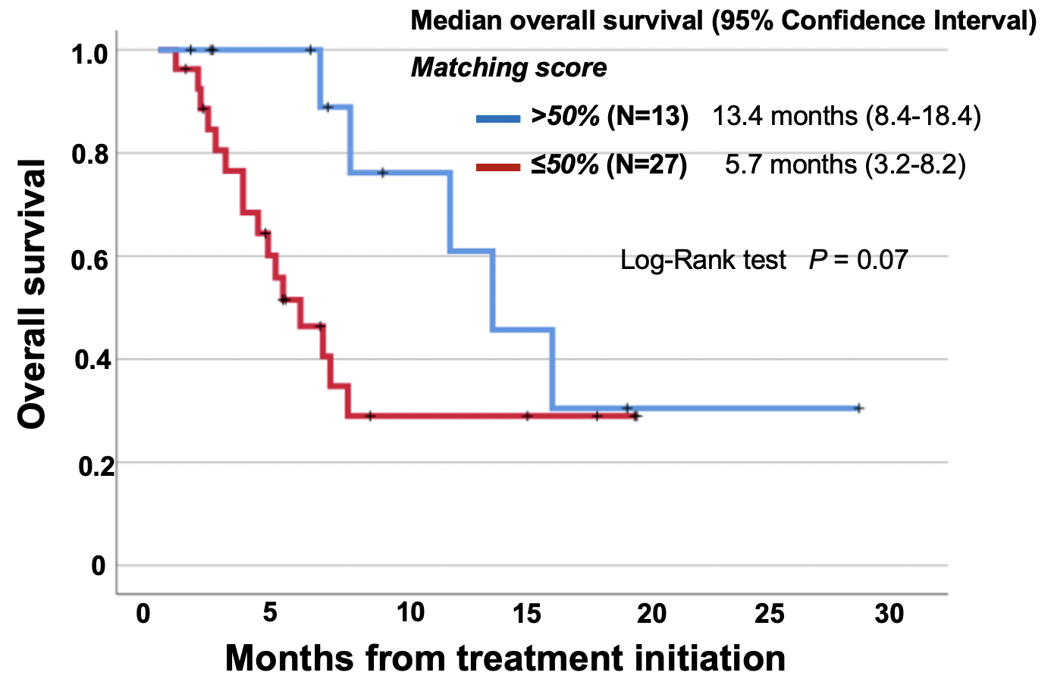
Matched targeted therapy with higher matching score was associated with better PFS, OS and clinical benefit.
Kato… Kurzrock , JCO PO 2021

Slide 43
62-year-old man with poorly differentiated carcinoma of unknown primary
Treatment history:
No systemic or local therapy.
cfDNA:
KRAS T20A
ARID1A Splice site SNV
Tissue NGS: Insufficient sample

Slide 44
62-year-old man with poorly differentiated carcinoma of unknown primary
Treatment history:
No systemic or local therapy.
cfDNA:
KRAS T20A → Trametinib
ARID1A Splice site SNV → Olaparib *
Tissue NGS: Insufficient sample
Consented on I-PREDICT protocol
(NCT02534675)
* Shen et al, Cancer Discovery 2015

Slide 45
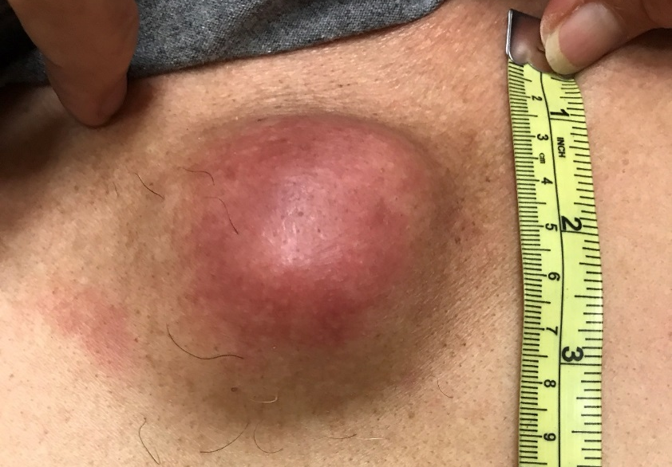
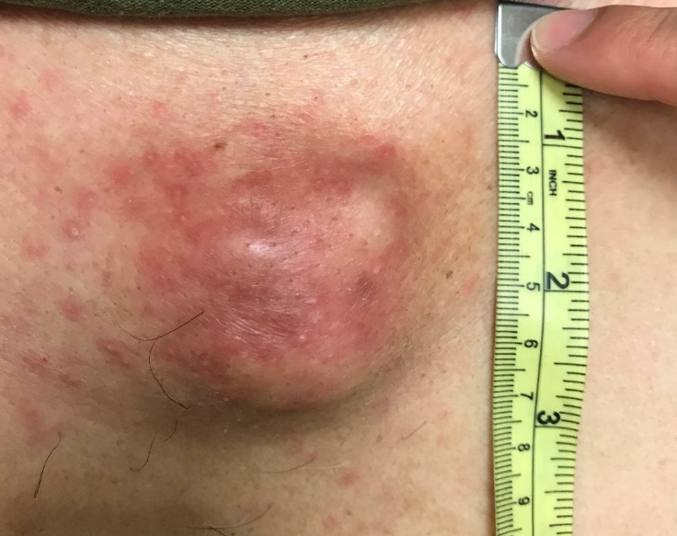
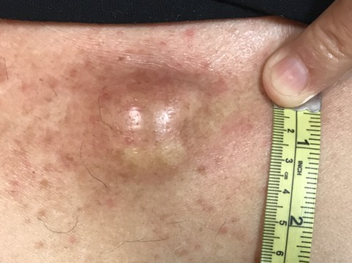
62-year-old man with poorly differentiated carcinoma of unknown primary
Trametinib/Olaparib
Pre-treatment
2 weeks post-treatment
6 weeks post-treatment
Mid-upper chest wall mass
Kato… Kurzrock , JCO PO 2021

Slide 46
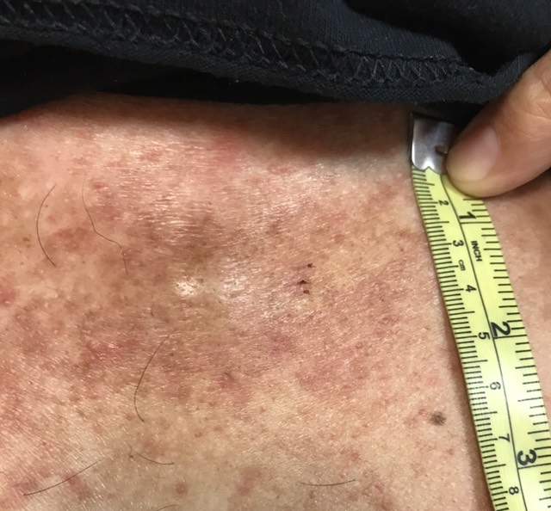
62-year-old man with poorly differentiated carcinoma of unknown primary
Trametinib/Olaparib
Pre-treatment
2 weeks post-treatment
16 weeks post- treatment
Mid-upper chest wall mass
PFS 26 months
Kato… Kurzrock , JCO PO 2021

Slide 47
Serial levels for early detection of
response and resistance
Blood or Urine

Slide 48
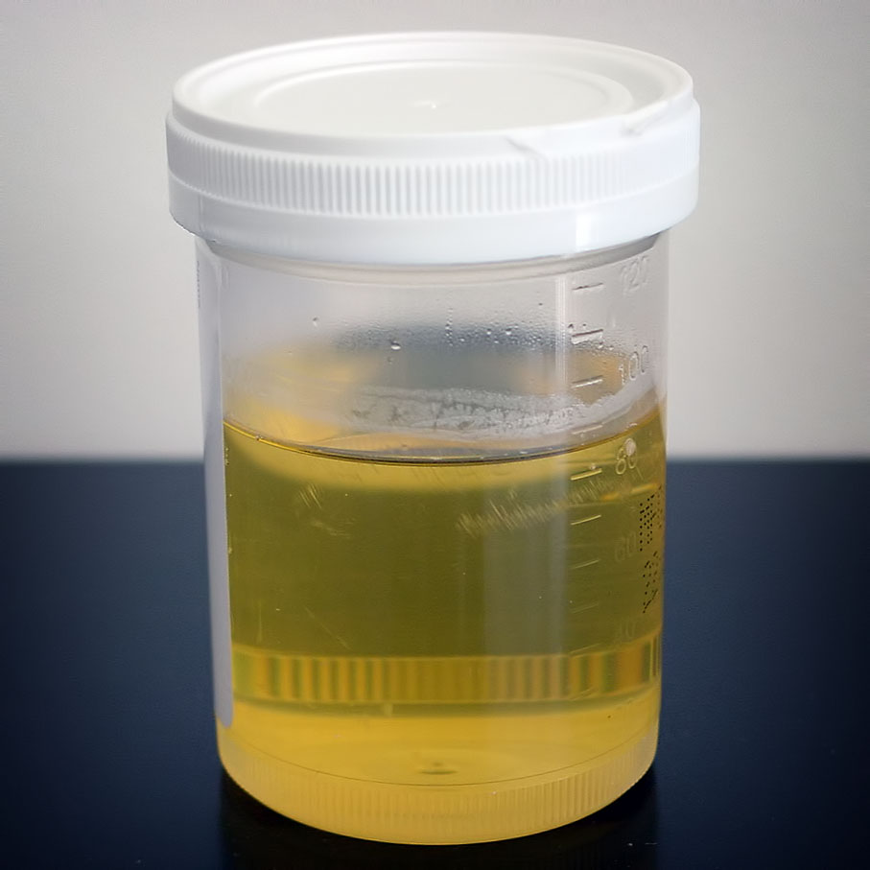
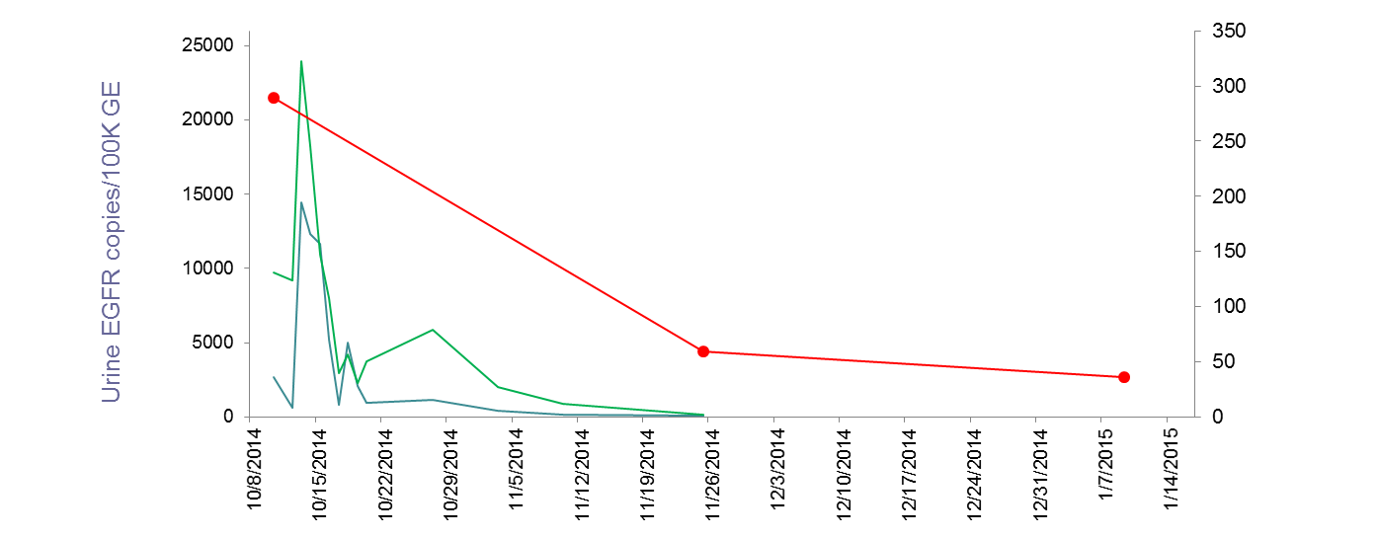
Early Response Detection Lung Cancer
Response prediction in 72 hours with urine genomics for EGFR T790M
L858R
CAT scan size
Sum of Longest Diameters (mm)
T790M
Week 1 on drug
6 wks CT scan
12 wks CT scan
EGFR T790M ctDNA spike > 25 copies/10⁵ genome equivalents and then fall correlates with CAT scan documented radiographic response
Lung Cancer with EGFR T790M mutation treated with second generation EGFR inhibitor
Husain…Kurzrock Monitoring Daily Dynamics of Early Tumor Response to Targeted Therapy by Detecting Circulating Tumor DNA in Urine. CCR 2017

Slide 49

Lung Cancer (EGFR)
Early Detection of Progression
Urine
T790M detected
Progresssion on CAT scan
IRB-approved HRPP 130794; H. Husain and R. Kurzrock (manuscript in prep)

Slide 50
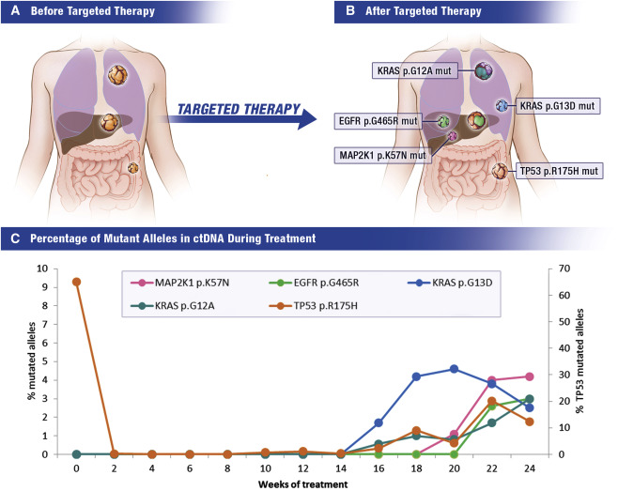
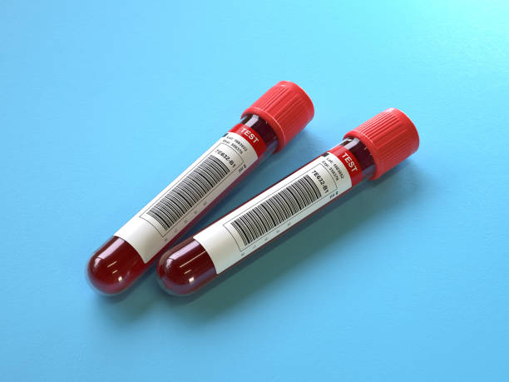
Resistance mutations detected early by liquid biopsy
Colorectal cancer treated with anti-EGFR antibodies
Bardelli and Pantel Cancer Cell, 2019

Slide 51
Liquid biopsies as a prognostic tool

Slide 52
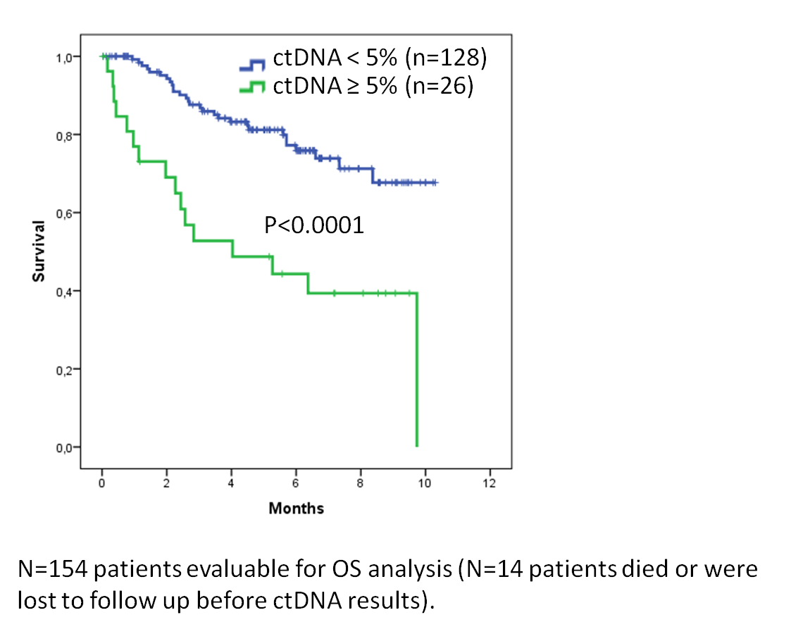
High Levels of Circulating Tumor DNA are Associated with Poor Survival
Schwaederle…..Kurzrock, CCR, 2016

Slide 53
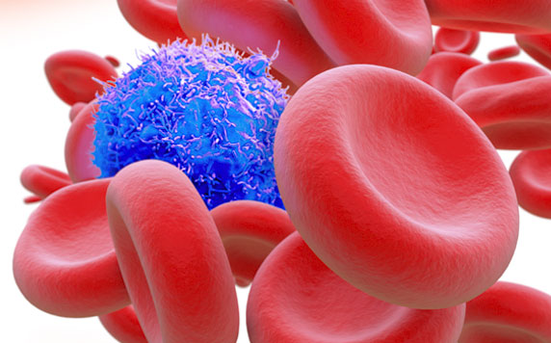
Circulating Tumor Cells
Ruchi Agashe, Razelle Kurzrock
Circulating Tumor Cells: From the Laboratory to the Cancer Clinic. Cancers (Basel) 2020

Slide 54
Circulating Tumor Cells (CTCs)
Breast
CTCs may serve as early predictors of metastatic potential
CTCs are prognostic for late recurrence in operable stage II-III breast cancer
HER2+ CTCs can be detected in patients with HER2- breast cancer
Lung
CTC characterization may identify genetic abnormalities, giving options fpr therapy
CTCs can track both treatment response and prognosis in lung cancer
Prostate
CTCs may be prognostic for overall survival

Slide 55
CTCs versus ctDNA
CTCs | ctDNA
Markers in addition to DNA (e.g. RNA and protein) | DNA markers
Quantification of number of cells | Quantification of %ctDNA
Extra step to isolate the CTCs | Direct isolation of tumor DNA; technically easier
Can be cultured to evaluate drug resistance/sensitivity | Ex vivo culture not possible

Slide 56
Early Detection:
The Final Frontier

Slide 57
Cancer is deadly + costly
>18M
new global cases per year
40%
of people will be diagnosed with cancer
>10M
annual global deaths due to cancer
#2
cause of
death globally
2.5x
higher bankruptcy likelihood
for cancer patients
4x
higher average spend per cancer patients
vs non-cancer
>$6B
out-of pocket
cancer-related costs for all patients in the US
>$245B
projected cancer-related healthcare system costs by 2030 (US)
Source: National Cancer Institute (NCI), Our World in Data, American Association for Cancer Research (AACR),
American Society of Oncology (ASCO), Hutchinson Institute for Cancer Outcomes Research, American Cancer Society (ACS)
Notes:
Everyone has been touched by cancer… between parents, siblings, friends, neighbors, and acquaintances, we are all in this together. In fact, 40% of all people will be diagnosed with cancer at some point in their life, it is the #2 cause of death, globally. And the costs associated with cancer are disruptive to our lives and are unsustainable for the healthcare system

Slide 58
Early detection = higher chance of survival
Today, most cancers
are diagnosed
at later stages,
resulting in a lower
chance of survival
5 YEAR SURVIVAL - PANCREATIC CANCER
5 YEAR SURVIVAL - COLORECTAL CANCER
Source: American Cancer Society (ACS), Cancer Research UK, NCI, The Surveillance, Epidemiology, and End Results (SEER) Program
5 YEAR SURVIVAL - BLADDER CANCER
5 YEAR SURVIVAL - OVARIAN CANCER

Slide 59
Early detection = higher chance of survival
57% PATIENTS DIAGNOSED AT THIS STAGE
82% PATIENTS DIAGNOSED AT THIS STAGE
Today, most cancers
are diagnosed
at later stages,
resulting in a lower
chance of survival
5 YEAR SURVIVAL - PANCREATIC CANCER
5 YEAR SURVIVAL - COLORECTAL CANCER
12% PATIENTS DIAGNOSED AT THIS STAGE
79% PATIENTS DIAGNOSED AT THIS STAGE
Source: American Cancer Society (ACS), Cancer Research UK, NCI, The Surveillance, Epidemiology, and End Results (SEER) Program
5 YEAR SURVIVAL - BLADDER CANCER
5 YEAR SURVIVAL - OVARIAN CANCER

Slide 60
Next-generation liquid biopsies enables detection at the earliest stages
 | Traditional Methods | Liquid Biopsy | Next-gen Liquid Biopsy
 | Screening methods in clinical practice (per USPSTF*) | Blood-based algorithmic tests, detection of multiple cancers | Blood-based multiomic tests for multiple cancers
Imaging (e.g. mammogram, colonoscopy, etc.) | ✓ | - | -
Single-marker tests (e.g. PSA, Pap, etc.) | ✓ | - | -
Blood-based multi-cancer tests | - | ✓ | ✓
Biomarkers (DNA mut/meth, free proteins) | - | ✓ | ✓
Advanced data science driven pipeline | - | ✓ | ✓
Novel biomarkers (exo-proteins, exo-RNA, long fragment DNA, etc.) with high integrity | - | - | ✓
Access to native-state/unprocessed biomarkers |  |  | ✓
*US Preventive Services Task Force (USPSTF)
Notes:
Given the capabilities of our technology and what it enables for cancer detection, we see ourselves as a next-generation liquid biopsy company using a true multiomics approach. We have many advantages over traditional screening methods for cancer, as well as many advantages over the first-generation liquid biopsy technologies. And what really enables cancer detection at the earliest stages is our ability to use our multiomics approach and capture novel biomarkers with high integrity.

Slide 61
Challenges with early detection strategies
Oncogenic mutations found in non-malignant conditions, e.g, TP53 mutations in rheumatoid arthritis
Lead-time bias
early detection

