Slide 1
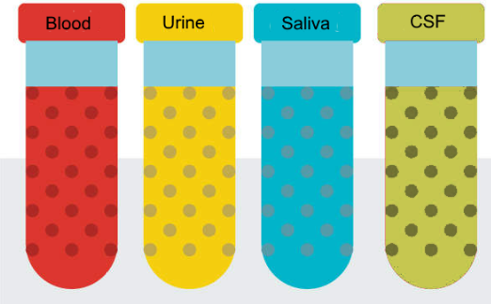
Liquid Biopsy
Johns Hopkins
MGH
MGH
Washington U
UCLA
Yale

Slide 2
Precompetitive Collaboration on Liquid Biopsy (LBC) for Early Cancer Assessment
Lynn Sorbara, Ph.D. and Guillermo Marquez, Ph.D. – Program Directors
Sudhir Srivastava, Ph.D., MPH – Program Coordinator
Cancer Biomarkers Research Group, Division of Cancer Prevention, NCI

Slide 3
NCI Precompetitive Collaboration on Liquid Biopsy for Early Cancer Assessment (LBC)
In 2018, the NCI Precompetitive Collaboration on Liquid Biopsy for Early Cancer Assessment (LBC) initiative was established to address many of the challenges impeding progress in the implementation of liquid biopsy technologies in the early cancer detection space.
The established Academic-Industrial Partnership Program’s objectives:
(a) develop new or validate existing liquid biopsy analytics;
(b) emphasize replicable analytics with sensitivity for detection of early-stage cancers
(c) emphasize specificity for cancer as distinct from benign conditions

Slide 4
Organizational Structure
National Cancer Institute
PD: Lynn Sorbara
Guillermo Marquez
PC: Sudhir Srivastava
Liq Bx Team
UCLA
PI: Wong, D
Liq Bx Team
Mass General
PI: Carter, B
Liq Bx Team
Johns Hopkins
PI: Papadopoulos, N
Liq Bx Team
Yale
PI: Patel, A
Steering Committee
Liq Bx Team
Mass General
PI: Lee, H
Liq Bx Team
Washington Univ
PI: Cote, R
Biospecimen Working Group
Study Design Working Group

Slide 5
Advancing Liquid Biopsy for Glioma Patients
Bob S. Carter MD, PhD,
Professor of Neurosurgery
Massachusetts General Hospital
Boston, MA
Notes:
Optimization of liquid biopsy assays of the IDH1.R132H and EGFRvlll mutations for the early detection of gliomas prior to surgical/therapeutic intervention, validation of the sensitivity and specificity of the assay developed in Aim 1 in initial patient cohorts, and performance of CLIA validation of the final assay.

Slide 6
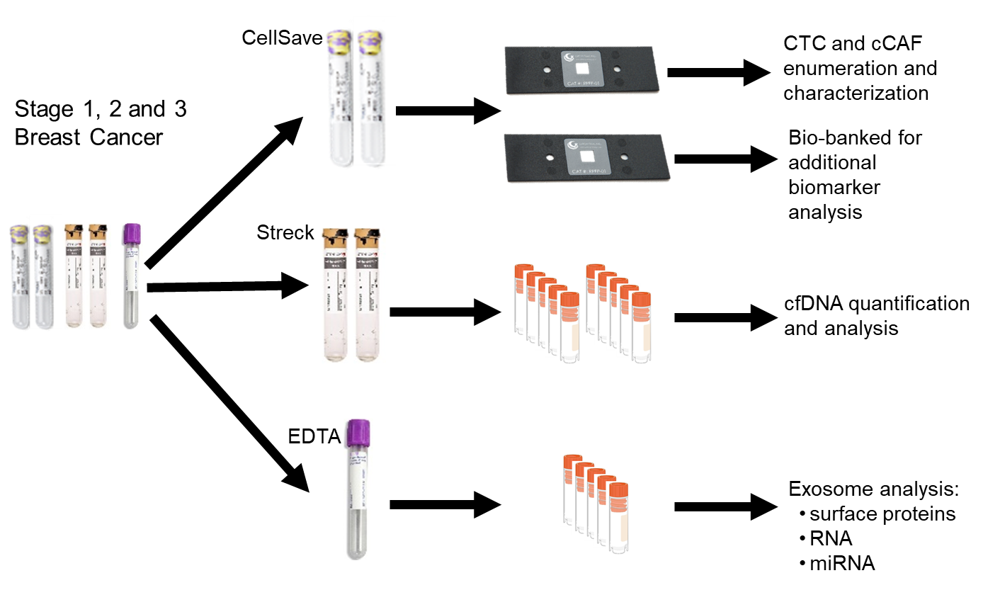
A comprehensive liquid biopsy platform for detection and prognostication in early-stage breast cancer
Comprehensive liquid biopsy for breast cancer management
Circulating Tumor Cell (CTC) + circulating Cancer Associated Fibroblast (cCAF) Quantification and Characterization
Rx response
Risk of recurrence
Toward Personalized Medicine
Novel Cellular Imaging and Image Analysis through Deep Learning
Comprehensive Multi-omic Liquid Biopsy Analysis
cfDNA and exosome
Synergistic assessment of prognosis, response, and potential management
Provide additional insight into tumor biology
Academic:
Industry:
Dr. Richard J. Cote
Dr. Sid Rawal
Dr. Rebecca Aft
Dr. Mark Watson
Dr. Ashutosh Agarwal
Dr. Susan Kesmodel
Dr. Changhuei Yang
Cheng Shen
Dr. Richard J. Cote
Dr. Sid Rawal
Dr. Anthony Williams

Slide 7
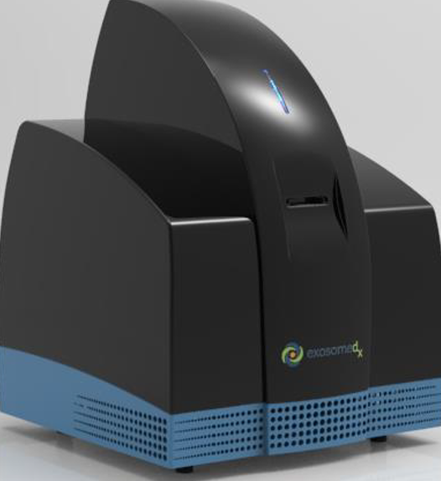
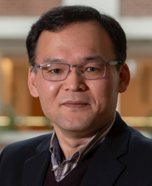
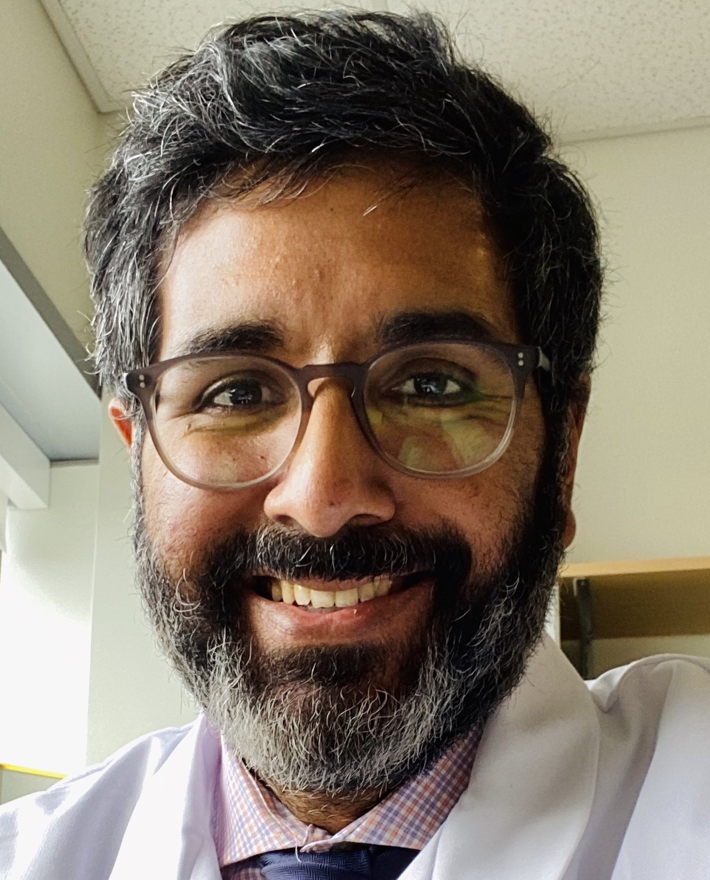
OCEAN Project
Ovarian Cancer Exosomal Analysis with Nanoplasmonics
Hakho Lee, PhD
Cesar M. Castro, MD
Johan Skog, PhD
Daniela Dinulescu, PhD
Lee
Castro
Skog
Dinulescu
Notes:
Addresses the technical challenges in extracellular vesicle (EV) analyses, rigorously evaluate EVs’ clinical value for early detection of ovarian cancer through the OCEAN system (Ovarian Cancer Exosomal Analysis with Nanoplasmonics), and establish standard methodology for total EV isolation and enrichment
Screen EVs from novel genetically engineered mouse models that closely mimic human ovarian cancer pathology

Slide 8
Lung Cancer Screening via Ultrasensitive and Cost-efficient Analysis of Tumor DNA Signatures in Blood
Abhi Patel, MD, PhD
Yale University,
New Haven, CT
Steven Skates, PhD
MGH/Harvard,
Boston, MA
David Zhang, PhD
Rice University, Houston, TX
Andrew Phillips, PhD
Microsoft Research, Cambridge, UK
Notes:
Optimizing an NGS-based ctDNA assay with rigorous error suppression, high-yield library conversion, and broad coverage of genomic alterations found in early-stage lung cancer and integrating methods to deplete wild-type molecules from sequencing libraries to reduce NGS costs
Developing and training a machine learning algorithm to distinguish individuals with early-stage lung cancer from heavy smokers without cancer based on analysis of genomic alterations in cell-free DNA

Slide 9
Earlier Detection of Cancer Using Non-Plasma Based Liquid Biopsies
Nick Papadopoulos and Chetan Bettegowda
Johns Hopkins School of Medicine
Overall goal
To develop multi-analyte tests in body fluids for the earlier detection of cancer.
The analytes currently used is a combination of aneuploidy and a well curated gene panel
Clinical Need and Focus of the proposal
CSF for the detection of CNS tumors
Saliva for the detection of Head & Neck cancers
Notes:
Optimizing a set of genetic markers for aneuploidy and somatic mutations, to be used in a test for the detection of rtDNA (release tumor DNA) in CSF, saliva and stool.
Analysis of the biofluids of individuals with pre-malignant and malignant lesions will be performed to achieve high sensitivity for detecting the specific tumor types in concert with CLIA

Slide 10
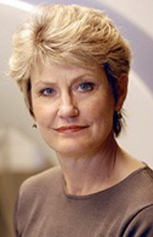
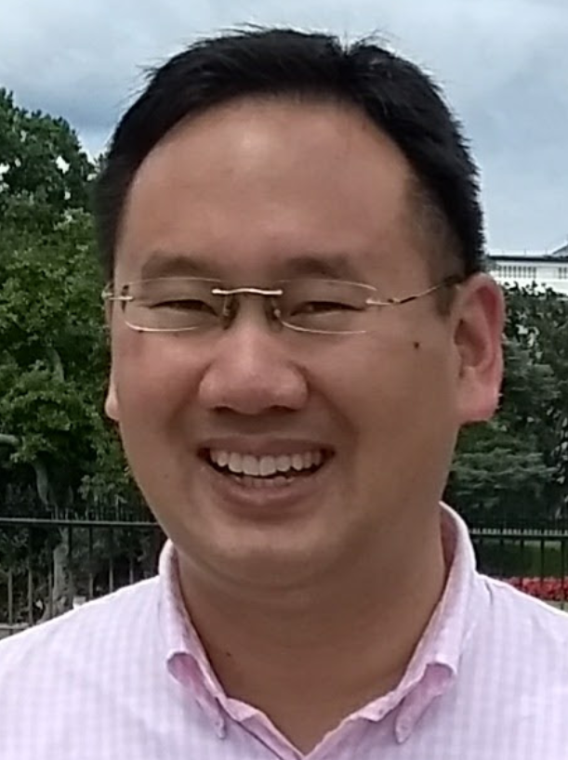
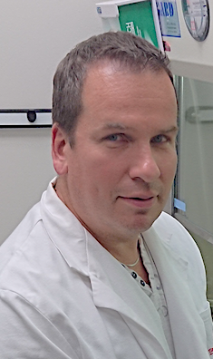
EFIRM Liquid Biopsy (eLB):
Malignancy Assessment in Indeterminate Pulmonary Nodules (IPN)
Charles (Buck) Strom
MD, PhD
Michael Tu PhD
Denise Aberle Fereidoun Abtin Scott Oh
MD MD MD, DO
Fang Wei PhD Jordan Cheng DMD David Wong DMD, DMSc
David Elashoff PhD Tristan Grognan MS
Kostyantyn
Krysan PhD
Steven Dubinett, MD Rena Xian MD
Johns Hopkins
MGH
MGH
Washington U
Yale
Hua-Jun He PhD
Kenneth Cole PhD
CA U01 233370
Lynn Sorbara PhD
Sudhir Srivastava PhD, MPH

Slide 11
LBC Synergy Cross Laboratory Collaborative Projects
MGH
Carter
EV isolation,
EV protein/RNA
CTC analysis
EV protein/RNA
Glioma/Breast
Washington University
Cote
EV isolation,
EV protein/RNA
Glioma/Ovarian
MGH
Lee
EVs, CTCs / nPLEX, CTC-chip
NCI
Cancer Prevention Program
CNV analysis in
CSF Glioma
CSF and blood for the
detection of DNA
Yale
Patel
Ultra-short ctDNA, Analysis by EFIRM & NGS
Mutations and methylation by NGS & EFIRM
UCLA
Wong
Saliva
Liquid Biopsy
Hopkins
Papadopoulos

Slide 12
Major Accomplishments: Technology Development
The EFIRM technology (Electric Field-Induced Release and Measurement), uses 40-100 µL of saliva or plasma to detect somatic mutations in cfDNA for early lung cancer detection. CLIA certified; adapted for SARs-CoV detection; currently at NIST for further analyses.
Multi-analyte tests in bodily fluids for earlier detection of cancer using combination of aneuploidy and a well-currated gene panel.
A unique imaging system combining Fourier Ptychographic Microscopy with a deep learning algorithm for early recurrence of breast cancer. Can capture and characterize in one device; adapting this to incorporate other cancer types.
nPLEX (nanoplasmonic exosome), an “all-in-one” chromatography system purifies EVs by removing high density lipoproteins; minimizes contamination and improves analytic sensitivity.
Development of an error-suppression technology enabling ultrasensitive detection of low-abundance mutations with high-confidence assessment of global hypomethylation patterns in ccf DNA; next step to adapt for multi-cancer detection.
A genome-wide aneuploidy score assay in combination with somatic mutation-based strategies using CSF for detection of Medulloblastoma.
z

Slide 13
Major Accomplishments: Process, Procedures, Protocols
In the first three years of funding, LBC has developed agreed-upon Standard Operating Procedures (SOPs) for the following:
The collection and prospective accrual of a variety of biospecimens/biofluids;
The processing, handling, and preparation of the biospecimens (pre-analytics);
Shared the protocols both within the consortium and with the community at large;
In Process for distribution to a broader audience: contributions from all of the sites has resulted in the preparation of two “white paper” manuscripts:
“The Liquid Biopsy Consortium: Challenges and Opportunities for Cancer Screening and Monitoring”
“Role of Preanalytical Variables in Liquid Biopsy”

Slide 14
Sharing Information
42 publications in peer-review journals with significant impact in the field resulting from this work.
Stringencies established for sample accession, preparation, shipping.
Analytics on low volumes of biofluids including saliva, sputum, urine.
“Out-Reach” has moved analytics into validation by NIST, NIH Foundation’s Liquid Biopsy Collaborative Community, BloodPAC and Advocacy Groups for Ovarian and Breast and Brain Tumors.
Added Value by this Consortium:
has a track record and organization that will provide analytics for the 65% of cancers lacking a screening test.
provides stringency and analytic standardization that is lacking in translational studies.
provides easy access to annotated samples accrued by their clinical collaborators.
the focus and attention to replicability and cross-analytic confirmation will increase sensitivity and specificity
will incorporate novel AI, proteomic, risk-benefit and imaging collaborators.

Slide 15
Continuing Challenges: LB In Early Cancer Assessment
Low levels of genetic targets:
Low levels of mutant ctDNA and other tumor associated circulating targets that are “diluted” with wild-type DNA; thus, requiring large volumes of blood/plasma;
Limit of Detection: what level of the biomarkers must be present in blood?
Low capture efficiency (ctDNA detection varies from 49-78% in patients with localized disease).
Issues with specificity, precision, accuracy, etc.
Tumor heterogeneity:
Is liquid biopsy representative of all the genetic clones of a tumor?
Is there sample bias? (i.e., are all regions of the tumor the same?)
What are the clinically relevant targets?
Data Sharing and Verification:
Currently available technologies are proprietary and does not allow data sharing and verification
Data sharing would empower inter-lab validation and verification
Developed algorithms are backbox and does not permit federated modeling

Slide 16
Liquid Biopsy (End)
Johns Hopkins
MGH
MGH
Washington U
UCLA
Yale

