Slide 1
The Possible Future of Liquid Biopsy in Cancer Prevention
National Cancer Institute: Charting the Course of Liquid Biopsy in Precision Prevention and Treatment
December 16, 2021
Ernest Hawk, MD, MPH
Vice President and Head, Division of Cancer Prevention and Population Sciences
The University of Texas MD Anderson Cancer Center
ehawk@mdanderson.org
Notes:
Picture downloaded from Brand Central.

Slide 2
Disclosure Information Presenter: Ernest Hawk, MD, MPH
I have the following financial relationships to disclose:
Past Consultant: Cancer Prevention Pharmaceuticals; PLx Pharma, Inc.; Pozen, Inc.
Speaker’s Bureau: N/A
Grant/Research support: NIH/NCI, CPRIT
Stockholder: N/A
Honoraria: Huntsman Cancer Institute, University of Kansas CC, Mayo CCC, Roswell Park Cancer Institute, Buffett CC at University of Nebraska, Simmons CCC at UT Southwestern, Fred Hutchinson CCC, Sidney Kimmel CCC at Johns Hopkins, Hollings CC at MUSC, O’Neal CCC at UAB, Albert Einstein CC, Knight CC at OHSC, ECHO Institute
Employee: The University of Texas MD Anderson Cancer Center

Slide 3
Current State of Cancer Screening
John B. Kisiel, MD; Nickolas Papadopoulos, PhD; Minetta C. Liu, MD; David Crosby, PhD; Sudhir Srivastava, PhD, MPH; and Ernest T. Hawk, MD, MPH. Multicancer Early-Detection Test: Preclinical-, Translational-, and Clinical-Evidence–Generation Plan and Provocative Questions. Cancer 2021, in press

Slide 4
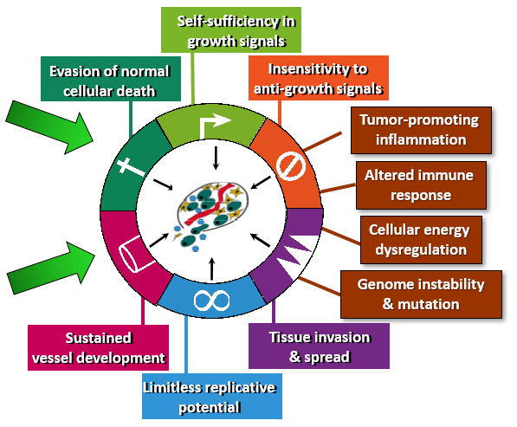
Cancer: A Chronic Interplay of Inherited Factors & Exposures that Progressively Alter Cellular Identity, Relationships, & Growth Control
Questions critical to risk assessment & prevention:
Mechanisms: How are pathways damaged? Any of special importance?
Sequencing: When? Does order matter?
Frequency: Which are most likely?
Prevalence in preinvasive neoplasia, especially lesions likely to progress
“Non-modifiable” Risk Factors
Major defects in cancer-promoting/ inhibiting genes
Subtle differences in genetic coding or expression
“Modifiable” Risk Factors
Tobacco
Poor diet
Physical inactivity
Viruses
Occupational exposures
Modified from Hanahan & Weinberg, Cell 100:57, 2000 & 144:646-674, 2011; Science 2006

Slide 5
Cancer: Rarely (if ever) Singular in its Molecular Pathogenesis in an Organ Results using molecular assays
Cervical - >90% driven by pathogenic HPVs
Substantial molecular heterogeneity
14 genes are recurrently mutated
Colorectal - 4 molecular subtypes :
CMS-1: hypermutated, microsatellite unstable, strong immune activation
CMS-2: epithelial, marked WNT and MYC signaling activation
CMS-3: epithelial, evident metabolic dysregulation
CMS-4: prominent transforming growth factor-β activation, stromal invasion, angiogenesis
All may not progress from flat, normal-appearing mucosa to a polyp and then invasion
Breast - several molecular subtypes:
Luminal A, Luminal B, HER2-enriched, Basal-like, Claudin-low
Lung - myriad molecular subtypes:
EGFR-sensitizing mutations, EGRF resistance mutations, VeriStrat proteomic signature, KRAS mutations, EML4-ALK
Implications
Heterogeneous biologies, prognostic ranges, predictive assessments
Differing timelines
Targeted-screening & therapeutic strategies may be helpful, but challenging to develop
Guinney, et al. Nature Med 21(11):1350, 2015; West, et al. PLoS ONE 7(2):e31906, 2012; Prat et al. The Breast 2015. http://dx.doi.org/10.1016/j.breast.2015.07.008; Meijer et al. Nature Rev. 2017, doi:10.1038/nrclinonc.2017.52

Slide 6
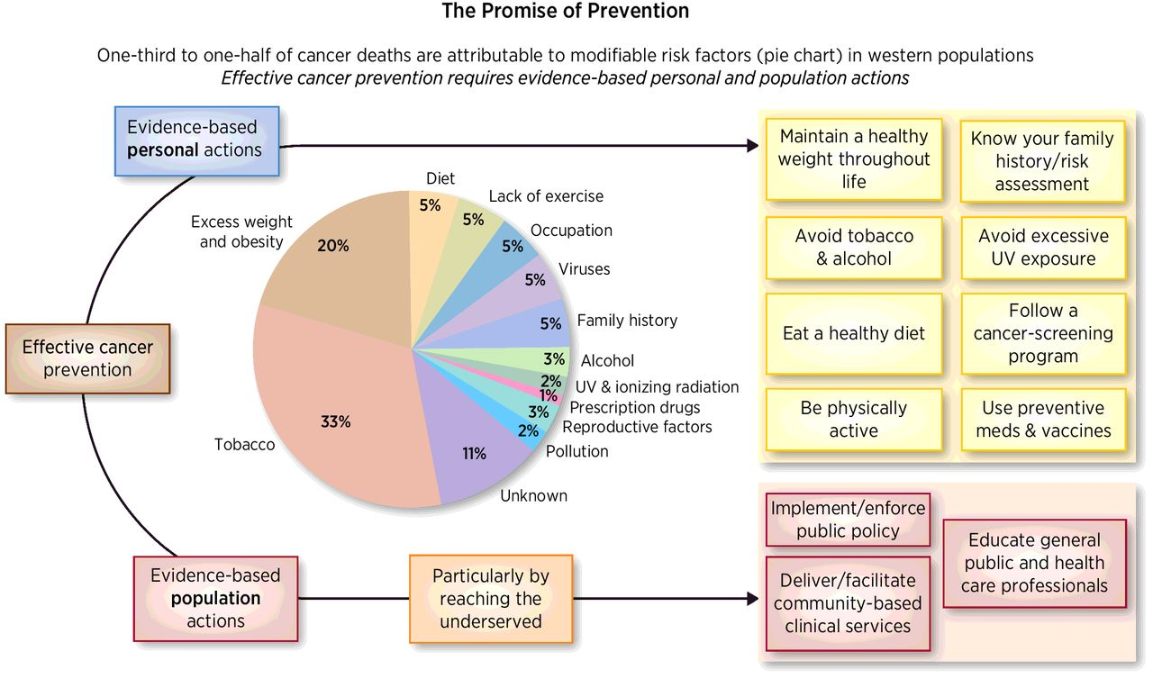
Premise for Prevention
One-Third to One-Half of Cancer Deaths Are Estimated to Be Preventable in Western Populations in 2021
Effective Cancer Prevention is Applied in Two Domains Across the Lifespan
Guideline-recommended tests available
Breast (mammography)
Cervix (pap smear; HPV)
Colon (scope, molecular, or image)
Lung (low-dose CT scan)
Prostate (PSA screening)
Current screening rates = 42% by self-report
Strategies must respond to:
Emerging therapies/vaccine prevention
Changing population trends (incidence and mortality)
Screening benefits/harms
Figure: Lippman, et al., CaPR 11(12), Dec 2018. Data based on Colditz, et al. Sci Trans Med., 2012 & Wolin, et al., Oncologist, 2010

Slide 7
Moderate Risk Populations Lifetime risk of CRC ~6-10% in those with current/prior adenomas or CRC
High-risk Populations
Lifetime risk of CRC ~40-100% in germline mutation carriers
Cumulative exposures
Tobacco/alcohol
Obesity/overweight
Physically inactive
Poor diet
Familial predisposition
Precancer/cancers in relatives
‘Nature’ - first degree (monozygotic twins, dizygotic twins/siblings, parents, and children)
‘Nurture’ (eg, second-hand smoking exposure)
Prior personal history of cancer or precancer
Cancer survivors—increased risk for same-organ second cancers, even without strong cytotoxic treatments or other past exposures
Precancer “survivors”—same as above, indicating a damaged epithelium
Dramatic exposures
Radiation leaks/blast survivors
Iatrogenically exposed
Childhood-cancer survivors who received radiation therapy
Cancer survivors treated with alkylating agents, VP16, etc.
Germline mutation carriers
APC
Mismatch repair genes (MLH1, MSH2, MSH6, PMS2, EPCAM)
BRCA1/2
P53
PTEN
UV, artificial and natural
Viruses
Sexual activity
Underserved/greater exposure to adverse social health determinants
Hawk E, et al: Epi & Prevention of CRC, Surg Clin NA, 2012

Slide 8
USPSTF Cancer Screening Recommendations and Benefit Level
Breast cancer
Moderate certainty: screening mammography in women aged 50 to 74 years has a moderate net benefit.
Moderate certainty: screening mammography in women aged 40 to 49 years has a small (yet positive) net benefit.
Colorectal cancer
High certainty: screening in adults aged 50 to 75 years has a substantial net benefit
Moderate certainty: screening in adults aged 45 to 49 years has moderate net benefit
Moderate certainty: screening in adults aged 76 to 85 years who have been previously screened has small net benefit. Adults without prior screening are more likely to benefit.
Lung cancer
Moderate certainty: annual screening with low-dose CT scan in adults ages 50 to 80 with a 20 pack-year smoking history who currently smoke or have quit within the past 15 years is of moderate net benefit
Discontinue screening when person has not smoked for 15 years, develops health problem that substantially limits life expectancy or the ability or willingness to have curative lung surgery
Cervical cancer
High certainty: screening every 3 years with cytology only in women aged 21 to 29 years—benefits substantially outweigh harms
High certainty: screening every 3 years with cytology only, every 5 years with hrHPV testing alone, or in combination in women aged 30 to 65 years—benefits outweigh the harms
Prostate cancer
Moderate certainty that PSA-based screening in men aged 55 to 69 years is of small net benefit for some men.
Moderate certainty that PSA-based screening in men 70 years and older: potential benefits do not outweigh expected harms
US Preventive Services Task Force. Cancer Recommendations. Accessed Oct 18, 2021 at uspreventiveservicestaskforce.org

Slide 9
Evidence-based Clinical Preventive Services—MD Anderson Cancer Center: Lyda Hill Cancer Prevention Center
Prevention
Survivorship
Diagnostic Evaluation
Risk Assessment
Screening
Qualitative
Quantitative
(ex. Gail model)
Genetic Testing
Healthy Lifestyles
Medical / Surgical Interventions
Breast Gyn
Colon
Lung
Prostate
Skin
Undiagnosed:
Breast
Dermatology
Gynecology
Breast
Gastrointestinal
Thyroid
Genitourinary
Cancer Prevention Center

Slide 10
Cancer Prevention Services: Implementation Challenges
Incomplete assessments (time pressures)
Subpar longitudinal/serial assessments
Subpar quality in delivery of rec’d services
Insufficient connections among various providers (PCPs, Gyn, Imaging, Pathology)
Provider ‘non-adherence’ to guidelines
Patient ‘non-adherence’ to guidelines
Inability to reach those in greatest need
Uninsured*
Under-insured*
Insufficient focus by providers and health care systems re: social determinants of health

Slide 11
Framing a Future with MCEDs
Actions, Challenges, Opportunities

Slide 12
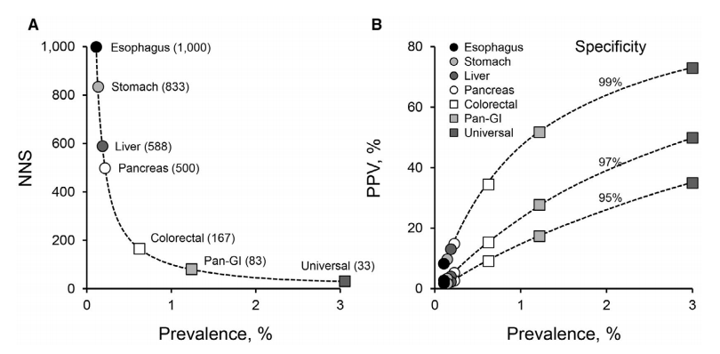
Theory: Aggregate Prevalence of Universal Screen Makes Screening of Infrequent Cancers Possible Impact of cancer prevalence on screening efficiencies
Multi-organ perspective: aggregate prevalence of less-common cancers overtakes even the most common single-organ cancers…if you have the ‘right test’; NNS can be dramatically lowered
Beyond the epidemiologic appeal, unclear if ‘informative biologic aggregation’ is possible to raise the PPV while also retaining high specificity
A. Exponential relationship between cancer prevalence and number of patients needed
to be screened (NNS) to detect 1 cancer (100% sensitivity presumed)
B. Influence of cancer prevalence on positive predictive value (PPV) at various
specificities
Ahlquist D Universal cancer screening: revolutionary, rational, and realizable. Npj Precision Oncology 2:23, 2018
Kisiel et al. Cancer 2021 (in press)

Slide 13
Potential Advantages for Multi-cancer Early Detection (MCED) Tests
Combines circulating tumor, cell-free DNA + genomic technologies + machine learning
Predicts tissue of origin (TOO)
Increases absolute number of cancers detected, including those with no current screening program
Proposed approach:
Define clinical pathway (first-line test to diagnosis) for each cancer
Establish minimum benefit-vs-harm ratios at diagnosis
Back-calculate minimum required sensitivity, specificity, and/or other performance metrics dependent on:
Invasiveness of diagnostic evaluation
Downstream consequences of test
Positive results—treatment strategy established?
Negative results—how long do we follow?
Easily accessible, minimally invasive to reach more persons
Minimizes testing-associated risks (e.g., overdiagnosis)
Detects cancers earlier
Liu, Br J Cancer 124:1475-1477, 2021; Kisiel et al. Cancer 2021 (in press)

Slide 14
Challenges and Opportunities

Slide 15
Changing Setting of Cancer-risk Factors
Lifestyle and environmental exposures are heterogeneous
MCED test should include markers of exposures that may vary by population
Highly likely: no test will serve as a single solution
Subpopulations stratified by cancer-causing exposures or germline characteristics
Will population need/accept/use the test?
Vaccine against several HPV-associated cancers approved in 2006
Australia implemented national HPV vaccination program in 2007
On track to ‘eliminate’ cervical cancer by 2028
US HPV-vaccine uptake lags far behind Australia’s (typically 45-65%)
MCED test with HPV-related markers: needed in US, but maybe not as necessary in Australia going forward
Evidence-based single-organ screening exams: available in US for most common cancers
Significant mortality reductions; however unequal access stymies population benefit
Will MCED tests extend availability to those who are less able to afford screening/diagnostics/treatment?
Kisiel et al. Cancer 2021 (in press)

Slide 16
Determining Appropriate Targets for a Test
Cancers
Populations
Most prevalent
Provide best chance of high PPV
May yield shorter development time (cases are more common)
Age/comorbidities
Minimizes potential harms from false positives
High-risk groups–germline mutations or consequential exposures
Drawbacks
Not representative of general population – smaller market
Most lethal
Societal and ethical imperative
Payers more willing to reimburse
Patients more willing to undergo testing
Advantages
Greater clinical need
Shorter duration of time to event
Smaller sample size required
Greater motivation to participate in research and interventions
Greater tolerance of side effects
Narrower range of biologic/molecular aberrations
Worst current early-stage detection rate
Survival rates are poorest for lung, pancreas, ovary
Average risk groups—could vary by geographic region: cultural-, economic-, lifestyle-, other factors
Will specific tests be required for specific populations?
Most amenable to existing interventions offering cure
Kisiel et al. Cancer 2021 (in press)

Slide 17
Current ‘Required’ Phases of Biomarker Development
NCI Early Detection Research Network (EDRN)
Determines readiness
to move to next phase
1: Discovery and prioritization
Ability to differentiate between cancer and non-cancer
Clinical application
Sample source
Mechanistic or other biological evidence
Applied study design
2: Development of clinical-grade assay
Is cancer mortality the only reasonable endpoint?
Is reduction in late-stage disease at presentation sufficient?
How can ‘real-world’ observational data influence development and regulatory approval by FDA, CMS?
3: Retrospective evaluation—does it detect
disease before clinical relevance?
4: Prospective-screening study: apply to
healthy, asymptomatic persons
5: Estimate cancer-mortality reduction
Prospective trial
Kisiel et al. Cancer 2021 (in press)

Slide 18
Defining Endpoints with Clinical Utility MCED rapid delivery versus prospective clinical trial methodology
1. Reduced mortality: randomized controlled trial
Follow tens of thousands
Follow 1-2 decades
Costly ($ millions)
Broad acceptance
2. Intermediate indicators of clinical utility
Large observational/interventional studies of emerging MCED tests
Conduct real-world post-marketing studies
3. Reduction in incidence of late-stage diagnosis for targeted cancer (earlier
endpoint)
Expedites prospective study execution, completions, reporting
Couple with post-implementation, real-world study of long-term outcomes
Accumulate mortality data over time
More rapid MCED test access
Acceptable to regulatory agencies, guideline developers, payers?
Kisiel et al. Cancer 2021 (in press)

Slide 19
Key Decision-makers Affect Screening Access in the U.S.
FDA
Assess and approve the scientific validity, with consideration of risk:benefit balance, and indicated uses of novel devices/technologies (as well as interventions/drugs)
AHRQ/USPSTF
Makes recommendations about three types of clinical preventive services for
asymptomatic people:
Screening tests
Preventive medications
Counseling
When compiling data, often finds substantial data that potential life-saving benefits of recommended services are not equitably available to certain racial/ethnic groups
Patient Protection and Affordable Care Act mandates private-insurer coverage without cost sharing for USPSTF grade A and B recommended clinical preventive services
CMS
Provides insurance coverage/reimbursement via Medicare and Medicaid
Oversees Center for Consumer Information and Insurance Oversight (CCIIO) to help implement Affordable Care Act reforms related to private insurance
Doubeni JAMA 325(7):627, 2021.
U.S. Preventive Services Task Force. Recommendations. Accessed on Oct 11, 2021 at https://www.uspreventiveservicestaskforce.org/uspstf/news.
CMS.gov. Consumer Information and Insturance Oversight. Accessed Oct 11, 2021 at https://www.cms.gov/CCIIO.

Slide 20
Examples of Ongoing, Population-based MCED Trials Asymptomatic intended-use screening populations
STRIVE (NCT03085888)
Case-cohort study of ~100,000 women undergoing mammography screening
Purpose: validate GRAIL Test ability to detect breast cancer and other invasive cancers
SUMMIT (NCT03934866)
Study of ~25,000 smokers and former smokers at high risk of lung cancer
Purpose: investigate how cancer screening can be improved and delivered
PATHFINDER (NCT04241796)
Prospective interventional study of ~6200 participants with no detected cancer
Purpose: evaluate clinical implementation of MCED testing
Tracks diagnostic pathways toward resolution of a signal-detected test result –
Number of tests
Types of tests
Time to diagnostic resolution
Assesses turn-around time of test results for clinicians and participants
Ascertains participant-reported outcomes (eg, health resource use) and perceptions of the test
Liu M. Br J Cancer 124:1475-1477, 2021
Nadauld LD, et al: Cancers 13:3501, 2021.

Slide 21
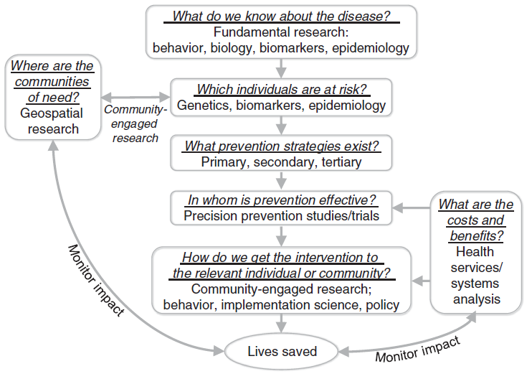
Idealized Model of ‘Precision Prevention’ of Cancer From discovery to population impact
Germline susceptibilities
Cumulative exposures
Biologic consequences
MCED Test + TOO Insight + Clear Diagnostic Path?
Tailored interventions
Lifestyle modifications
Surgical resection/ablation
Molecular interception
HPV Vaccination
Reduced toxicity
Better outcomes
Lower costs
Improved ‘value’
Rebbeck T. Cancer Epidemiol Biomark & Prev 23(12):2713, 2014.

Slide 22
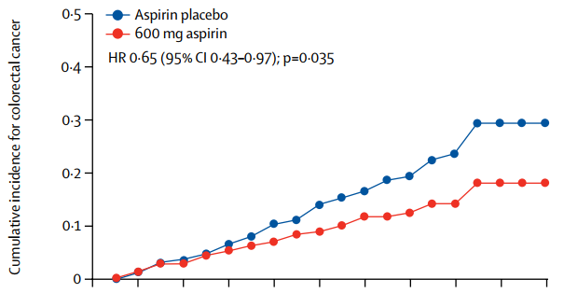
Precision Prevention Strategies
861 Lynch syndrome carriers randomized to aspirin (600mg/d) vs placebo for mean of 2.5 years w/10+ years of follow-up
FAP/Lynch Syndrome
Colectomy in FAP & Lynch Syndrome
Surveillance upper & lower endoscopy w/polypectomy
BRCA Carriers
Risk-reducing bilateral salphinoophorectomy
Prophylactic mastectomy
Under investigation
Aspirin dose-finding in LS (CAPP3)
Novel NSAID combos in FAP
Mismatch repair directed vaccines in LS
PARP inhibitors in BRCA carriers
Liquid biopsies - risk reduction endpoints?
Burns, et al. Lancet. 395:1855, 2020

