Slide 1

Liquid Biopsy Applications in Clinical Research and Disease Interception
Sean Khozin, MD, MPH
CEO, CancerLinQ
@SeanKhozin
Disclosure: Executive Committee, Alliance for Artificial Intelligence in Healthcare

Slide 2
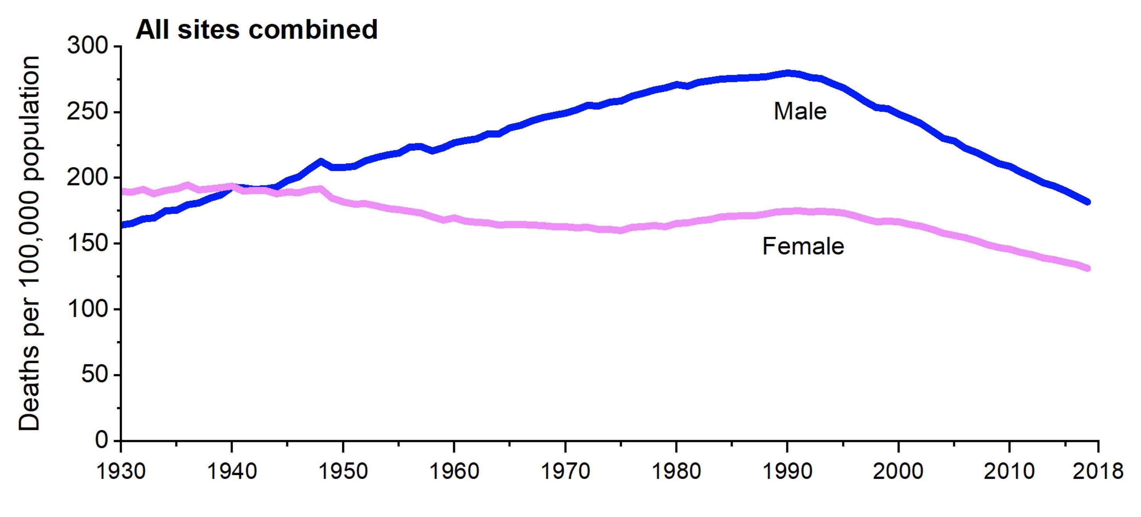
Significant improvements in cancer mortality rates
Siegel RL, Miller KD, Fuchs HE, Jemal A. Cancer Statistics, 2021 CA Cancer J Clin. 2021;71(1):7-33

Slide 3
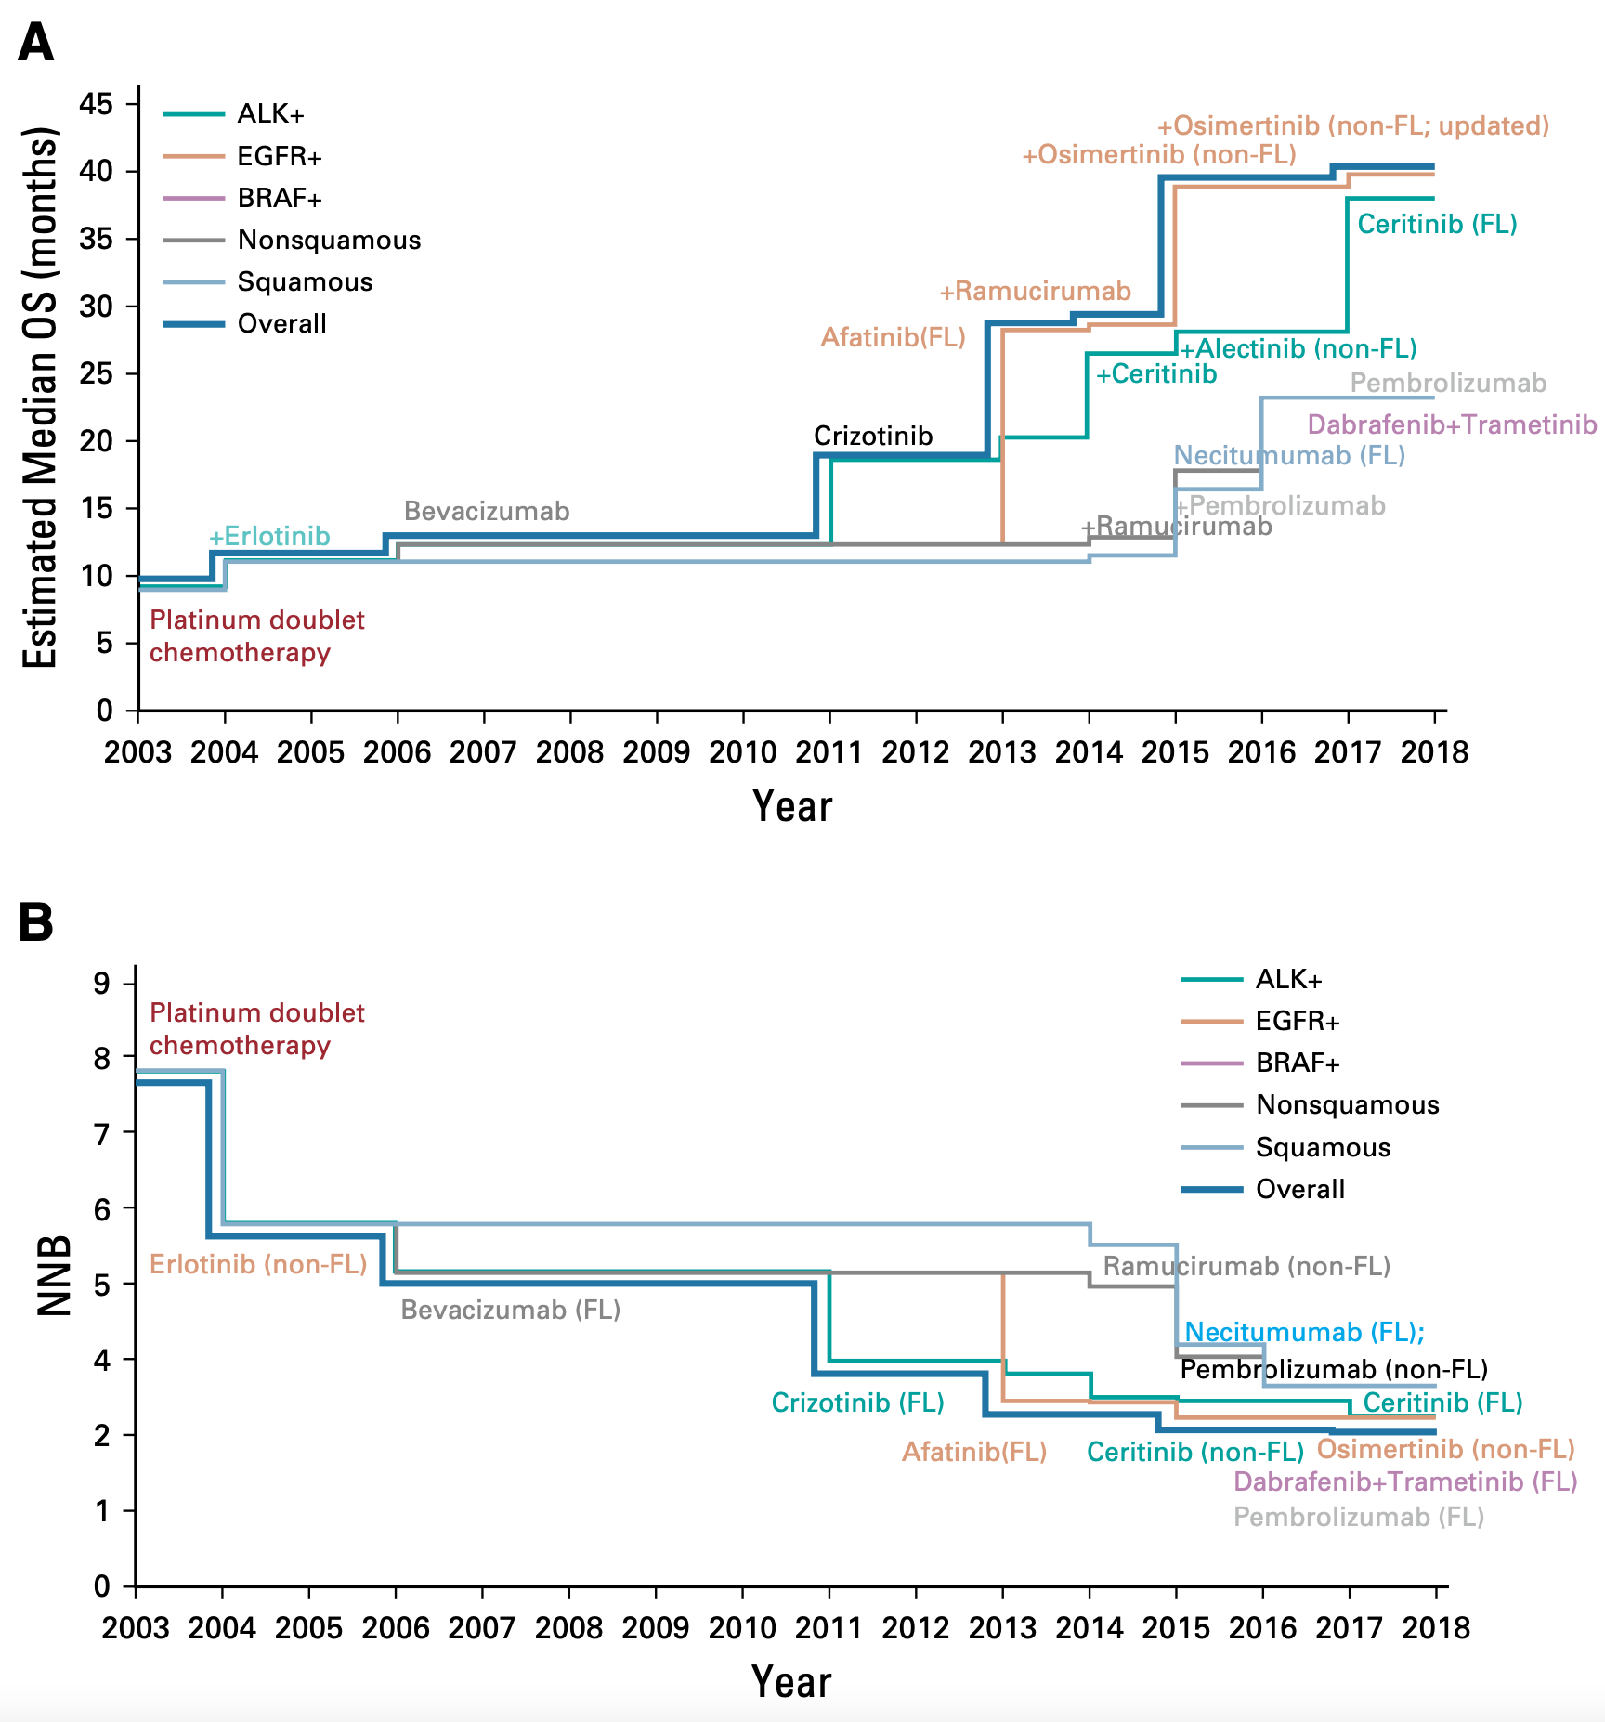
Advanced Non-Small Cell Lung Cancer
Primary Resistance
Wrong drug, wrong time, wrong dose
Raju, GK, Khozin, S, Gurumurthi, K, Domike, R. Woodcock, J. JCO Clin Cancer Inform. 2020 Aug;4:769-783

Slide 4
Current paradigm in cancer therapeutic development
Symptomatic disease
Healthy state
Death
Oncogenesis
Advanced stage

Slide 5
Current paradigm in cancer therapeutic development (1)
Advantages:
Can demonstrate efficacy with small studies
  Many may not require active comparator arm if no available therapy
Short study duration: progression or death events typically occur rapidly
  Decreases time to reach a pre-specified endpoint
Rapid recruitment: patients with advanced refractory disease highly motivated
Symptomatic disease
Healthy state
Death
Oncogenesis
Advanced stage

Slide 6
Current paradigm in cancer therapeutic development (2)
Is the current paradigm the only rational way of reducing the burden of cancer on patients and society?
Symptomatic disease
Healthy state
Death
Disadvantages:
Tumor heterogeneity
High mutational burden and complexity
Extremely low likelihood of cure
Patient pain and suffering: poor performance status, adverse events
Oncogenesis
Advanced stage

Slide 7
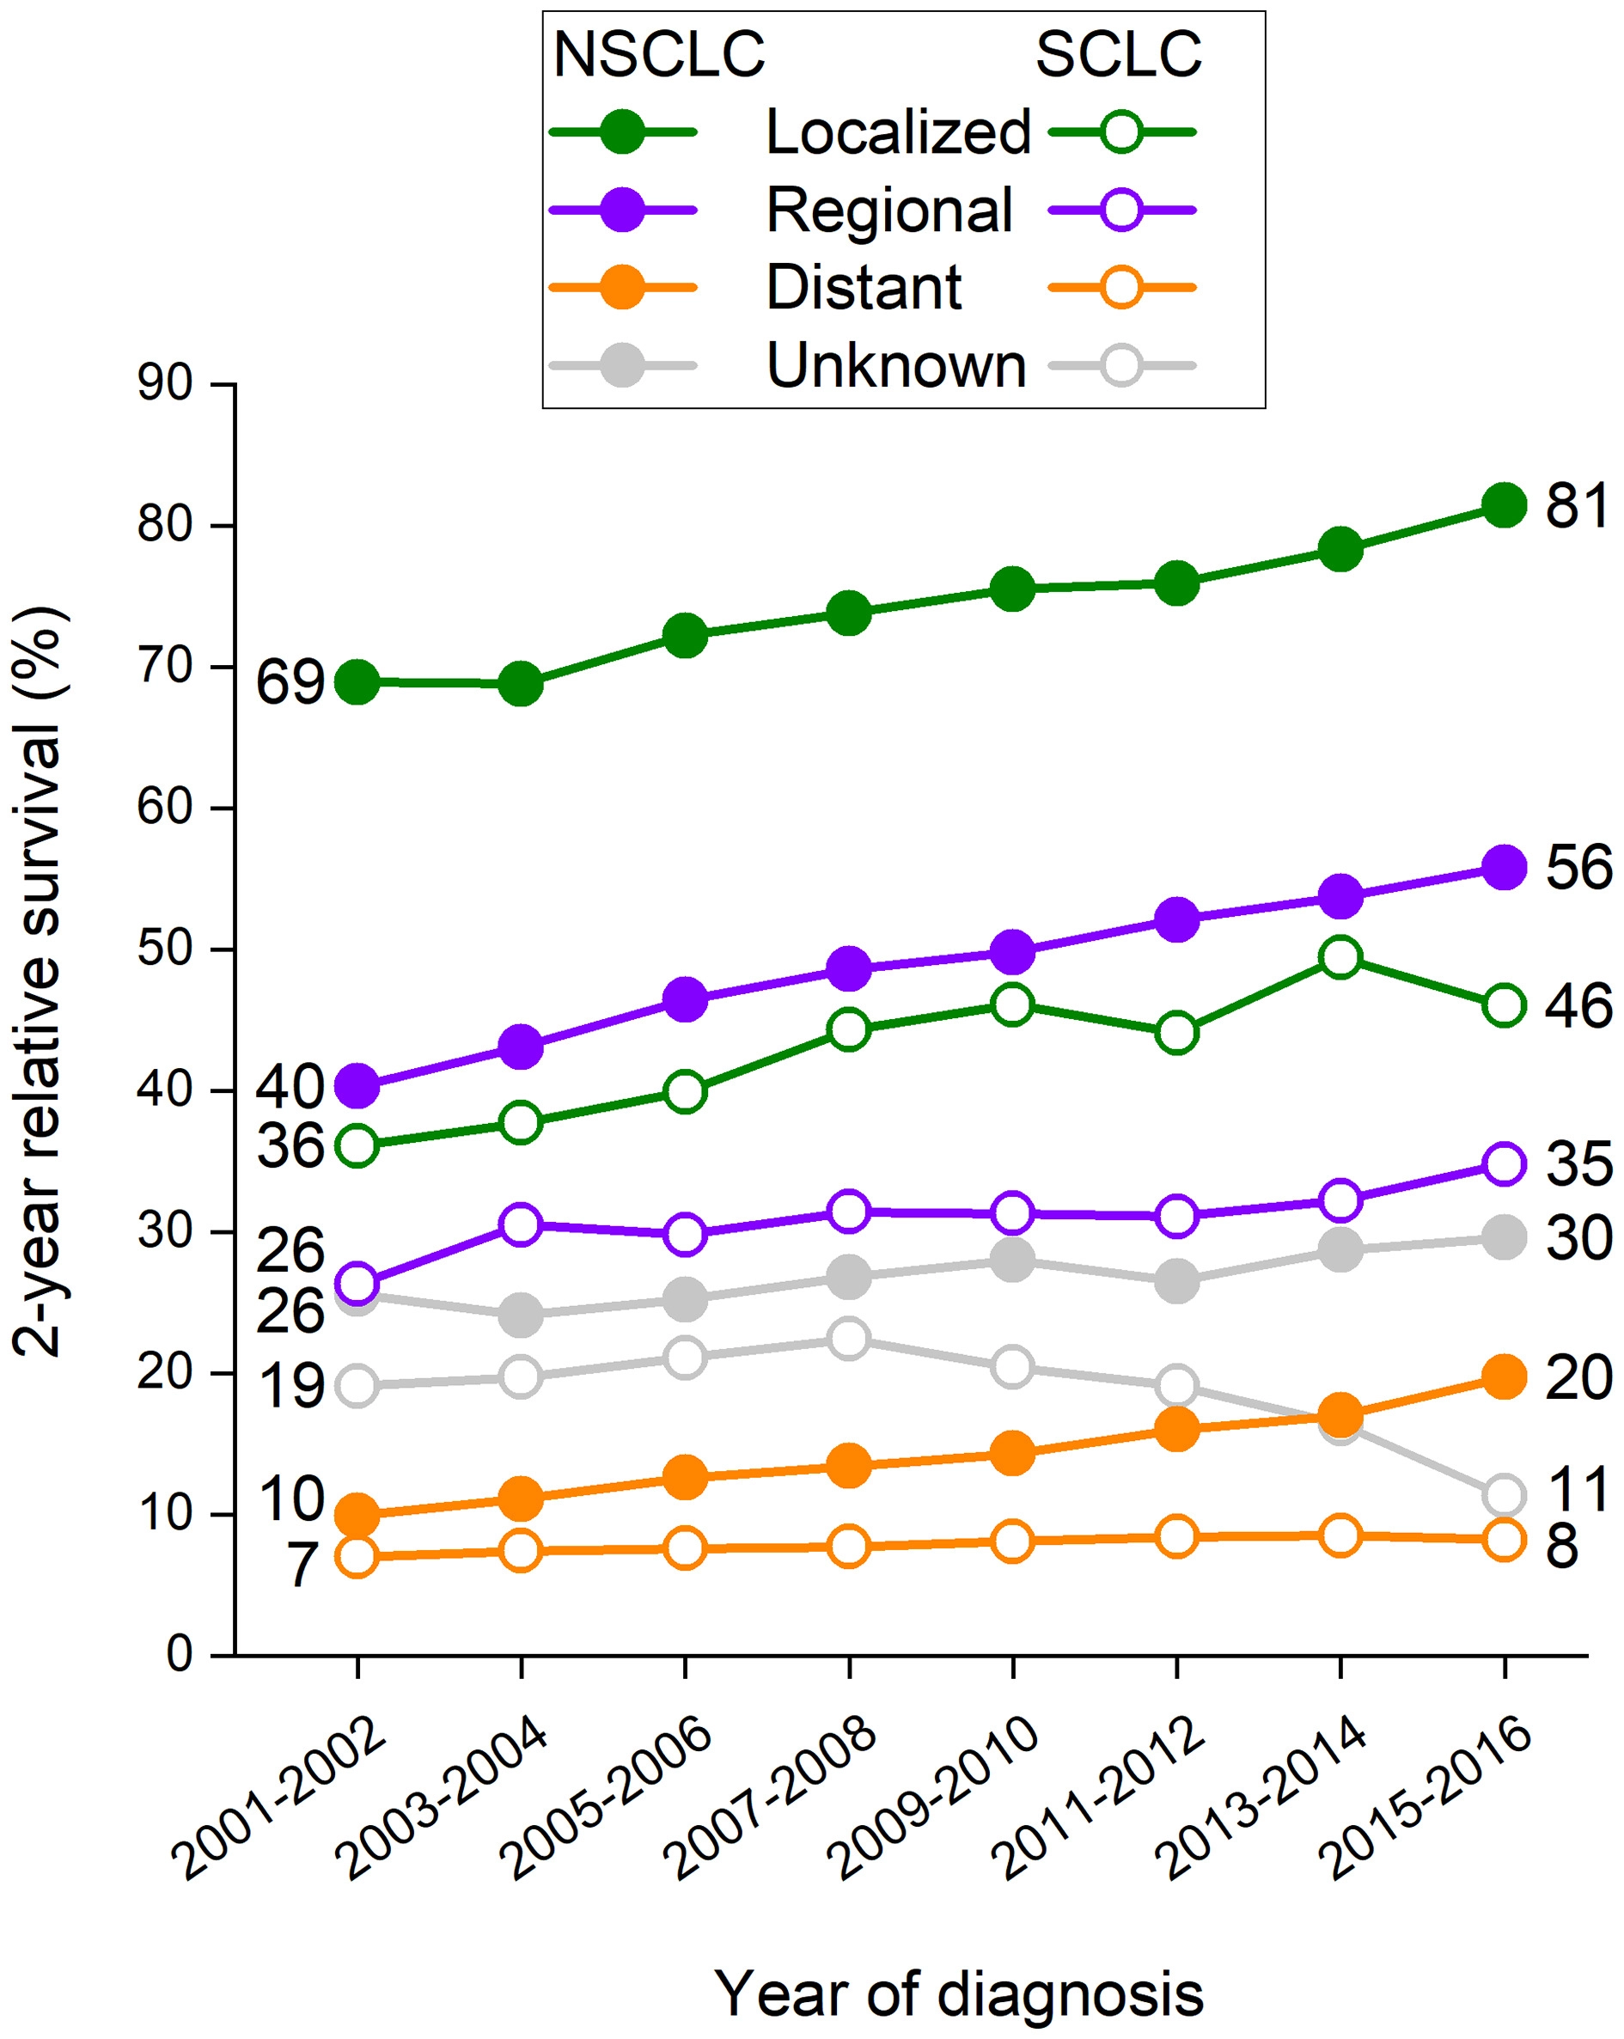
Non-Small Cell Lung Cancer
Significant difference in survival
Siegel RL, Miller KD, Fuchs HE, Jemal A. Cancer Statistics, 2021 CA Cancer J Clin. 2021;71(1):7-33

Slide 8
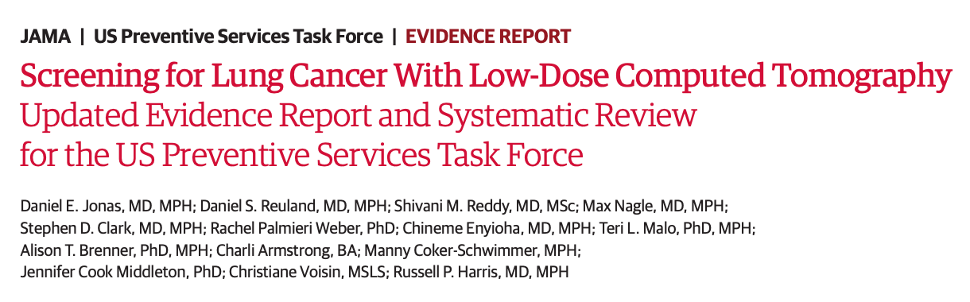
JAMA US Preventive Service Task Force Evidence Report
March 9, 2021
223 publications
Seven randomized clinical trials (N = 86,486)
  National Lung Screening Trial (NLST, N = 53,454) and Nederlands-Leuvens Longkanker Screenings Onderzoek (NELSON, N = 15,792)
NLST reduction in lung cancer mortality (incidence rate ratio [IRR], 0.85 [95% CI, 0.75-0.96]; number needed to screen [NNS] to prevent 1 lung cancer death, 323 over 6.5 years of follow-up) with 3 rounds of annual LDCT
NELSON reduction in lung cancer mortality (IRR, 0.75 [95% CI, 0.61-0.90]; NNS to prevent 1 lung cancer death of 130 over 10 years of follow-up) with 4 rounds of LDCT screening
For every 1000 persons screened in NLST, false-positive results led to 17 invasive procedures with fewer than 1 person having a major complication

Slide 9
Moving upstream in cancer therapeutic development with liquid biopsies to enable disease interception
Symptomatic disease
Asymptomatic stage
Healthy state
Death
Oncogenesis
Advanced stage

Slide 10
How good are liquid biopsy assays for cancer detection in asymptomatic stage?
The Circulating Cell-free Genome Atlas (CCGA, NCT02889978) Study
Prospective, multicenter, case-control, observational study with longitudinal follow-up
De-identified biospecimens were collected from 15,254 participants with (n = 8,584; 56%) and without (n = 6,670; 44%) cancer from 142 sites in North America
Up to 80 ml whole blood collected from all participants
Three sub-studies
  Discovery to identify highest performing assay(s) for further development
  Training/validation with selected assay
  Further validation with optimized assay
Liu MC, Oxnard GR, Klein EA, Swanton C, Seiden MV; CCGA Consortium. Ann Oncol. 2020;31(6):745-759

Slide 11
How good are liquid biopsy assays for cancer detection in asymptomatic stage? (1)
The Circulating Cell-free Genome Atlas (CCGA, NCT02889978) Study
Discovery
Whole-genome bisulfite sequencing (WGBS) interrogating genome-wide methylation patterns outperformed whole-genome sequencing (WGS) interrogating copy-number variants (CNVs) and targeted sequencing looking at single-nucleotide variants (SNVs) with small insertions and deletions
  Targeted sequencing with SNV-based classification was significantly confounded by clonal hematopoiesis of indeterminate potential (CHIP)
Liu MC, Oxnard GR, Klein EA, Swanton C, Seiden MV; CCGA Consortium. Ann Oncol. 2020;31(6):745-759

Slide 12
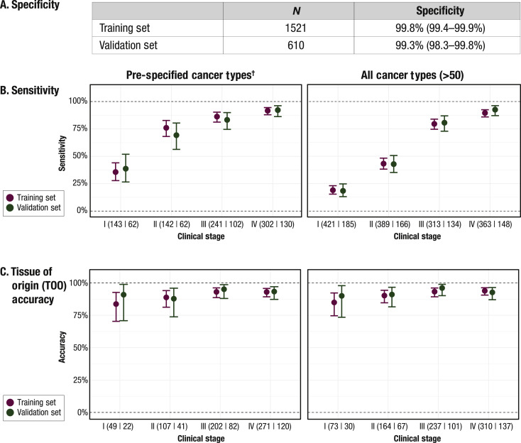
Results
Liu MC, Oxnard GR, Klein EA, Swanton C, Seiden MV; CCGA Consortium. Ann Oncol. 2020;31(6):745-759

Slide 13
Results (1)
Liu MC, Oxnard GR, Klein EA, Swanton C, Seiden MV; CCGA Consortium. Ann Oncol. 2020;31(6):745-759

Slide 14
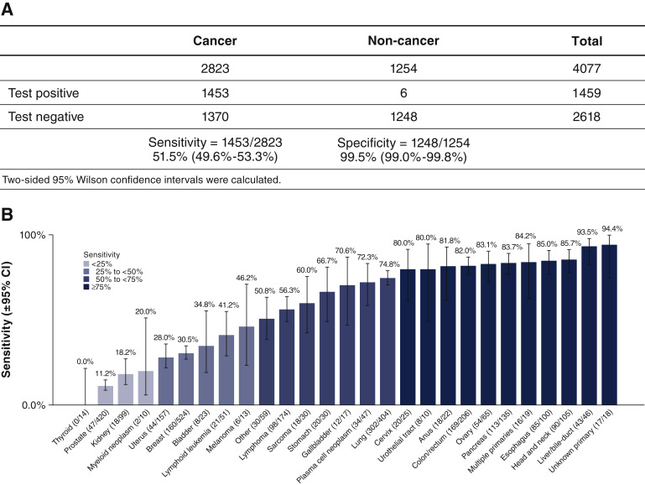
Results (Sub-study 3 with optimized assay)
Klein EA, Richards D, Cohn A, et al. Ann Oncol. 2021;32(9):1167-1177

Slide 15
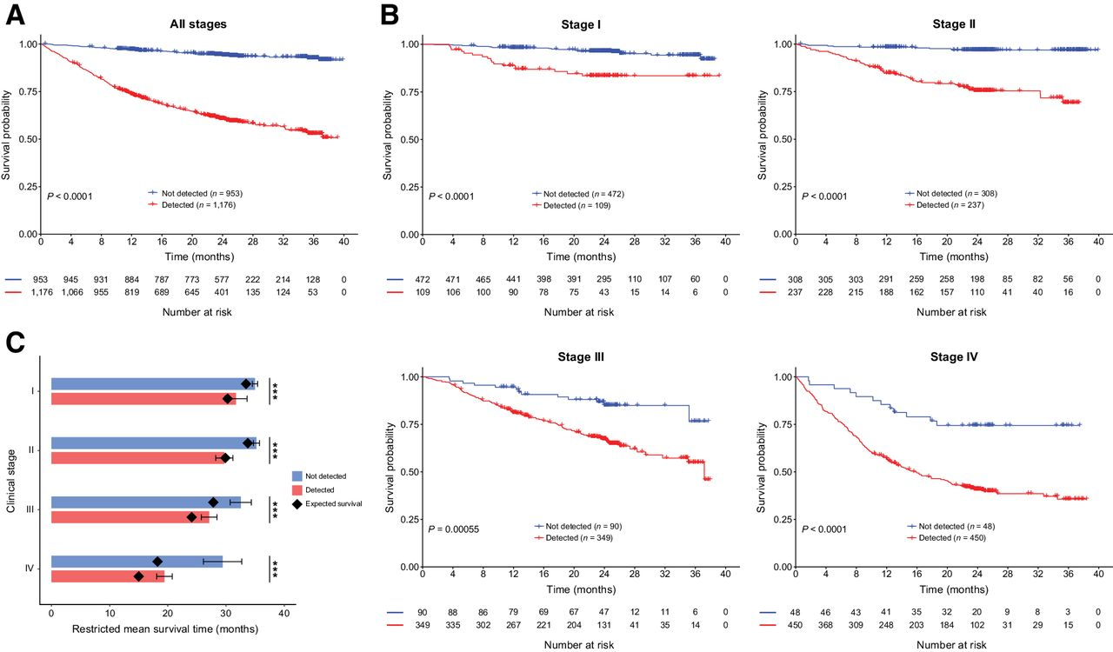
Cancers not detected had more favorable prognosis
Chen X, Dong Z, Hubbell E, et al. Clin Cancer Res. 2021;27(15):4221-4229

Slide 16
Moving upstream in cancer therapeutic development requires development and validation of intermediate endpoints
Symptomatic disease
OS
Asymptomatic stage
PFS, ORR
Healthy state
Intermediate endpoints
Death
Oncogenesis
Advanced stage

Slide 17
Regulatory precedent: disease interception using metastasis free survival (MFS) in prostate cancer
In 2018, FDA approved apalutamide, an androgen receptor inhibitor, for treatment of patients with nonmetastatic castration-resistant prostate cancer (nmCRPC)
Approval based on SPARTAN, a randomized, placebo-controlled trial involving 1207 patients that demonstrated a statistically significant improvement in metastasis-free survival, defined as the time from randomization to either imaging-detectable distant disease or death
Beaver JA, Kluetz PG, Pazdur R. Engl J Med. 2018;378(26):2458-2460.

Slide 18
Regulatory precedent: disease interception using metastasis free survival (MFS) in prostate cancer (1)
In 2011, FDA convened an Oncologic Drugs Advisory Committee (ODAC) meeting to discuss clinical trial end points
Committee members recognized MFS as a clinically relevant endpoint
  They believed transition from nmCRPC to detectable metastatic disease is a clinically relevant event that can be associated with pain and illness and result in the need for additional interventions
In 2012, another ODAC examined the results of denosumab use in a randomized, placebo-controlled trial involving 1432 men with nmCRPC. This trial demonstrated an estimated median improvement of only 4 months in bone-only MFS
  The committee concluded that this improvement coupled with denosumab’s safety profile did not amount to a favorable risk–benefit profile
FDA updated guidance on MFS in 2021
Beaver JA, Kluetz PG, Pazdur R. Engl J Med. 2018;378(26):2458-2460.
FDA. Nonmetastatic Castration Resistant Prostate Cancer: Considerations for Metastasis-Free Survival Endpoint in Clinical Trials, version 8.21.

Slide 19
Future directions: use of germline testing to increase pre-test probability
Symptomatic disease
OS
Germline
Asymptomatic stage
PFS, ORR
Healthy state
Intermediate endpoints
Death
Oncogenesis
Advanced stage

Slide 20
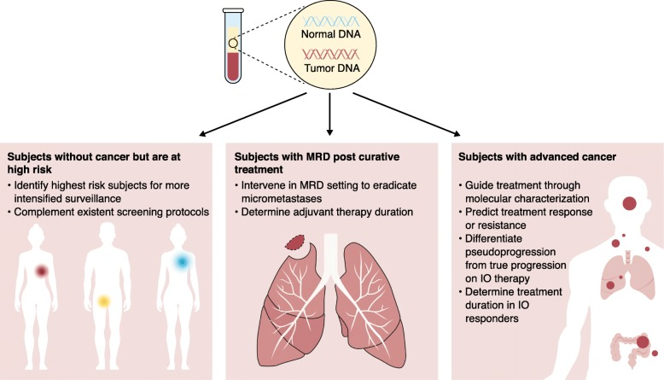
Broad range of application for liquid biopsies in clinical trials
Araujo DV, Bratman SV, Siu LL. Genome Med. 2019;11(1):22.
Notes:
17530/865

Slide 21
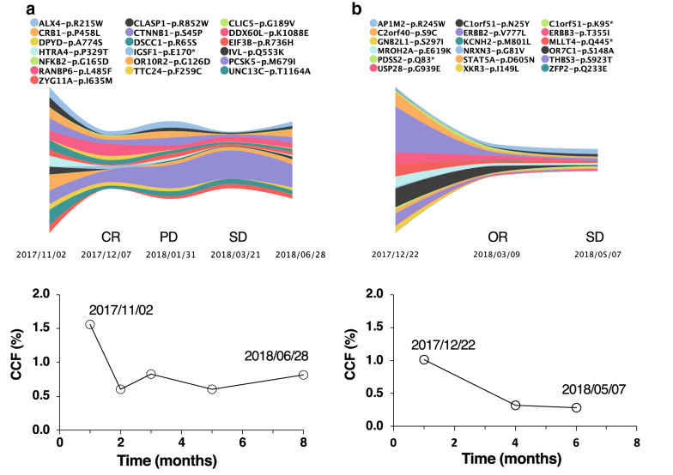
Monitoring treatment response and tumor dynamics
hepatocellular carcinoma
Breast cancer
Li J, Jiang W, Wei J, et al. J Transl Med. 2020;18(1):293.

Slide 22
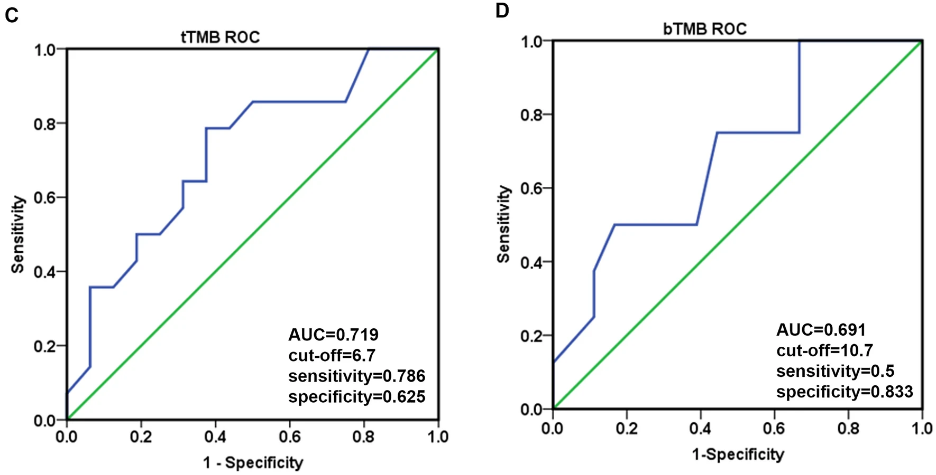
Liquid biopsy derived predictive biomarkers for immunotherapy
Chen X, Fang L, Zhu Y, et al. Cancer Immunol Immunother. 2021;70(12):3513-3524.

Slide 23
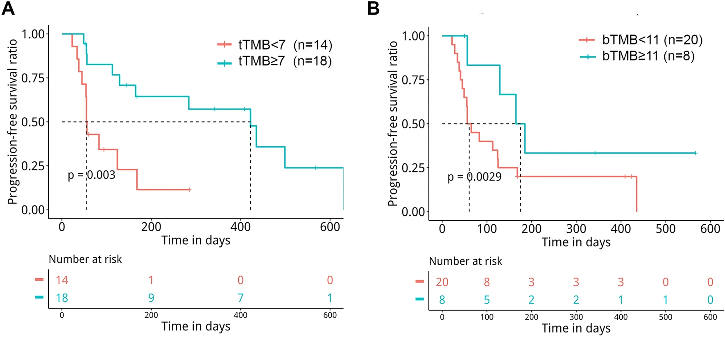
Liquid biopsy derived predictive biomarkers for immunotherapy 1
Chen X, Fang L, Zhu Y, et al. Cancer Immunol Immunother. 2021;70(12):3513-3524.

Slide 24
Summary
Despite great progress in oncology therapeutic development in recent years, curative interventions are rare, many patients do not respond, nearly all patients develop resistance, and many therapies are associated with serious toxicities
Current paradigm in oncology therapeutic development is focused on advanced disease where tumors are heterogenous, gnomically complex, and hard to treat
Liquid biopsy assays can help us move upstream in oncology therapeutic development where the chances of disease control and cure are the highest
Development and validation of intermediate endpoints crucial for cancer interception. Can learn from existing precedent.
Several use cases beyond cancer interception for liquid biopsies in clinical trials
  Highly personalized monitoring of tumor dynamics (response/progression)
  Predictive biomarkers for therapeutic development and clinical trial enrichment strategies

Slide 25
Thank you
Notes:
17530/865

