Slide 1
Cost Benefit Analyses for Liquid Biopsy Studies
December 16, 2021

Slide 2
Outline
Health Economics and Decision Making
Clinical Utility of Liquid Biopsies
Development of a Preliminary Liquid Biopsy CEA
Q&A

Slide 3
Health Economics and Decision Making

Slide 4
Health Economics and Economic Modeling
Economic Evaluation
The underlying goal in any health care decision is to attain maximal health benefit for a given budget [1]
Health economics and health economic modeling provide an evidence-based framework to help make decisions under resource constraints.
Healthcare decision making in the US currently does not formally consider such models, but most health plans and formulary managers do have an interest in economic evaluation and they still can influence clinical guidelines.[2]
Economic Models
Models are simplifications of real world concepts or processes
Models are created to view, manipulate, or test the thing that they represent
A cost-effectiveness analysis (CEA) is a common type of health economic evaluation, typically used when comparing interventions or strategies
[1]. Ryder, H.F., et al., Decision Analysis and Cost-effectiveness Analysis. Seminars in spine surgery, 2009. 21(4): p. 216-222.
[2]. Peter J. Neumann, S., Why Don"t Americans Use Cost-Effectiveness Analysis? The American Journal of Managed Care, 2004. 10(5).

Slide 5
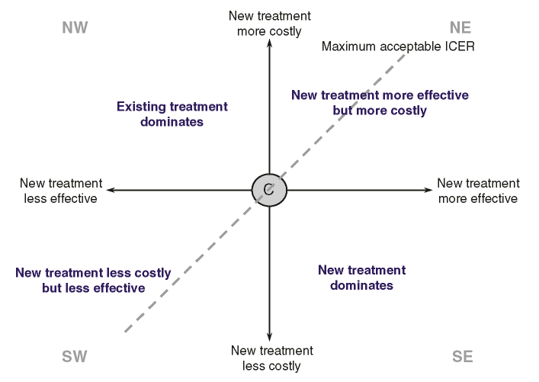
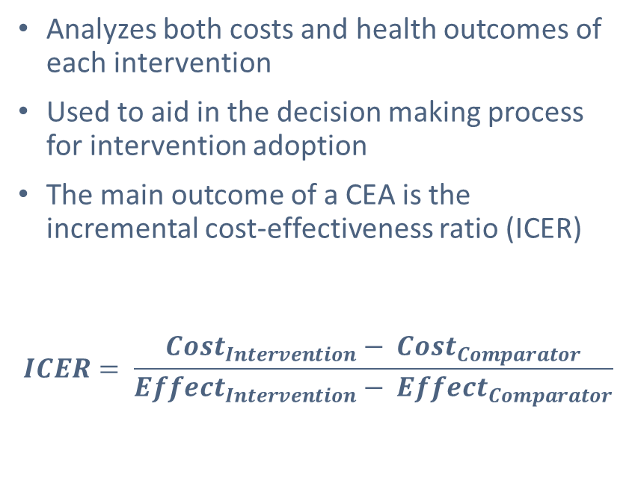
Cost-Effectiveness Analyses
Analyzes both costs and health outcomes of each intervention
Used to aid in the decision making process for intervention adoption
The main outcome of a CEA is the incremental cost-effectiveness ratio (ICER)
$$ICER= \frac{{Cost}_{Intervention}− {Cost}_{Comparator}}{{Effect}_{Intervention}− {Effect}_{Comparator}}$$

Slide 6
Cost-Effectiveness of Liquid Biopsies
Ijzerman et al. identified 3 early health economic studies which have evaluated the cost-effectiveness of liquid biopsies [1]
  Degeling et al. concluded that there is potential to avoid overtreatment and reduce healthcare costs through the use of CTCs to determine progressive diseases in metastatic castration-resistant prostate cancer [2]
  Kapoor et al. found that a cost of $200 would be cost-effective for an miRNA blood-based test to screen for gastric cancer [3]
  Sánchez-Calderón et al. found a comprehensive ctDNA panel to determine treatment resistance in HER2-positive breast cancer to be not cost-effective [4]
[1] Ijzerman., et al., Towards Routine Implementation of Liquid Biopsies in Cancer Management: It Is Always Too Early, until Suddenly It Is Too Late. Diagnostics (Basel), 2021. 11(1).
[2] Degeling, K., et al., Comparison of Timed Automata with Discrete Event Simulation for Modeling of Biomarker-Based Treatment Decisions: An Illustration for Metastatic Castration-Resistant Prostate Cancer. Value Health, 2017. 20(10): p. 1411-1419.
[3] Kapoor, R., et al., Evaluating the Use of microRNA Blood Tests for Gastric Cancer Screening in a Stratified Population-Level Screening Program: An Early Model-Based Cost-Effectiveness Analysis. Value Health, 2020. 23(9): p. 1171-1179.
[4] Sánchez-Calderón, D., et al., Analysis of the Cost-Effectiveness of Liquid Biopsy to Determine Treatment Change in Patients with Her2-Positive Advanced Breast Cancer in Colombia. Clinicoecon Outcomes Res, 2020. 12: p. 115-122.
Notes:
[1] MJ, I.J., et al., Towards Routine Implementation of Liquid Biopsies in Cancer Management: It Is Always Too Early, until Suddenly It Is Too Late. Diagnostics (Basel), 2021. 11(1).
[2] Degeling, K., et al., Comparison of Timed Automata with Discrete Event Simulation for Modeling of Biomarker-Based Treatment Decisions: An Illustration for Metastatic Castration-Resistant Prostate Cancer. Value Health, 2017. 20(10): p. 1411-1419.
[3] Kapoor, R., et al., Evaluating the Use of microRNA Blood Tests for Gastric Cancer Screening in a Stratified Population-Level Screening Program: An Early Model-Based Cost-Effectiveness Analysis. Value Health, 2020. 23(9): p. 1171-1179.
[4] Sánchez-Calderón, D., et al., Analysis of the Cost-Effectiveness of Liquid Biopsy to Determine Treatment Change in Patients with Her2-Positive Advanced Breast Cancer in Colombia. Clinicoecon Outcomes Res, 2020. 12: p. 115-122.

Slide 7
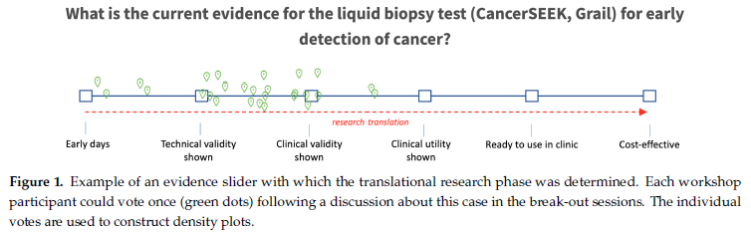
Current Evidence
Ijzerman., et al., Towards Routine Implementation of Liquid Biopsies in Cancer Management: It Is Always Too Early, until Suddenly It Is Too Late. Diagnostics (Basel), 2021. 11(1).
Notes:
MJ, I.J., et al., Towards Routine Implementation of Liquid Biopsies in Cancer Management: It Is Always Too Early, until Suddenly It Is Too Late. Diagnostics (Basel), 2021. 11(1).

Slide 8
Clinical Utility of
Liquid Biopsies

Slide 9
Liquid Biopsy Advantages and Applications
Advantages
Noninvasive and an alternative for more inaccessible tumors
Quicker
Less expensive
Applications [1]
Cancer screening programs
Improved tumor staging
Response monitoring
Treatment targeting following genomic profiling
[1] Ijzerman., et al., Towards Routine Implementation of Liquid Biopsies in Cancer Management: It Is Always Too Early, until Suddenly It Is Too Late. Diagnostics (Basel), 2021. 11(1).
Notes:
[1] MJ, I.J., et al., Health economic impact of liquid biopsies in cancer management. Expert Rev Pharmacoecon Outcomes Res, 2018. 18(6): p. 593-599.

Slide 10
Cancer Screening Programs
Routine Screening
True Positive
True Negative
False Positive
False Negative
The use of liquid biopsies as a supplement in a cancer screening program would improve the sensitivity of the screening program.
More true positive results and less false positives
This translates to earlier detection, quicker treatment, better outcomes, and reduced imaging and diagnosis costs

Slide 11
Improved Tumor Staging
Liquid biopsy generated evidence on micro metastasis
Guides and informs systemic therapy
More optimal resource allocation
Reductions in over and under treatment

Slide 12
Response Monitoring
Liquid biopsies can be used to initiate and serially monitor treatment response to inform decisions. [1]
Changes in CTC or ctDNA levels thorugh serial monitoring is correlated with tumor size and survival outcomes offering prognostic benefits. [2]
Potential Health Economic benefits:
Inform treatment decisions or discontinuation
Reduction in treatment related adverse event and improved outcomes
[1] Ijzerman., et al., Health economic impact of liquid biopsies in cancer management. Expert Rev Pharmacoecon Outcomes Res, 2018. 18(6): p. 593-599.
[2] Tay, T.K.Y. and P.H. Tan, Liquid Biopsy in Breast Cancer: A Focused Review. Arch Pathol Lab Med, 2021. 145(6): p. 678-686.
Notes:
[1] MJ, I.J., et al., Health economic impact of liquid biopsies in cancer management. Expert Rev Pharmacoecon Outcomes Res, 2018. 18(6): p. 593-599.
[2] Tay, T.K.Y. and P.H. Tan, Liquid Biopsy in Breast Cancer: A Focused Review. Arch Pathol Lab Med, 2021. 145(6): p. 678-686.

Slide 13
Development of a Preliminary Liquid Biopsy CEA in Breast Cancer

Slide 14
Model Goals
Objective
To provide a preliminary direct economic argument for the use of liquid biopsies in breast cancer diagnosis, staging, and response, through a simplistic decision analytic model.
Hypothesis
The use of liquid biopsies as a supplement to the current standard of care for breast cancer in diagnosis, tumor staging, and response will be cost-effective.

Slide 15
Early Conceptual Model
Population
Diagnostics
Diagnostic Outcomes
Treatment
Primary Outcomes
TP
$
$
Personalized Treatment
Liquid Biopsy
$
Survival and HRQoL
At Risk Individuals
TN
Cancer Patients
$
FP
$
$
Standard of Care
$
Standard
of Care
Adverse Events
$
FN
$
Costs
Survival and Quality of Life

Slide 16
Model Overview
Model Type: Decision analytic Markov model
Population: Healthy women eligible for breast cancer screening
Time Horizon: Lifetime
Cycle Length: 1-Year
Intervention: Liquid Biopsies
Comparator: Current standard of care (SOC)
  Screening: Annual mammography
  Staging: Tissue biopsy
  Response: Conventional molecular target treatment

Slide 17
Breast Cancer Natural History Model
Model Inputs
  Incidence Rates
  Transition rates
  Stage distribution
  Survival by stage and age
  Screening pattern
  Sensitivity estimates
  Costs
  HRQoL estimates
Cancer Free
Asymptomatic Breast Cancer
Invasive
Breast Cancer
Cancer Death
Other Death
A review of the CISNET Model Registry served as a foundation for structural choices.[1] The CISNET-DFCI model was utilized as the basis for the current model due to its simplicity and ease of replication.[2]
[1] CISNET Model Registry. [cited 2021; Available from: https://resources.cisnet.cancer.gov/registry/home/.
[2] CISNET-DFCI (Dana-Farber). [cited 2021; Available from: https://resources.cisnet.cancer.gov/registry/packages/cisnet-dfci-dana-farber/#basics.
Notes:
[1] CISNET Model Registry. [cited 2021; Available from: https://resources.cisnet.cancer.gov/registry/home/.
[2] CISNET-DFCI (Dana-Farber). [cited 2021; Available from: https://resources.cisnet.cancer.gov/registry/packages/cisnet-dfci-dana-farber/#basics.

Slide 18
Breast Cancer Natural History Model
ctDNA +
Invasive
Breast Cancer
ctDNA -
Patients in the invasive breast cancer stage are stratified by ctDNA status, guiding treatment and impacting outcomes, as well as costs.

Slide 19
Primary Assumptions
The primary model assumptions are similar to those used in the CISNET-DFCI model:
Breast cancer is a progressive disease
Early detection reduces disease severity
Survival is dependent on whether the cancer is interval detected or screen detected
Screening sensitivity of mammography is dependent on age and breast density
Stratification of ctDNA allows for improvements in patient triaging leading to reductions in mortality and costs

Slide 20
Key Model Inputs
Input | Value | Source
Cost of liquid biopsy screening test | $500 | Expert estimate
Cost of liquid biopsy therapeutic determination test | $1800 | Expert estimate
Health state utility values | 0.6 - 1.0 | Mandelblatt et al.
Discount rate (health and cost) | 3% | Standard
Breast cancer incidence | Age dependent | SEER Cancer Statistics Review
Breast cancer mortality | Stage and age dependent | SEER Cancer Statistics Review
Background mortality | Age dependent | U.S. female life table (CDC)
Time horizon | Lifetime

Slide 21
Preliminary Model Results
We identified moderate clinical benefits in terms of Life years and quality of life
The liquid biopsy arm of the model had slightly higher testing costs.
Therefore, preliminary estimates of an ICER were greater than the typical willingness to pay threshold of $100,000/QALY

Slide 22
General Implications
There is currently substantial uncertainty in estimating the health economic potential of liquid biopsies [1]
Key next step in modeling is to devote greater efforts to capturing clinical benefit
There is great potential for liquid biopsies to reduce healthcare costs and improve patient outcomes
Early stage models can help identify viable and cost-effective applications of liquid biopsies
Further modeling efforts can help to identify the key drivers of cost-effectiveness, as well as optimal use cases for liquid biopsies
Alternative funding models (e.g. bundled payments) may help with coverage of new tests
[1] Ijzerman., et al., Towards Routine Implementation of Liquid Biopsies in Cancer Management: It Is Always Too Early, until Suddenly It Is Too Late. Diagnostics (Basel), 2021. 11(1).

Slide 23
Q&A

