Slide 1
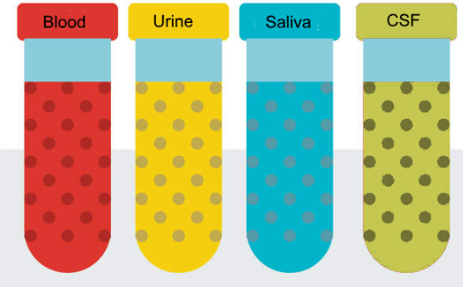
National Cancer Institute Symposium on Charting the Course of Liquid Biopsy in Precision Prevention and Treatment
December 15-16, 2021
Johns Hopkins
MGH
MGH
Washington U
UCLA
Yale

Slide 2

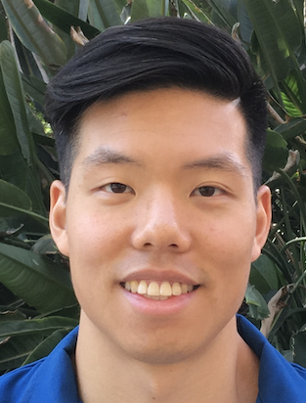
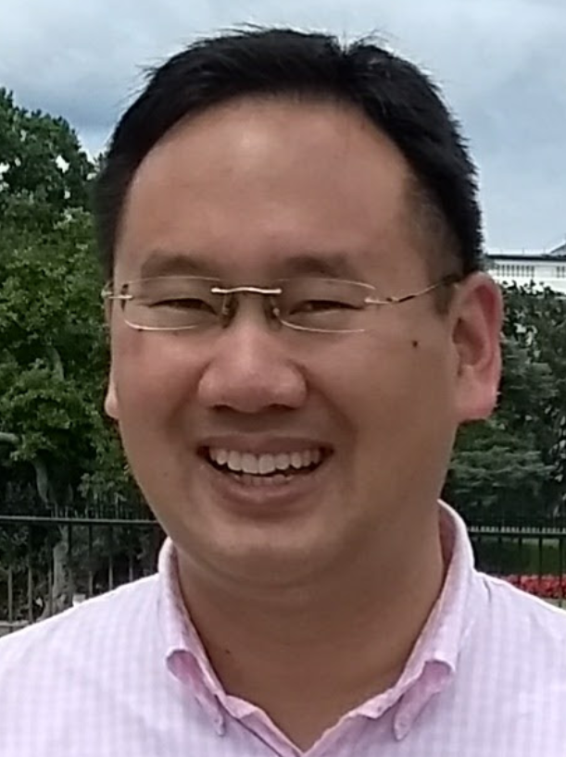
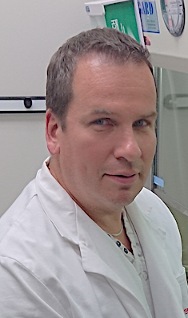

EFIRM Liquid Biopsy (eLB):
Malignancy Assessment in Indeterminate Pulmonary Nodules (IPN)
Charles (Buck) Strom
MD, PhD
Michael Tu PhD
Denise Aberle Fereidoun Abtin Scott Oh
MD MD MD, DO
Fang Wei PhD Jordan Cheng DMD David Wong DMD, DMSc
David Elashoff PhD Tristan Grognan MS
Kostyantyn
Krysan PhD
Steven Dubinett, MD Rena Xian MD
Johns Hopkins
MGH
MGH
Washington U
Yale
Hua-Jun He PhD
Kenneth Cole PhD
CA U01 233370
Lynn Sorbara PhD
Sudhir Srivastava PhD, MPH

Slide 3
CT Screening for Lung Cancer

Slide 4
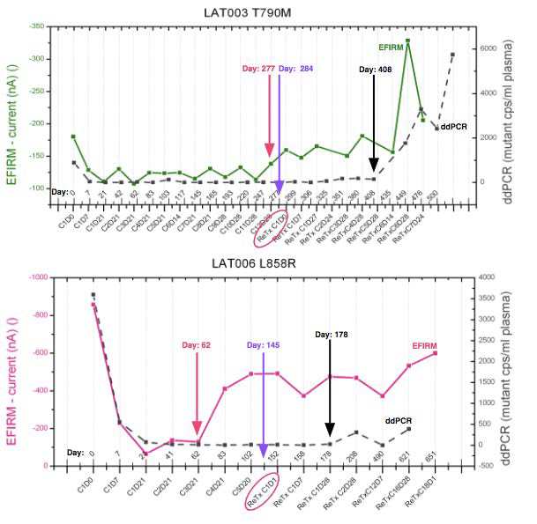
Saliva and plasma profiles of EGFR ctDNA in 2 lung cancer patients with baseline T790M and L858R mutations
Longitudinal circulating tumor DNA (ctDNA) analysis of blood and saliva predicts osimertinib response and disease progression in EGFR-mutant non-small-cell lung cancer (NSCLC)
U. Guha MD, PhD
NCI/NIH Clinical Research Center
Kim C, Xi L, Cultraro CM, Wei F, Jones G, Cheng J, Shafiei A, Pham TH, Roper N, Akoth E, Ghafoor A, Misra V, Monkash N, Strom C, Tu M, Liao W, Chia D, Morris C, Steinberg SM, Bagheri H, Wong DTW, Raffeld M, Guha U. Longitudinal Circulating Tumor DNA Analysis in Blood and Saliva for Prediction of Response to Osimertinib and Disease Progression in EGFR-Mutant Lung Adenocarcinoma. Cancers (Basel). 2021;13(13). Epub 2021/07/21. doi: 10.3390/cancers13133342. PubMed PMID: 34283064; PMCID: PMC8268167.
Notes:
Figure 4. Saliva and plasma profiles of EGFR ctDNA in 2 lung cancer patients with baseline T790M and L858R mutations respectively. A) Patient with EGFR T790M mutations: saliva detected surge of T790M on Day 277, CT detected tumor progression on Day 284 (clinical recurrence). Re-treatment to clinical recurrence (ReTx) was instigated on Day 299. Plasma ddPCR did not detect T790M surge until Day 408, 131 day later than EFIRM. B) Patient with L858R mutation: saliva detected surge of L858R on Day 62, CT detected tumor mass expansion on Day 145 (clinical recurrence). Re-Treatment was instigated on Day 152 (ReTx). Plasma ddPCR did not detect mild L858R surge till Day 178, 161 days after EFIRM. EFIRM detected surge of respective ctDNA targets advance of CT by 7 and 83 days; advance of ddPCR by 131 and 116 days.

Slide 5
Thank You!
Johns Hopkins
MGH
MGH
Washington U
UCLA
Yale

