Slide 1
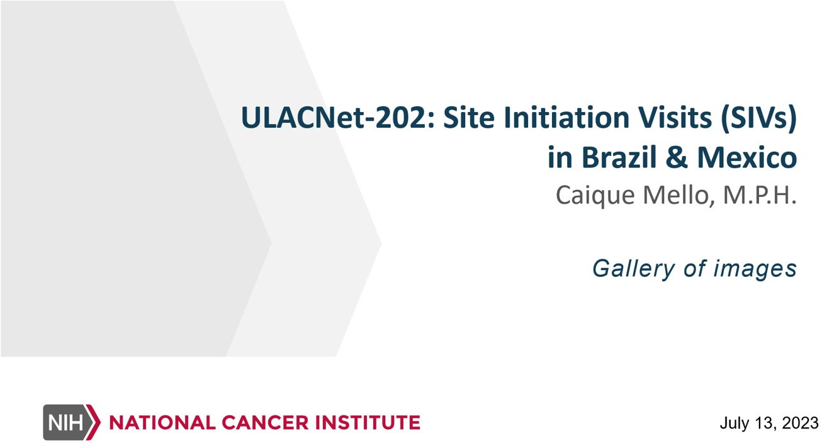
ULACNet-202: Site Initiation Visits

Slide 2
ULACNet-202: Site Initiation Visits (SIVs) in Brazil & Mexico
The ROCCHHA team has been energized to begin trial activities for ULACNet-202, entitled, “Optimization of Cervical Cancer Screening Among Women Living with HIV in Latin American Countries”. For over a year, the team has been working tirelessly to fine tune elements of our protocol and workflow, procuring supplies, and seeking the necessary approvals from local-institutional bodies, as well as those on the federal and international levels.
Once we had our ducks in a row, it was finally time to visit our ULACNet-202-participating sites at the Universidade de São Paulo (University of São Paulo or USP), Brazil and the Instituto Nacional de Salud Pública (National Institute of Public Health or INSP), Mexico. For those at Weill Cornell and Moffitt, this would be the first time visiting these sites within the context of our ULACNet trials. Due to the COVID-19 pandemic, the ROCCHHA group was never able to conduct in-person site initiation visits (SIVs) to the Brazil or Mexico sites for ULACNet-201. For myself specifically, this was also the first time I would be meeting many on the team personally since joining back in January 2022.

Slide 3
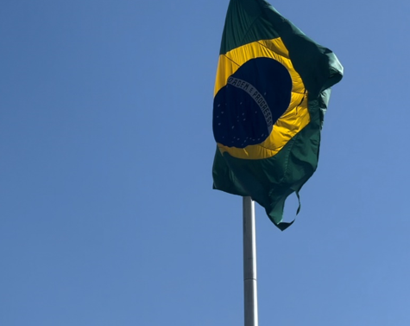
In Brazil
In the last several months, I worked with the site leads to coordinate all the many moving parts of an international trip: flights, hotels, and transportation accommodations, agendas and training materials, and my favorite part, the food. The first stop on our ULACNet-202 SIV journey was with our Brazil team in the amazing city of São Paulo.

Slide 4
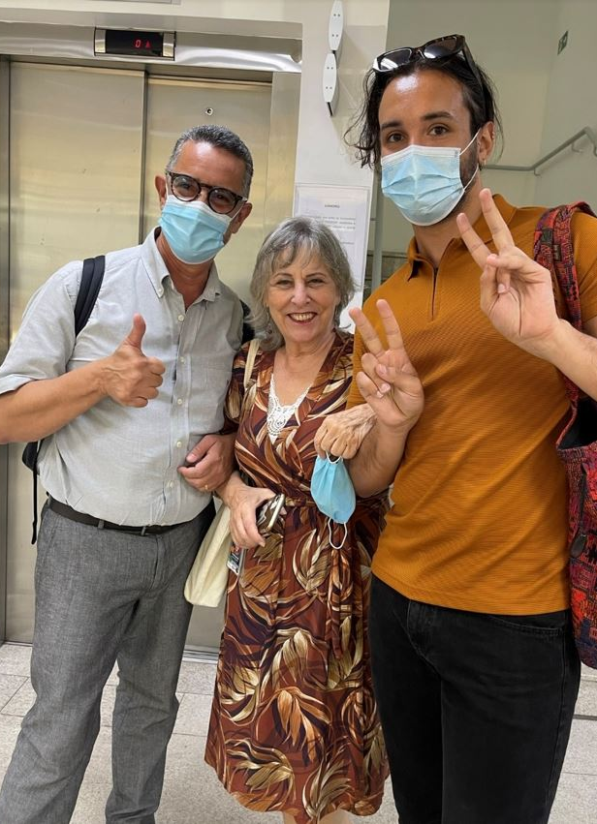
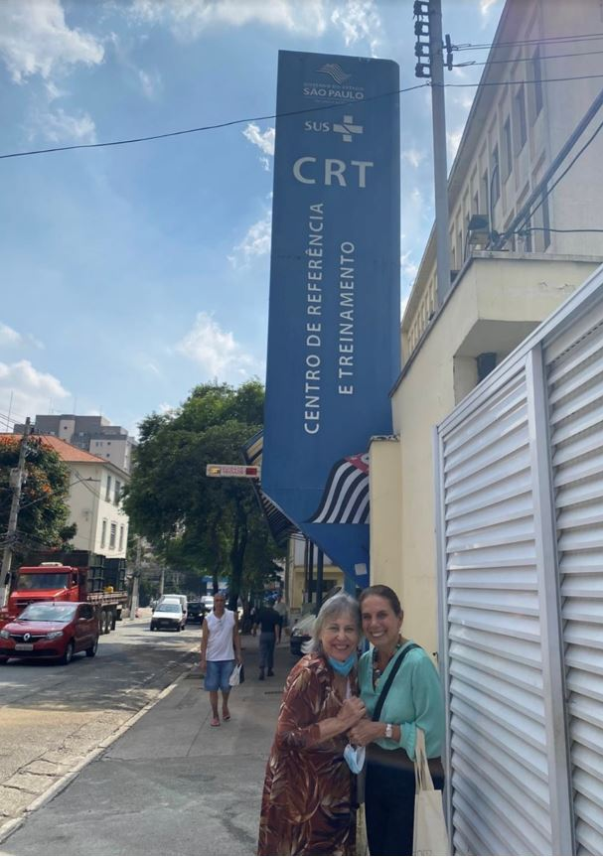
Clinic tours
We had a packed itinerary as soon as we stepped in the country. For ULACNet-202 at USP, we will be recruiting participants in completely new clinics from where we enrolled in ULACNet-201. While ULACNet-201 recruited from a research-designated clinic, our ULACNet-202 sites will be enrolling participants from both HIV/AIDS and gynecology clinics.
During our visit, we got to tour each of these clinics and hospitals and meet the new staff that will be joining the team on this effort. We discussed the unique patient populations, space capacity and limitations, operational workflows of each clinic, and how we plan to incorporate ULACNet-202 into this dynamic.

Slide 5
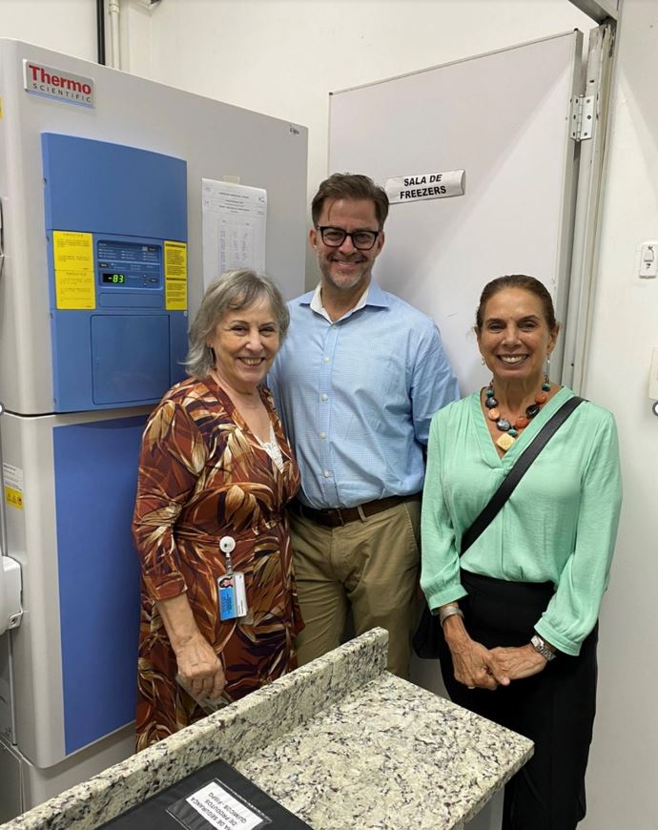
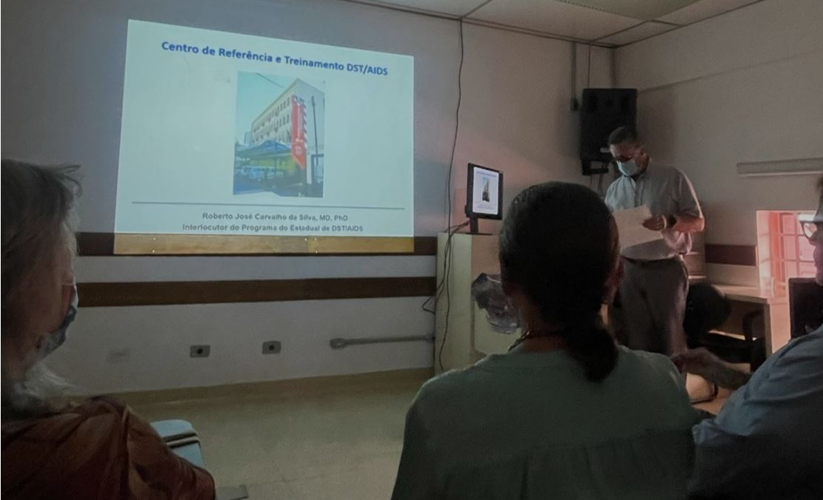
Dr. Villa’s Laboratory
One space that was of added interest was Dr. Villa’s laboratory. With a new Gene Xpert machine and tons of freezer space, her laboratory will take on an increased role as the ULACNet-202 biorepository for archiving specimens for future research purposes.

Slide 6
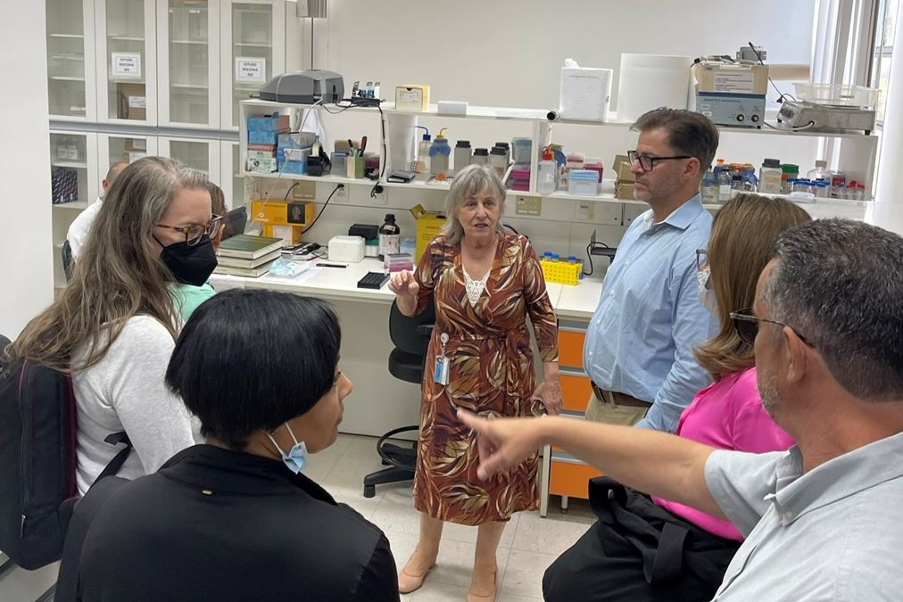
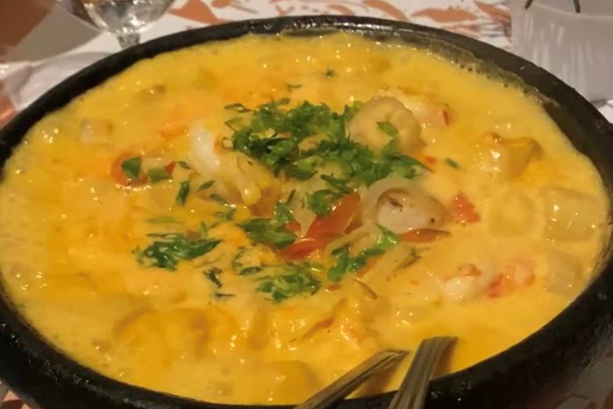
Team building opportunities
No trip is complete with the ROCCHHA group without our fair share of team building opportunities. With each day of training, we always came together to share a meal together. Dr. Villa kindly coordinated every dining experience. My favorite meal was the moqueca, a typical dish in Brazil that combines origins of indigenous, African, and Portuguese elements in one delicious and warmly soothing seafood stew.

Slide 7
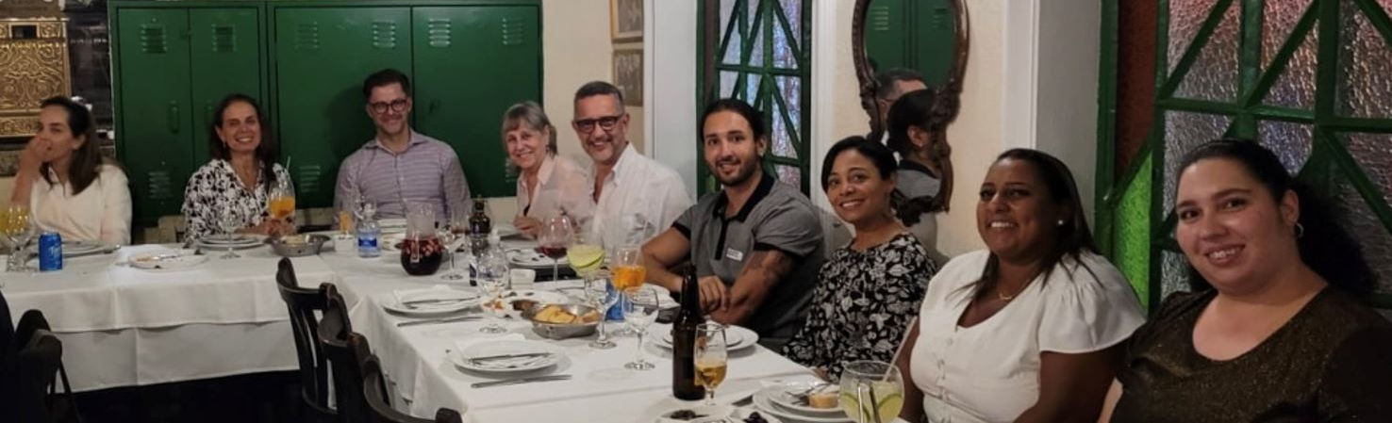
Meals shared
One meal we had at the top floor of USP, which is also the highest building in all of São Paulo. The city of São Paulo stretches over an area of about 590 mi² with 12.3 million people. By comparison, New York City (NYC) encompasses an area of about 303 mi², with a population of about 8.5 million people. According to 2018 UN Population estimates, São Paulo is the 4th largest city in the world by population – the largest in the western hemisphere! So, when we ate at the top floor of the hospital cafeteria, you could see how far and wide the city of São Paulo stretched.

Slide 8
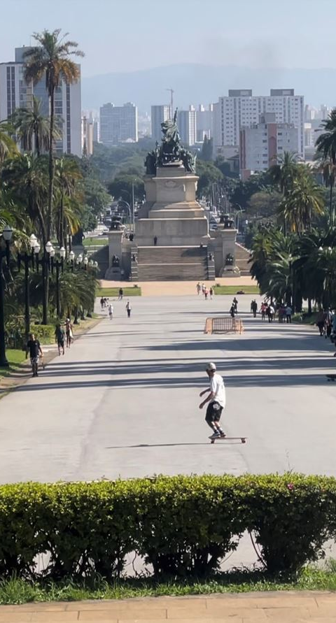
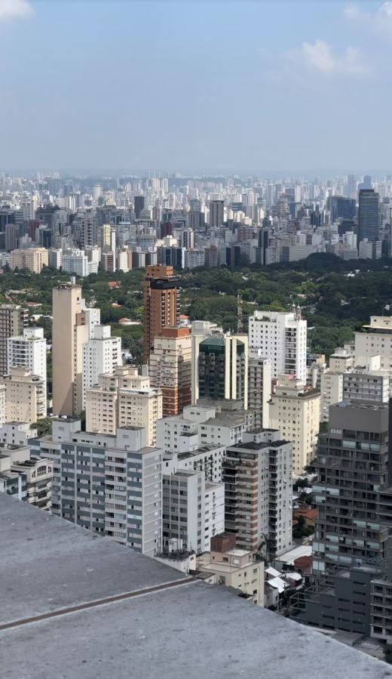
Landmarks visited
We concluded our visit with sightseeing some of the landmarks around the city, including Parque Ibirapuera (Ibirapuera Park), what I would consider São Paulo’s equivalent to Central Park, and the much smaller Parque da Independência (Independence Park) that houses the Ipiranga Monument. This monument was built as a celebration of the 100 years of Brazil’s independence at the exact location where Prince Regent Dom Pedro declared sovereignty for Brazil from his royal family back in Portugal.

Slide 9
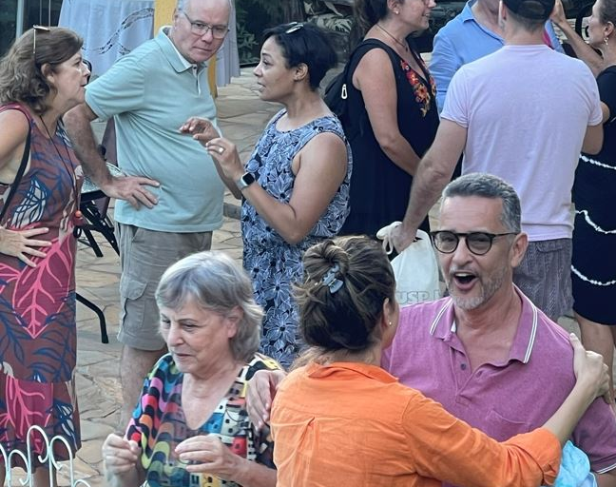
Brazilian barbeque
We also celebrated the completion of our first partnership SIV with a traditional Brazilian barbeque at Dr. Villa’s beautiful summer home, decorated with so many unique knickknacks she’s collected over the years.

Slide 10
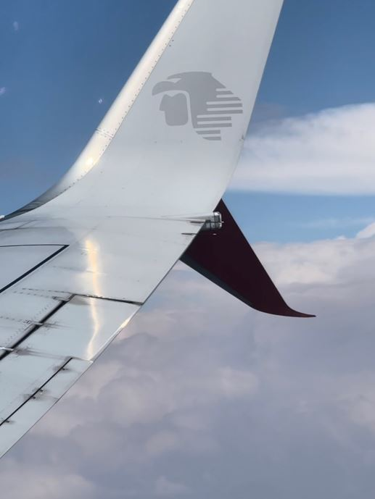
Flight to Mexico
Fast-forward a few months, and our team was now ready for our second SIV at our Mexico site. Fresh off the heels of our previous site visit in São Paulo, we had updated the agenda with some new activities and discussions.

Slide 11
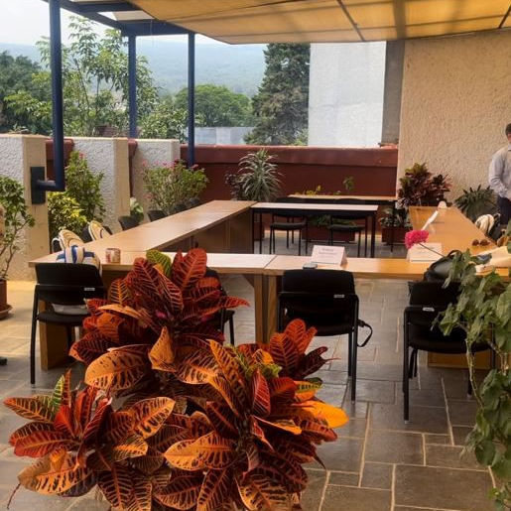
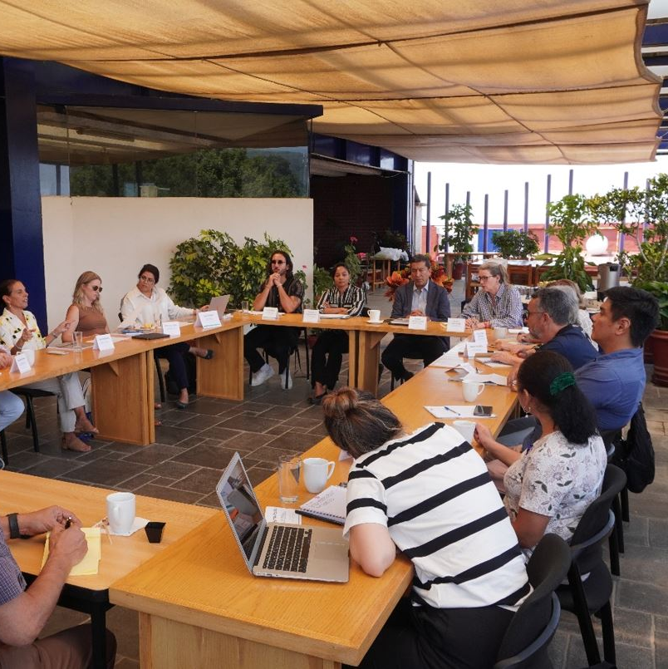
In Mexico
Upon arrival, I immediately began to feel the effects of the elevation. In comparison, NYC has an altitude of about 35 feet, while Mexico City’s (CDMX) is nearly 7,350 feet! We didn’t stay long in CDMX, however, as our main partner, INSP, is based in the city of Cuernavaca, about an hour and a half drive southwest from CDMX.
While visiting INSP, we got to tour the grounds, and see not only the spaces dedicated to the laboratory and processing for both our trials (ULACNet-201 and ULACNet-202), but also the beautiful sculptures and workspaces. In fact, we held one of our meetings in an outdoor-concept space with amazing foliage scattered throughout and a grand view of the mountains that surrounded the institute.

Slide 12
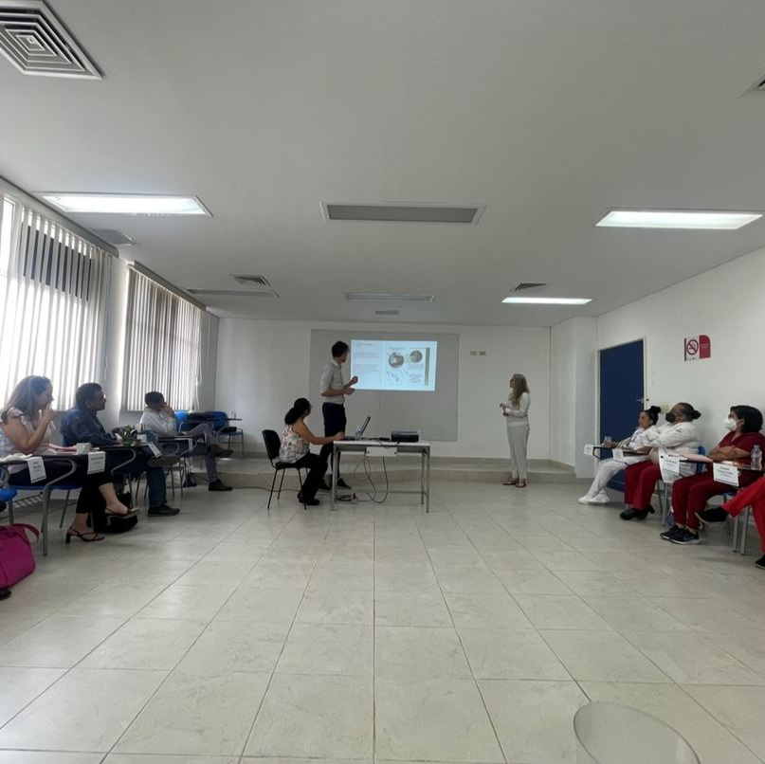
Recruitment clinics in Mexico
Similar to our Brazil site that will be introducing entirely new recruitment clinics, our Mexico team is also adding a new clinic in the city of Puebla (approximately 2 hours southeast of CDMX) for ULACNet-202. This new ambulatory clinic, Centro Ambulatorio para la Prevención y Atención al SIDA e Infecciones de Transmisión Sexual (CAPASITS), which per its name focuses on the prevention and treatment of HIV/AIDS and other STIs, will also be introduced for ULACNet-201, and we hope will be a fruitful site for enrollment for both trials.

Slide 13
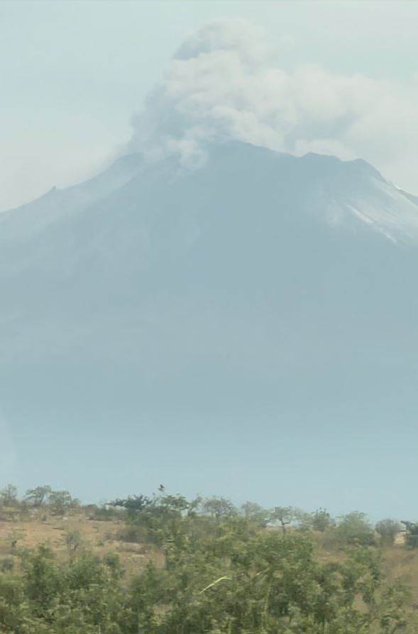
Popocatépetl Volcano
En route to the Puebla clinic, we were able to see the beautiful, and again very elevated, landscape of Mexico. Much of it is sacred land to the indigenous Mexican cultures. One geographical feature that was a first for me was Volcán Popocatépetl (Popocatépetl Volcano). The name Popocatépetl is an Aztec word for “smoking mountain.” In fact, we got to see it “smoking” during our drive, which much to our later chagrin caused global flight delays due to ash that was erupted into the air. But at the time it looked awesome!

Slide 14
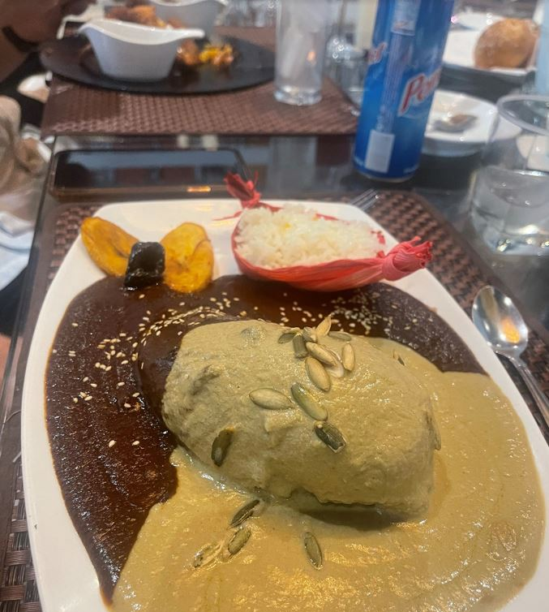
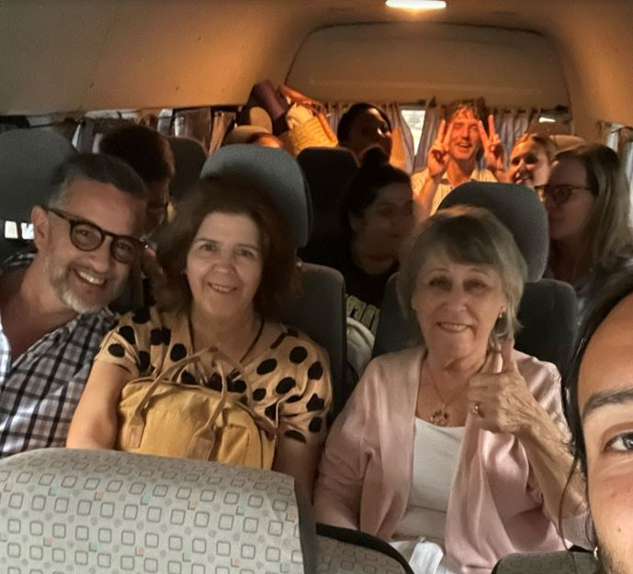
Team building and food
Like our visit to the Brazil site, our Mexico team did not disappoint when it came to both teambuilding and the food. We travelled closeknit from place to place in our van.
And as a dedicated fan of Mexican cuisine, this was another opportunity for me to try many of the rich food options that different regions of Mexico had to offer. One meal highlight was a chicken dish Dr. Villa ordered while we were in Puebla that featured not only the local staple, mole poblano, a savory chile and chocolate sauce, but also a mole verde (green mole) made from pumpkin seeds.

Slide 15
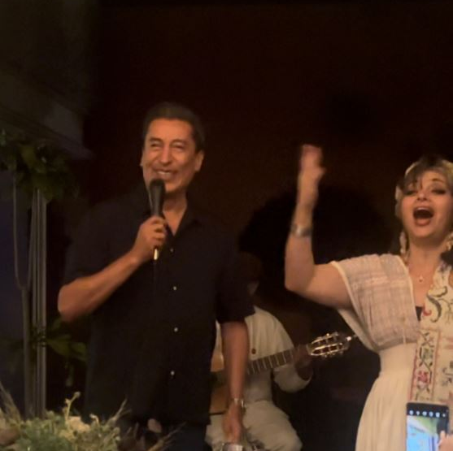
Entertainment by Director of INSP, Dr. Eduardo Lazcano Ponce
Capping off our visit to INSP, we were invited to dine at the home of our Co-PI and Director of INSP, Dr. Eduardo Lazcano Ponce. Not only was his home decorated with such beautiful art pieces, but he also invited an indigenous music duo to perform traditional songs. Much to my surprise and everyone’s entertainment, Dr. Lazcano Ponce joined in, and serenaded the whole group.

Slide 16
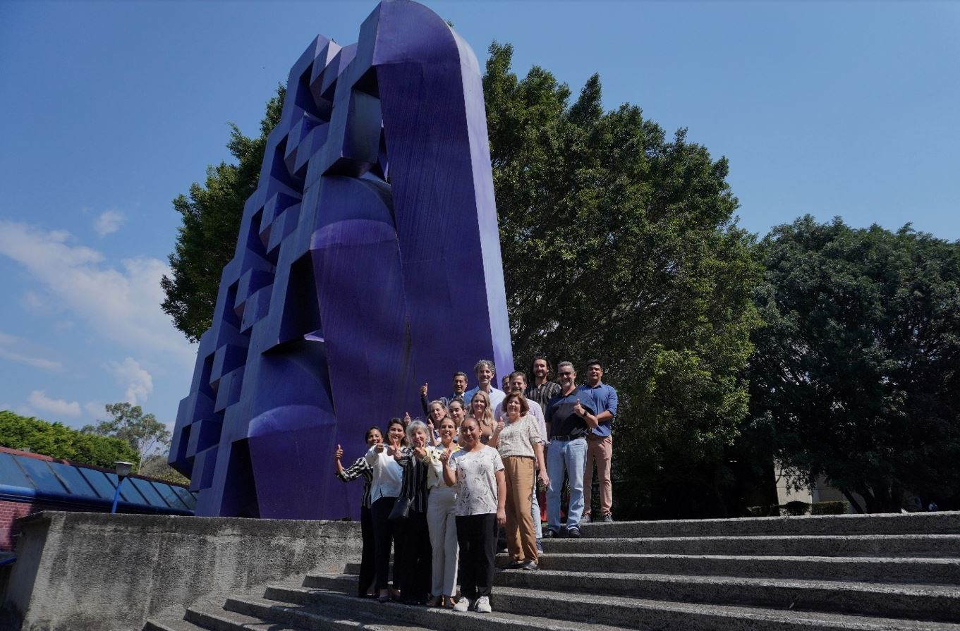
Group photo
Both our visits to Mexico and Brazil proved to be a great success in the lead up to our ULACNet-202 activation. The in-person component made it all the more fruitful for us as a team not only to visualize the spaces and meet the staff that will be working on this trial, but also in helping us grow stronger as a team with a clearer vision on how we move forward together as a partnership.

Slide 17
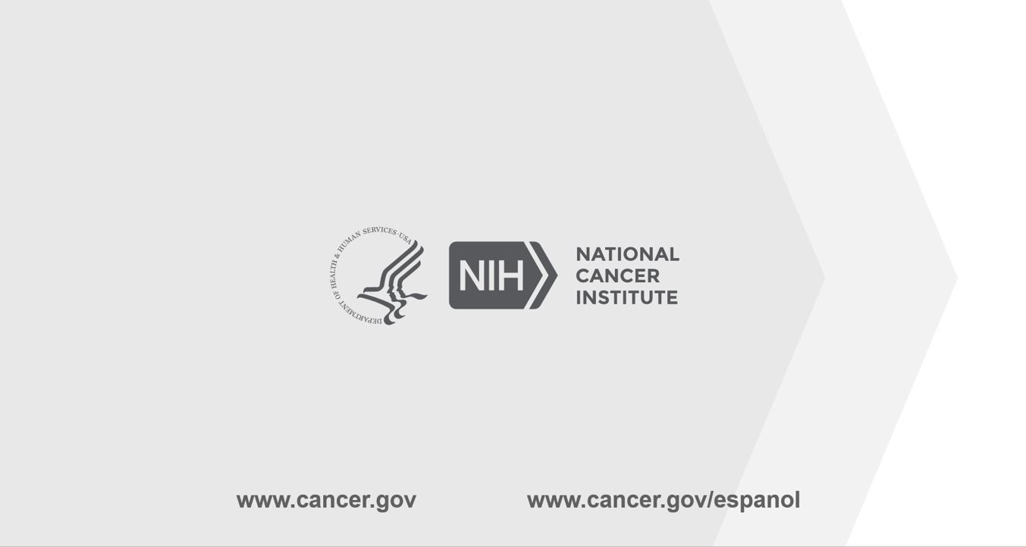
End slide

