Slide 1
Pre-Application Webinar for RFA-CA-23-040
Human Tumor Atlas Network (HTAN)
Precancer Atlas (PCA) Research Centers
Pre-Application Webinar for RFA-CA-23-040
The PCA webinar will start at 2:00 PM EST
All participants are muted upon entry to the webinar
Please submit your questions in the Q&A box
HTAN pre-application webinars will be recorded and posted on
https://www.cancer.gov/about-nci/organization/dcb/news/past-events
Notes:
Review the housekeeping items-
all participants muted upon entry to webinar,
submit questions to Q&A box
HTAN pre-application webinars will be recorded and posted on​ https://www.cancer.gov/about-nci/organization/dcb/news/past-events

Slide 2
Human Tumor Atlas Network (HTAN) Agenda for Precancer Atlas Orientation Meeting
Welcome to Orientation: Sudhir Srivastava
Overview of HTAN: Shannon Hughes
Overview of Precancer Atlas Program: Sudhir Srivastava
Guidance on Application Submission and Requirements: Indu Kohaar
Fielding of Question and Answers: Nick Hodges
NCI Program Officers: Indu Kohaar (Molecular), Nick Hodges (Technology), Sidney Fu (Clinical), Richard Mazurchuk (Imaging), Sean Hanlon (DCC-Data) and Sudhir Srivastava (Overall Program)
6. Next Step and Follow-up: All

Slide 3
The NCI Human Tumor Atlas Network (HTAN)
Overarching program goal: Construct dynamic 3D atlases of human cancers
Integrate molecular, cellular, and tumor tissue composition and architecture, including the microenvironment and immune milieu.
Describe transitions during cancer: pre-malignant lesions to malignancy, locally invasive to metastatic cancer, response to therapy.
Represent a diverse patient population, including underrepresented and underserved patients.
Enable predictive modeling to discover biomarkers, understand basic cancer mechanisms, (eventually) refine therapeutic choices for patients.
Rozenblatt-Rosen et al., Cell 2020

Slide 4
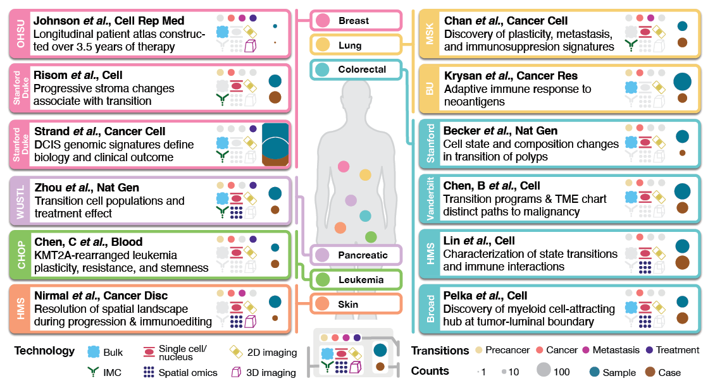
Current HTAN Atlases
Figure courtesy of L. Ding, WUSTL HTAN
Notes:
HTAN has published 12 precancer and tumor atlases describing the transition from precancer to full malignancy, from locally invasive to metastatic disease, and the development of therapy resistance. These atlases will be followed in the next 1.5 years by at least another 20 data and insight-rich atlases. The publications not only describe extensive datasets, but also provide biological insights.
In addition to the 12 main HTAN atlases, HTAN investigators have also contributed to an additional 149 manuscripts. About 40% of these manuscripts are focused on development of new single-cell data analysis techniques and integration approaches.

Slide 5
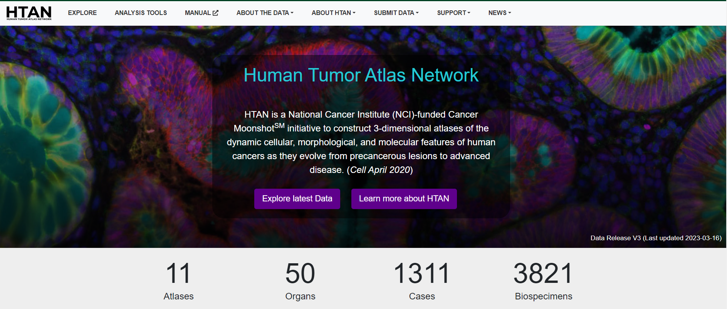
HTAN Data and Resources for the Cancer Research Community
https://data.humantumoratlas.org
Notes:
The HTAN program, in close collaboration with the NCI Cancer Research Data Commons, has worked very hard to make a wide variety of data available, including multiplexed tissue imaging data. The first stop to find all HTAN data is the HTAN data portal, which currently has made available data from ~1300 cases and ~4000 biospecimens.
HTAN data is released quarterly and significant amount of HTAN data has been available pre-publication.

Slide 6
HTAN Organization
HTAN Steering Committee
HTA
Research
Center
HTA
Research
Center
Components of the HTAN:
Human Tumor Atlas (HTA) Research Centers
RFA-CA-23-039 (U01)
Pre-Cancer Atlas (PCA) Research Centers RFA-CA-23-040 (U01)
HTAN Data Coordinating Center (DCC)
RFA-CA-23-041 (U24)
HTA
Research
Center
PCA
Research
Center
DCC
HTA
Research
Center
PCA
Research
Center
PCA
Research
Center
PCA
Research
Center
The number of HTA and PCA Research Centers will depend on availability of NCI FY24 funding.

Slide 7
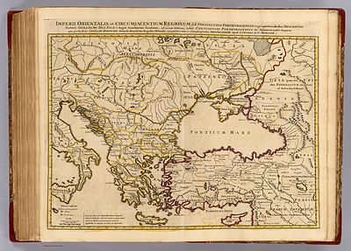
Human Tumor Atlas Network (HTAN) PreCancer Cancer Atlas Application's Orientation Meeting
Sudhir Srivastava, PhD, MPH
Indu Kohaar, PhD
Nicholas Hodges, PhD
Sidney Fu, MD
Richard Mazurchuk, PhD
All team members can be reached at NCI_HTAN_PCAU2C@mail.nih.gov

Slide 8
Purpose of Applicant’s Orientation
Purpose of this orientation is to discuss Notice of Funding Opportunity (NOFO) that solicits applications for HTAN Precancer Atlas (PCA) Research Centers to construct temporal-spatial atlases that comprehensively characterize a pre-malignant lesion with an explicit focus on understanding the transition from a precancerous lesion to malignancy
Applicants must consult RFA-CA-23-040 for detailed information on the scope of this RFA, application procedures and requirements, and review criteria

Slide 9
What is a Cancer Atlas?
In cancer, it is graphical representation of data in time and space.
In cancer, the type of data may include, but are not limited to:
Omics data
Immune cells data
Imaging Data
Clinical Data
A PreCancer Atlas is a gateway to comprehensive knowledge of alterations in microenvironment, including histological, pathophysiological and omics profiles, e.g., genomic, proteomic epigenomic, immune cells, etc. and their interplay that drive cancer progression at its earliest stages. PreCancer Atlas envisages systematic efforts to longitudinally collect and perform molecular and cellular profiling of premalignant lesions in time and space as they progress towards frank malignancy

Slide 10
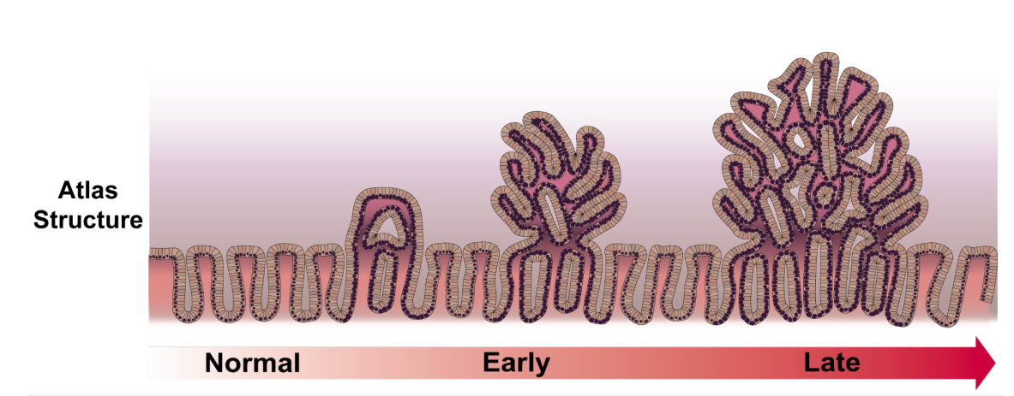
Why is Tumor Atlases Needed?
Diagnosis & Treatment
Early Detection & Interception
Prevention
Figure modified from Ken Lau Lab, Vanderbilt University

Slide 11
Precancer Atlas Overview
Atlas must address an important unmet clinical need
Define the overall significance of the proposal with vision and goals for the center
Describe the precancerous lesion atlas and how it will contribute to the understanding of the precancerous lesions and progression of precancerous lesions to invasive cancers.
Provide background and rationale for the selection of tissue type and outline the significance and potential impact provided by the atlas
Describe the planned final structure of the atlas, including Biospecimen, Molecular and Data functional units
Briefly describe how the atlas might be employed by the scientific and clinical communities
Provide one use case that illustrates how the proposed atlas datasets could be utilized to build a predictive model

Slide 12
Definition of Precancer
Precancerous lesions are regions of histologically and/or molecularly abnormal tissues that more often progress to invasive carcinoma than healthy or normal tissue.
Precancers can be defined as
lesions that may or are likely to progress to invasive cancer
lesions where there is clear evidence of an association with increased risk of invasive cancer
lesions which are different from normal cells and share molecular and phenotypic features with invasive cancer

Slide 13
PCA Research Centers
Undertake comprehensive characterization of human precancerous lesion/state and their surrounding microenvironment.
Focus on deriving insights from the most informative measures from bulk or single cell molecular analysis.
Collect at least two existing HTAN data types one must be a spatial assay. Additional data types that are appropriate and specific to the proposed research will be considered.
Atlases that add significant value to current HTAN atlases
Inclusion of diverse patient population (if possible)
When possible, include longitudinally collected specimens from the same patients where outcome can be evaluated.

Slide 14
Required Resources and Capabilities of the PCA Research Center
Access to high-quality, well-annotated premalignant biospecimens and reference controls
Strong clinical and research environment
Expertise and access to innovative technologies and instrumentation
Expertise in data analysis and atlas building activities
Demonstrated evidence for
understanding of the transition of precancerous lesions to invasive cancer,
generate testable hypotheses
potential to identify markers for risk, early detection and preventive intervention.

Slide 15
Proposed Research on Organ Site(s) Must Meet The Following
Impact on Public Health: The proposed atlas should have the potential to have a substantial impact on clinical decision-making, as determined by public health burden, and high-risk populations.
Access to Technologies and Biospecimens: The applicants must have access to state-of-the-art technologies and the resources to obtain well-characterized and well-annotated biospecimens (cross-sectional and longitudinal).
Feasibility of Atlas Construction: The feasibility of atlas construction is based on the available cohorts, number of available biospecimens, rate of progression to cancer and available tools and technologies.
Synergistic Partnerships for Maximizing Resources: The ability to partner with ongoing initiatives (federal, foundation, industry, etc.) is vital as this will increase access to cohorts, technologies, and other resources necessary for atlas construction.

Slide 16
Expected Outcomes of PCA Research Center
Provide an improved understanding of disease initiation and progression
Characterize heterogeneity of pre-malignant lesions
Quantify the dynamics and multidimensional architecture of the tumor ecosystem during transition to malignancy (or regression)
Identify novel biomarkers for early detection, risk stratification and chemoprevention targets including somatic mutations; the interaction of germline mutations with somatic mutations, molecular changes that affect cellular fitness and immunity.
Facilitate predictive modeling of pre-malignant to malignant transition

Slide 17
PCA Research Center Organization
Molecular,
Cellular and
Spatial
Characterization
Biospecimen
Acquisition,
Processing
and Annotation
PCA
Research Center
Data Processing, Analysis, Modeling,
and Visualization
Scientific
Community
PCA Subcommittee: PCA
HTAN Steering Committee: HTAN
HTAN Research Centers
HTAN Data Coordinating
Centers (DCC)
NCI Cancer Research Data Commons

Slide 18
Biospecimen Acquisition, Processing and Annotation (Please review the PCA RFA for detailed information/functions)
Describe the methods used for the identification, collection, preservation, labeling, and quality control of all biospecimens used to construct the proposed atlas.
A biological and statistical justification for collection frequency, sample type, and volume of biospecimens to be acquired.
Evidence of access to human biospecimens relevant to the proposed atlas.
Information on quality assurance and quality control metrics employed to ensure high sample quality upon collection, after preservation, and upon pre-analytical processing.
A short description of retrospective human samples, non-human tissues and/or alternative in vivo and/or ex vivo human models that maybe used in the conduct of the proposed research.
Describe and, preferably, demonstrate through presentation of preliminary data strategies to minimize confounding variables during sample collection.

Slide 19
Molecular, Cellular, and Spatial Characterization
(Please review the PCA RFA for detailed information/functions)
Describe methods to characterize the biospecimens that will be used to develop the precancer atlas.
A biological and statistical justification for types and volumes of data to be acquired to construct the atlas.
Assay methods and platforms to be employed, their reproducibility and preliminary data that demonstrate their use within the context of the proposed atlas construction.
It is required that each atlas include at least two common HTAN data types (one must be a spatial data type) for which data and metadata standards have been developed.
A strategy to monitor and ensure data quality, including action plans for when quality issues are discovered.
The expected data collection workflow, QA/QC points, and potential challenges associated with the analysis of small or variable samples.

Slide 20
Data Processing, Analysis, Modeling, and Visualization
(Please review the PCA RFA for detailed information/functions)
Describe methods that will be used for data processing, analysis, modeling, and visualization of atlas data.
Existing or proposed data processing pipelines to be employed, specifically regarding imaging, spatial and omics data.
State the degree to which the resulting processed data meets the qualifications for findability, accessibility, interoperability, and reusability (FAIR) data sharing standards.
Plans for how the resulting human precancer atlas dataset can be utilized to build a predictive computational model of progression from a precancerous lesion to an invasive cancer.
Describe the clinical or biological insight that can be gained from the modeling effort and steps required to test hypotheses derived from the modeling effort.
Analytical flexibility and plans to aggregate and integrate data and metadata from the broad range of experimental and computational approaches.

Slide 21
Governance
HTAN Steering Committee will provide oversight of HTAN collaborative activities, data sharing, data deposition to the HTAN-DCC.
PCA Sub-Committee composed of all PCA Research Centers PIs will focus on scientific, programmatic, and administrative directions for PCA. The Sub-committee will integrate the efforts of all PCA Centers and will provide oversight of collaborative activities to be reported to HTAN Steering Committee.

Slide 22
Non-Responsive Applications
The following types of applications are outside the scope of this NOFO and will not be reviewed.
Applications primarily focused on the pursuit of a biological mechanism through basic research that does not result in an atlas.
Applications focused on the progression of invasive cancer to metastasis are not responsive to this NOFO but may be responsive to RFA-CA-23-039 , U01 for HTA Research Centers.
Applications proposing atlases constructed through exclusive use of non-human biospecimens.
Applications based upon one experimental measurement and do not propose methods that provide multidimensional data/information regarding the spatial distribution of cellular and/or non-cellular components of the tumor.
Applications that propose to primarily study biofluids for identification of biomarkers without any attempt to reconstruct the multidimensional tumor ecosystem.
Applications that do not propose to collect at least two existing HTAN data types (at least one must be a spatial assay) for which data and metadata standards and levels exist,
Applications that are not able to satisfy current HTAN policies
Applications that do not include biospecimens representative of patient diversity in the United States, as required by NIH policy.

Slide 23
Award Information
Funding Mechanism: Cooperative Agreement (U01)
Budget:
should not exceed $800,000 per year in direct costs.
Commitment (minimum): Single PI applications: 1.8-person month per year; Multi-PD/PI applications: 1.2-person month per year to the award.
Set-Aside Funds for HTAN Pilot Projects and Trans-Network Projects (TNPs): Applicants must set aside 15% (Direct Cost) of their annual budget in Years 2-5 to facilitate the testing of hypotheses derived from atlas construction and to develop TNPs.
Support for Early-stage/Junior Investigators: The budget should include funds to enhance professional development of early-stage/junior investigators.
Travel Funds: Applicants must budget for travel and per diem expenses for biannual HTAN in-person meetings.

Slide 24
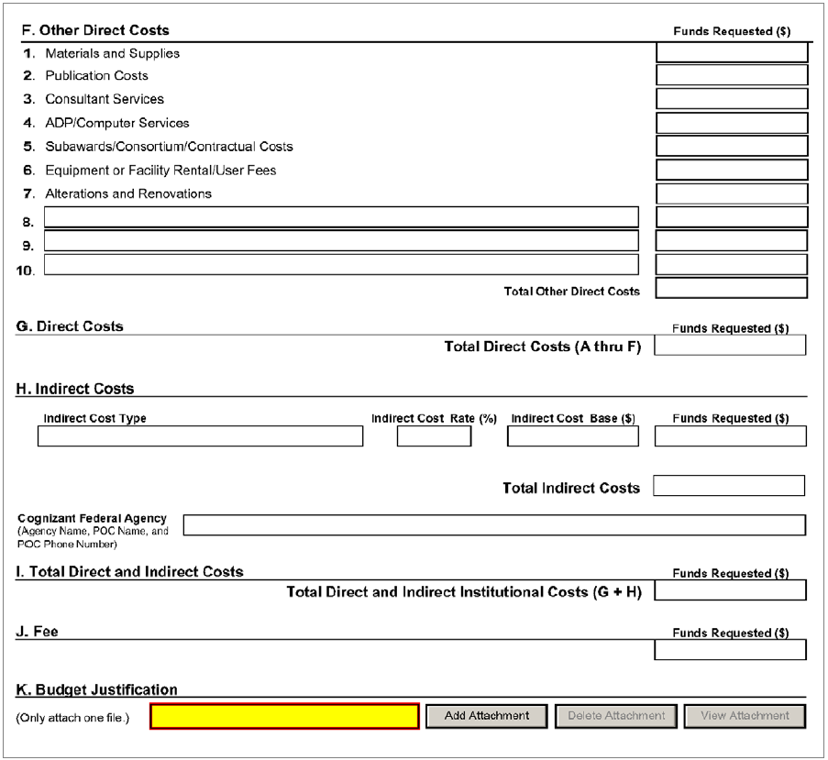
Where to Add the “Restricted Fund” Information in the Application
Consortium Collaborative Funds (15% of Direct Costs)
120,000
800,000
800,000
Do not include a description of pilot projects or TNPs within application

Slide 25
Research Strategy Section and Page Limitations
Applicants should use the following Research Strategy Subsections to present a concise plan for the proposed PCA Research Center.
All page limits described in the SF424 Application Guide must be followed, with an exception for the Research Strategy section. Research Strategy must not exceed 30 pages, but the program recommends (not required) the following page limits for each subsection:
Subsection A: Proposed Precancer Atlas Overview - 2 pages
Subsection B: Research Team - 2 pages
Subsection C: Integrated Functions of the PCA Research Center - 12 pages
Subsection D: Addressing Cancer Health Disparities - 1 page
Subsection E: Project Management Plan - 2 pages

Slide 26
Helpful Tips for Application
Please read the PCA RFA carefully to understand the requirements.
Applicants must highlight the integrated functions of the proposed activities that speak to the significance and innovation of the approach.
Please pay attention to review criteria, including the criteria listed in “Specific to this NOFO” section, to help you prepare a strong application.
For any specific questions, contact Program Directors listed on the RFA for guidance on your application.
Application due date: December 05, 2023
Award start date (earliest): July 2024

Slide 27
Frequently Asked Questions
Is there a requirement for an ESI to act as Co-PI?
No, the ESI may hold the title of Postdoctoral Fellow, Staff Scientist, Research Associate, Instructor, Assistant Professor, or equivalent and should be within 6-8-years following completion of a professional degree or subsequent mentored academic or clinical training program.
Are HTAN data subtypes limited to previously data subtypes?
Any data subtype may be utilized that would support the application. Two previously established data subtypes within HTAN must be included and one must be spatial.
How many samples must be included?
The number of samples and timepoints in longitudinal samples is dependent on study design.
Can PIs be members of another application or leverage other consortiums/grants?
Yes; however, the contact PI may not be a contact PI for another application.
Are specific aims required to be organized according to the three integrated functions of the PCA Research Center?
No. The three integrated functions must be included in the research strategy but are not required to be divided into individual specific aims.

Slide 28
Thank you!

