Slide 1
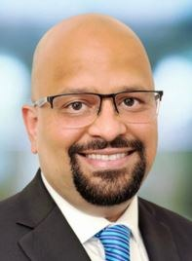
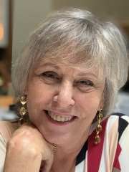
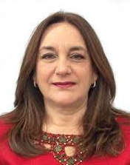
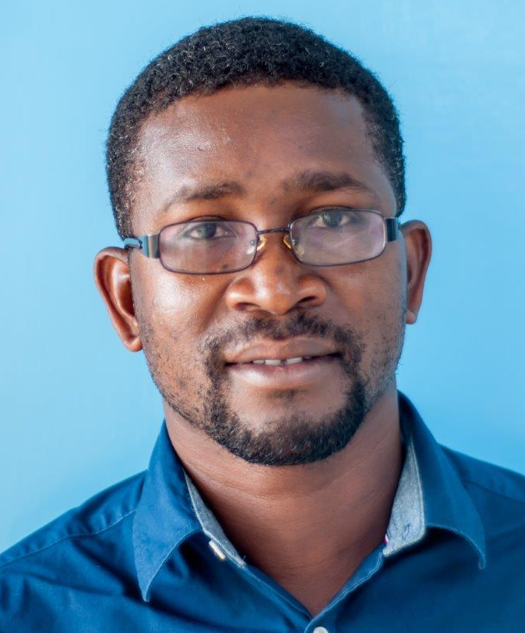
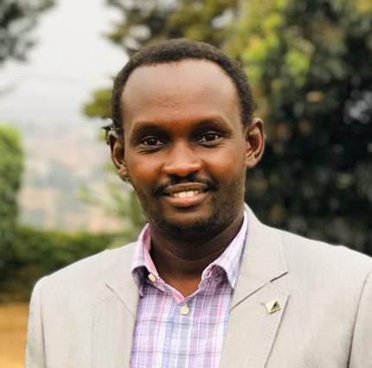
Special Interest Satellite Symposium at IPVC 2024
ULACNet and CASCADE: Equitable Partnerships for Clinical Trials on Pragmatic Interventions for HPV-related Screening and Precancer Treatment in People living with HIV
Chair(s): Vikrant V. Sahasrabuddhe (United States of America) and Leeya F. Pinder (United States of America)
Foundational vision, organizational linkages, and partnership development in ‘ULACNet’ and ‘CASCADE’: Vikrant V. Sahasrabuddhe (United States of America)
Innovations and technologies to improve and optimize cervical and HPV-related cancer screening and triage for persons living with HIV: Luisa L. Villa (Brazil)
Capacity building for expanding anal cancer prevention clinical care delivery and clinical research efforts for persons living with HIV: Josefina Romaguera (Puerto Rico)
Implementation experiences for clinical trials on cervical cancer screening, triage and precancer treatment in persons living with HIV: Bothwell T. Guzha (Zimbabwe)
Horizontal and diagonal integration approaches for enhancing access to HPV/cervical cancer screening: Lameck Chinula (Malawi)
Management of multi-institutional collaborations for HPV/cancer prevention clinical trials for persons living with HIV: Carla J. Chibwesha (South Africa)
Bridging disciplines to foster effective implementation of collaborations for HPV/cervical cancer prevention research: Gad Murenzi (Rwanda)
Evaluating novel strategies to improve precancer treatment for PLWH in ULACNet and CASCADE: Leeya F. Pinder (United States of America)
Presentation by Vikrant Sahasrabuddhe, National Cancer Institute

